Slide 1
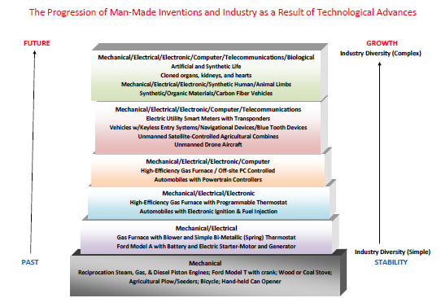

Slide 2
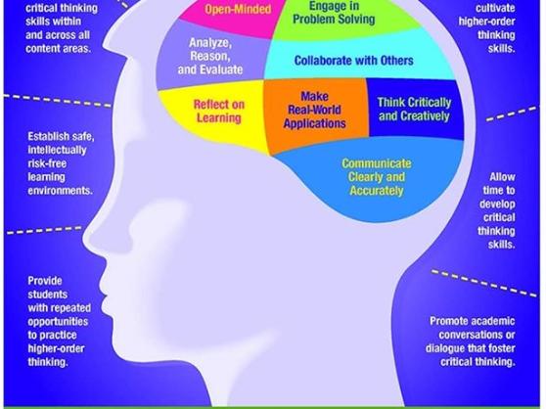
21st Century Skills

Slide 3
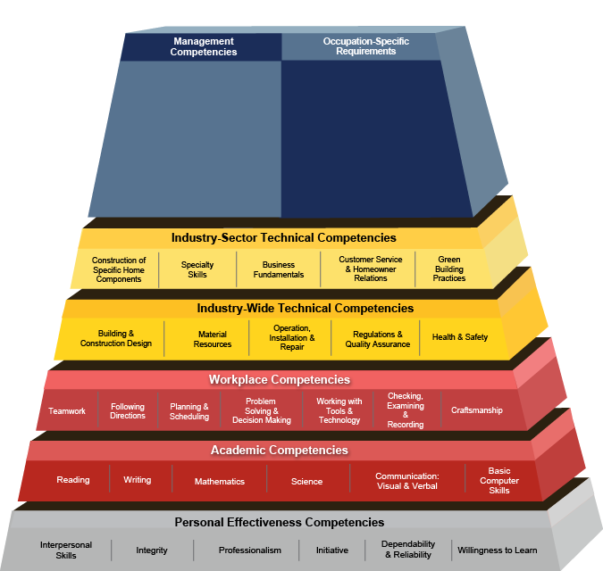
Employability Skills – USDOL Competency Models

Slide 4

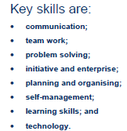
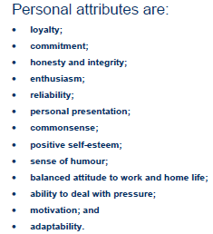

Slide 5
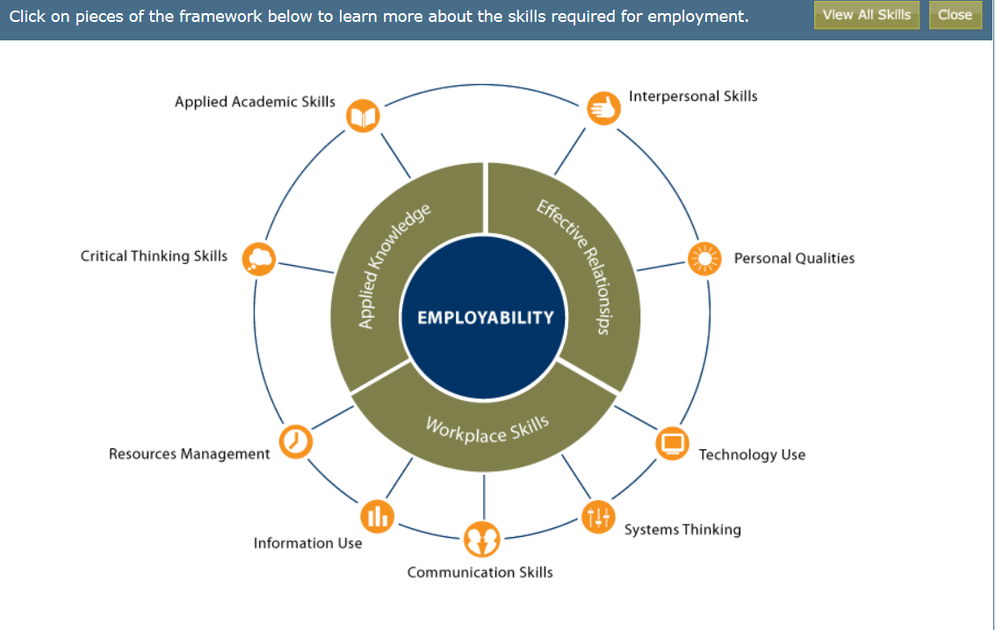
U.S. Department of Education
http://cte.ed.gov/employabilityskills/
Notes:
We jumped out with the U.S. DOE. Foundational skills. US DOL ETA Competency Models. Career Ready Practices. Workforce ready System.

Slide 6
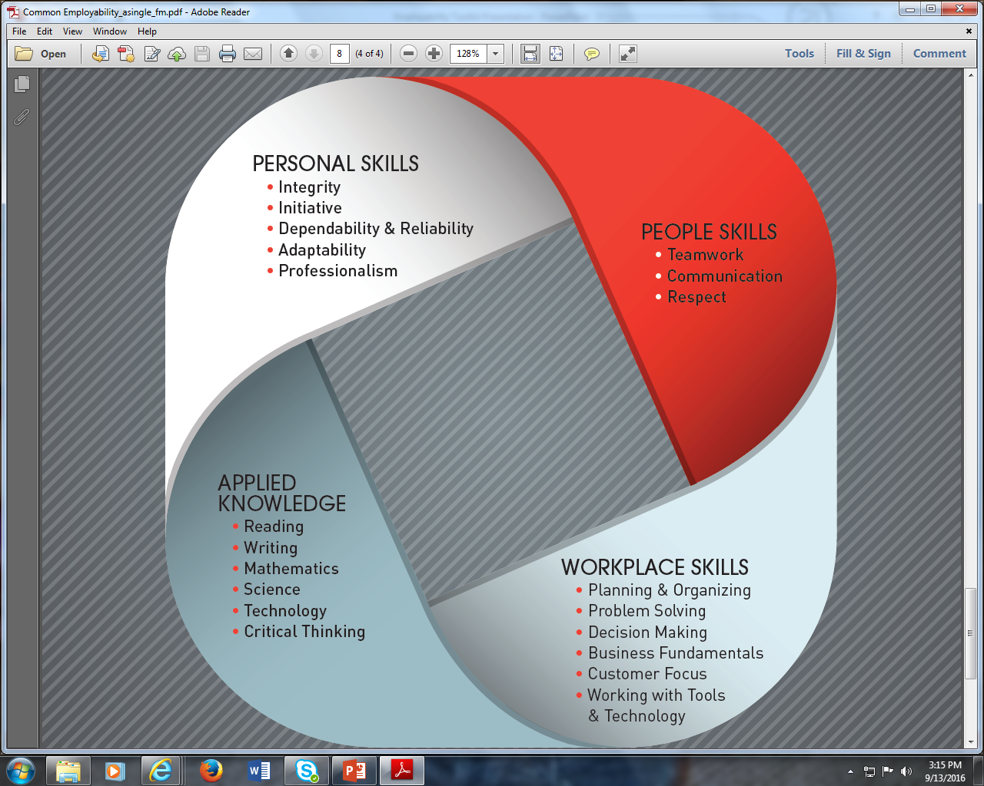
The Skills All Employees Need, No Matter Where They Work
National Network of Business and Industry Associations

Slide 7
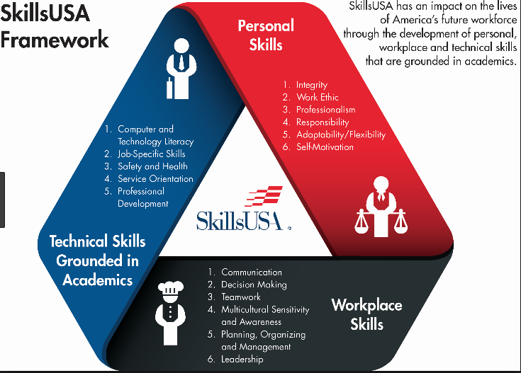

Slide 8

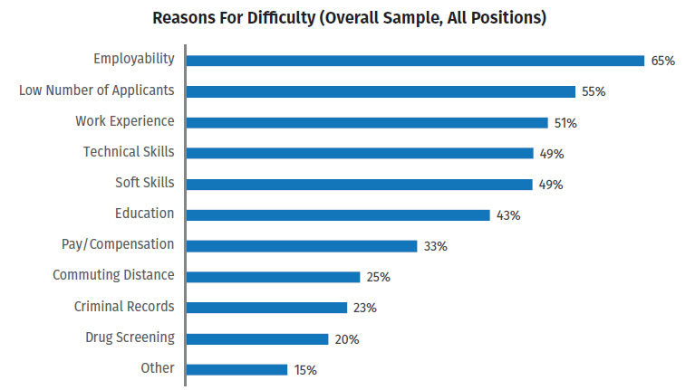


Slide 9

The Importance of Social Skills
Interacting with Others
Personal and Social Skills
Conflict Resolution & Criticism
Teamwork and Leadership

Slide 10

Review
Non-technical Skills are Critical to Success
Present Yourself in the Best Light
The Sky is the Limit!

