Slide 1

Integrating strategies to engage online learners
NCCCS CTE Faculty Institute
November 7, 2018
Dr. Mary Olvera

Slide 2
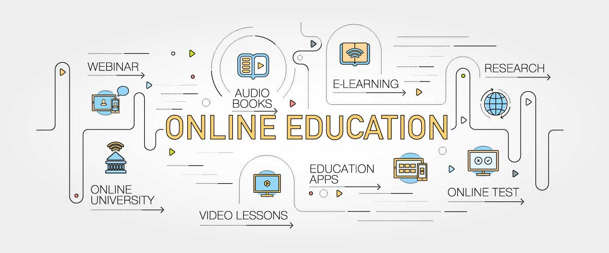
First….
Define online engagement.

Slide 3
What We Know…
Online growth has outpaced total growth since 2003 (Brewer & Brewer, 2015).
    Web-Assisted
    Hybrid
    Synchronous Online
    Asynchronous Online
  "relationship resiliency appears to be an important resilience to address at all grade levels" (Taylor & Karcher, 2009, p. 8).

Slide 4
Engaging Students
Learning is optimized when students are actively engaged in learning. Research on teaching and learning shows that most of us remember:
  10% of what we read
  20% of what we hear
  30% of what we see
  50% of what we both see and hear
  70% of what we have discussed with others
  80% of what we have experienced personally
  95% of what we teach someone else

Slide 5
Foundational Concepts for Online Learning
Online instruction is not replicating in-class instruction; it is about offering an effective learning experience.
Online courses can be produced very well or very poorly. Development of courses should be guided by the context of the course, the program, the students, the technology, and the faculty.
Thorough planning and a rich mixture of technology enable effective learning.
Social communication is important.
It is critical to address student, faculty, and administrative motivators in order to provide programs of excellence
                (Brewer & Brewer, 2015)

Slide 6
Adult Learners
Adult learners are stimulated by authentic, meaningful learning experiences that allow for the application of knowledge and skills to real life situations.
Adult learners are more engaged when they feel they have some power and control over their learning conditions.
To engage adult learners: The Three R’s
  Relationship
  Relevancy
  Responsibility

Slide 7
Adolescent Learners
ES- Emotional Spark
Intense internal sensations that serve to create meaning and vitality
SE- Social Engagement
Connections that support our journey through life with meaningful, mutually rewarding relationships
N-Novelty
Seek out and create new experiences to fully engage through emotions, thinking and body in new challenging ways
CE- Creative Expressions
Conceptual thinking, abstract reasoning and expanded consciousness creating a gateway to seeing the world through new lenses (Siegal, 2013)

Slide 8
What Do Your Students Need?
Non-lecture styles to learn effectively
Relevant, interpersonal interaction
Significant hands-on opportunities
Well executed, visual-spatial content
Learner-centered environment
                (Lane, 2005)

Slide 9
What Do Your Students Need?
Canfield Learning Styles Assessment
Conditions
  Peer, goal-setting, competition, instructor, detail, independence, authority
Content
  Numeric, qualitative, inanimate, people
Mode
  Listening, reading, iconic
Direct Experience
  Lab, field trips, practice exercises
Expectancy Score
  Predictive level of performance

Slide 10
Online Strategies
Group Assignments
Presentations w/ Voice
Video Discussions
Simulations
Peer Reviews
Create things, post pictures, discuss

Slide 11
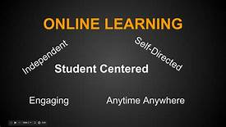
Discussion
What types of strategies to you utilize in online courses?
Share with the large group

Slide 12
References
Lane, C. (2005). Online training supported by learning models based on multiple intelligences and learning styles.
Honigsfeld, A., & Dunn, R. (2006). Learning-style characteristics of adult learners. Delta Kappa Gamma Bulletin, 72(2), 14-31
Siegel, D.J. (2013). Brainstorm: The power and purpose of the teenage brain. New York, NY. Penguin Random House Company.

Slide 13
References:
  Klein-Collins, R. (2011). Strategies for becoming adult-learning- focused institutions. Peer Review, 13(1), 4-7.
  Russell, S. S. (2006). An overview of adult-learning processes. Urologic Nursing, 26(5), 349-370.
  Taylor, E. R., & Karcher, M. (2009). Cultural and developmental variations in the resiliencies promoted by school counselors. Journal of Professional Counseling, Practice, Theory, & Research, 37(2), 66–87. Retrieved from http://ezproxy.surry.edu/login?url=https://search.proquest.com/docview/212437428?accountid=14179

Slide 14
References
  Smith, J. (2002). Learning styles: Fashion fad or lever for change? The application of learning style theory to inclusive curriculum delivery. Innovations in Education & Teaching International, 39(1), 63-70. doi:10.1080/13558000110102913.
  Smith, M. K. (2002). Malcolm Knowles, informal adult education, self-direction and anadragogy. The encyclopedia of informal education. Retrieved August 24, 2007, from http://www.infed.org/thinkers/et-knowl.htm
  Weber, E. (1992). Curriculum for success. New Horizons for Learning: On the Beam. 12(3), 339-340.
  Worley, K. (2011). Educating college students of the net generation. Adult Learning, 22(3), 31-39.

