Slide 1
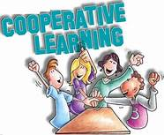
Implementing cooperative learning/teaching for Multiple intelligences
NCCCS CTE Faculty Institute
November 7, 2018
Dr. Mary Olvera

Slide 2
Activity #1
Think about your most memorable learning experience.

Slide 3
Intelligence
“Intelligence is the ability to find and solve problems and create products of value in one’s own culture” -Dr. Howard Gardner
  Intelligence is pluralistic.
  There are many ways to be intelligent.
  Multiple intelligence strategies value and invite multiple ways to explore a topic, deepen understanding of it, and build related skills.

Slide 4

Types of Intelligence: Forms of Analysis
Linguistic (poet);
Logical-mathematical (scientist);
Musical (composer);
Spatial intelligence (sculptor or airplane pilot);
Bodily kinesthetic (athlete or dancer);
Interpersonal (salesman or teacher);
Intrapersonal (self-aware).
Naturalistic (botanist or zoologist).
Existential (philosopher).

Slide 5
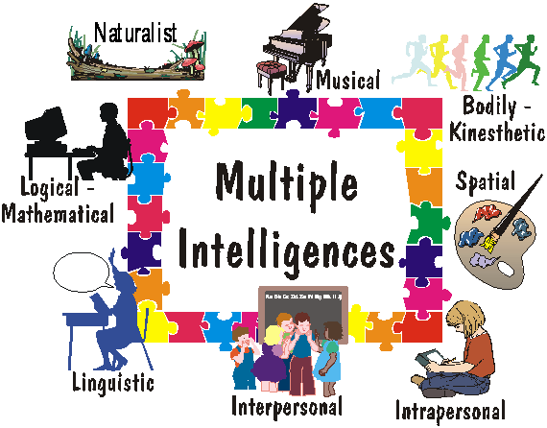

Slide 6
What Does the Research Say?
Weber (2011) stated that even though studies indicate that many college freshmen reported disinterest and boredom, institutions of higher learning “tend to neglect active student involvement” (p. 1).
Bias toward a particular learning style for instructional delivery “may disadvantage some groups of learners” and that “if the individual preferences of students are ignored, those already most at risk of withdrawal or failure are put in double jeopardy” (Smith, 2012, p. 64,66).

Slide 7
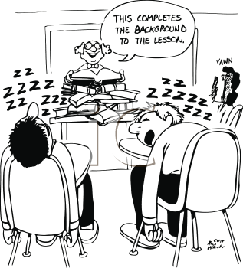
What Does the Research Say?
Lecture appears to be the most prominent form of instructional delivery in higher education, although, only about 25% of higher education students prefer the verbal learning style.
Lecture style teaching may be
efficient but not necessarily
effective
(Turner, 2009).

Slide 8

What Does the Research Say?
There are substantial differences in the learning preferences of students with high academic success and students with low academic success (Honigsfield and Dunn, 2006) .
Learning styles dictate how individuals respond to the learning environment (Evans, Cools, and Charlesworth, 2010) .

Slide 9
What Does the Research Say?
When learning styles are accommodated, the result is increased:
  Productivity
  Academic achievement
  Creativity
  Students learn better, smarter, faster, and return more information when operating in preferred learning style.
  Interesting Fact: Learning styles change with age.
    Linguistic Intelligence increases with age
    Bodily-Kinesthetic, Interpersonal decrease with age.

Slide 10
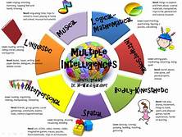
Activity #2
How do your students learn?
Think of a class that you are teaching now.
Draw a picture to represent
your perception of how
these students prefer
to learn.

Slide 11
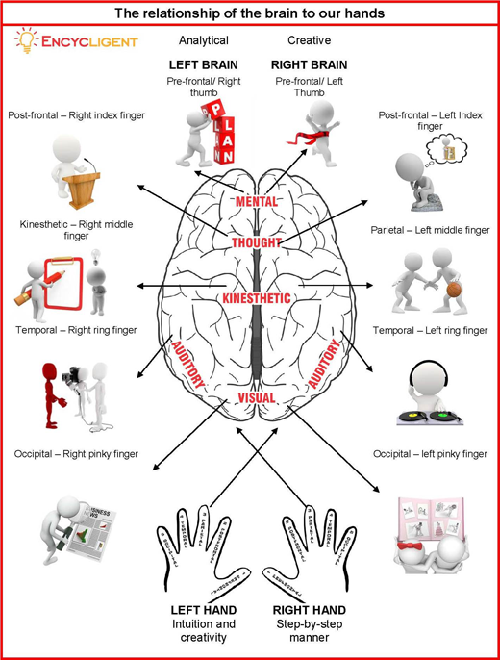
Multiple Intelligences and the Brain

Slide 12
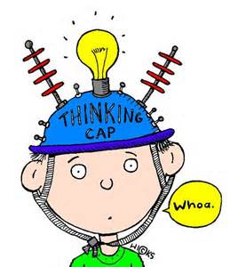
Thinking Styles
Conceptual Thinkers
  Big picture, how things work
Creative Thinkers
  Seek answers to problems, trouble shooters
Practical Thinkers
  Interested only in the facts
Reflective Thinkers
  Effective at connecting new information with prior knowledge

Slide 13

Collaborative Learning
Cooperative learning is one of the most widespread and fruitful areas of theory, research, and practice in education.
To engage adult learners:
  Relationship
  Relevancy
  Responsibility
Discussion:
Pros and Cons of Group Projects

Slide 14
Collaborative Learning Strategies
Big Group Projects
  Grading: Group, Individual, Peer
  Research Model: Names in order of greatest contribution
  Structure, Composition of the Group
  Roles
  Group Contract
Smaller or Low-Stakes Collaborative Tasks
  Mini-lectures
  Think, Pair, Share
  Mock Situations/Role Playing
  Reciprocal Teaching

Slide 15
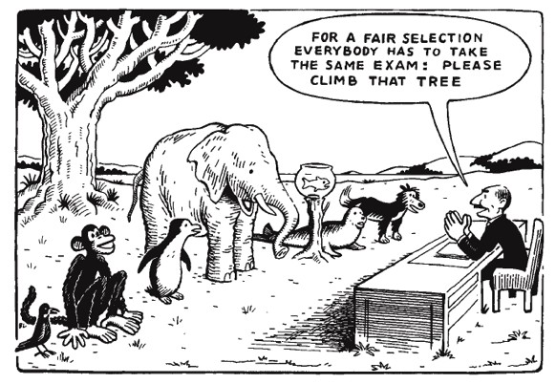
Process, Product, Assessment

Slide 16
Collaborative Learning Strategies
Group Tests
Group Writing Assignments
Assessment Choice
All collaborative assignments should be:
Intentionally planned
Identify clear goals and expectations (social & academic)
Explain structure or process for organizing structure
For big projects, periodic updates

Slide 17
Activity #4
Group Activity
Share strategies you currently use to address the diversity of preferred intelligences in your classroom.

Slide 18
Activity #5
Group Activity
Share your ideas with the whole group.

Slide 19
Conclusion
Everyone has ALL the intelligences. The intelligences are not mutually exclusive - they act in consort.
MI Theory was not developed to exclude individuals, but to allow all people to contribute to society through their own strengths.
          Walter McKenzie

Slide 20
References
Dede, C. (2005). Planning for neomillenial learning styles. Educause Quarterly.
Evans, C., Cools, E., & Charlesworth, Z. M. (2010). Learning in higher education - how cognitive and learning styles matter. Teaching In Higher Education, 15(4), 467-478. doi:10.1080/13562517.2010.493353
Gardner, H. (n.d). Intelligence in seven steps. John Hopkins University. Retrieved from http://education.jhu.edu
Hauer, J., & Quill, T. (2011). Educational needs assessment, development of learning objectives, and choosing a teaching approach. Journal of Palliative Medicine, 14(4), 503-508. doi:10.1089/jpm.2010.0232
Honigsfeld, A., & Dunn, R. (2006). Learning-style characteristics of adult learners. Delta Kappa Gamma Bulletin, 72(2), 14-31
Landrum, T. J., & McDuffie, K. A. (2010). Learning styles in the age of differentiated instruction. Exceptionality, 18(1), 6-17. doi:10.1080/09362830903462441.
Multiple Intelligence Institute. (2008). Moving from theory to Practice. MI Institute. Retrieved http://www.miiinstitute.info/uploads/download/Moving_from_Theory_to_Practice.pdf.

Slide 21
References
Postholm, M. (2008). Group work as a learning situation: a qualitative study in a university classroom. Teachers & Teaching, 14(2), 143-155. doi:10.1080/13540600801965978
Russell, S. S. (2006). An overview of adult-learning processes. Urologic Nursing, 26(5), 349-370.
Smith, J. (2002). Learning styles: Fashion fad or lever for change? The application of learning style theory to inclusive curriculum delivery. Innovations In Education & Teaching International, 39(1), 63-70. doi:10.1080/13558000110102913.
Turner, P. M. (2009). Next generation: Course redesign. Change, 41(6), 10-16.
Viens, J. (2011). Putting MI theory to work: Keystones of MI theory and MI practice. MI Institute. Retrieved from http://www.miinstitute.info/show/new_view_48.html.
Weber, E. (1992). Curriculum for success. New Horizons for Learning: On the Beam. 12(3), 339-340.

Slide 22
References
  Smith, J. (2002). Learning styles: Fashion fad or lever for change? The application of learning style theory to inclusive curriculum delivery. Innovations in Education & Teaching International, 39(1), 63-70. doi:10.1080/13558000110102913.
  Smith, M. K. (2002). Malcolm Knowles, informal adult education, self-direction and anadragogy. The encyclopedia of informal education. Retrieved August 24, 2007, from http://www.infed.org/thinkers/et-knowl.htm
  Weber, E. (1992). Curriculum for success. New Horizons for Learning: On the Beam. 12(3), 339-340.
  Worley, K. (2011). Educating college students of the net generation. Adult Learning, 22(3), 31-39.

