Slide 1




Faculty Pathways to Learning & Success
CTE Leadership Institute 2018
February 12-14, 2018
Hawthorne Conference Center
Serving 58 Community Colleges

Slide 2

Welcome back!
Today we will work together to understand
Curricular considerations for assessment
Classroom Assessment Techniques (CATs)
How to use the Jigsaw Strategy
Sharing professional learning at your college

Slide 3
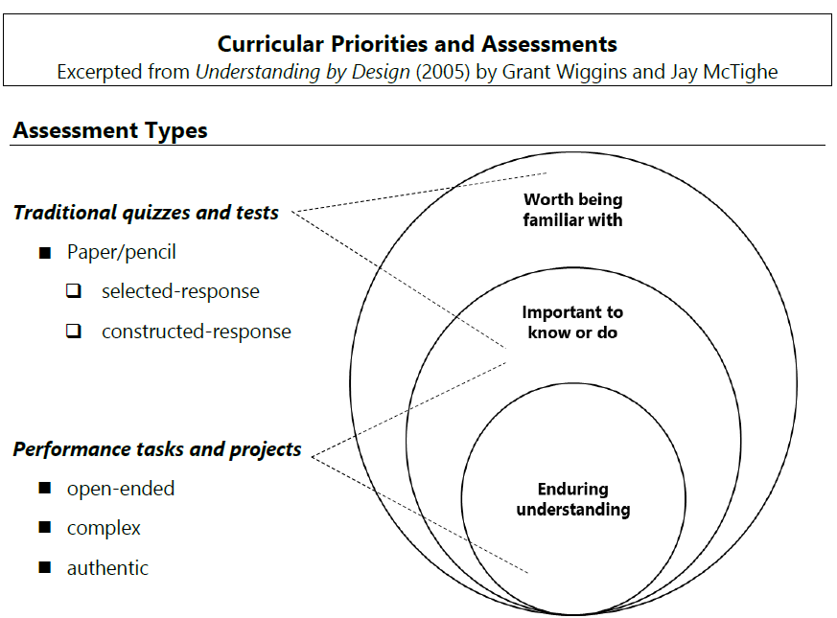
Assessment for understanding

Slide 4


15-minute break

Slide 5
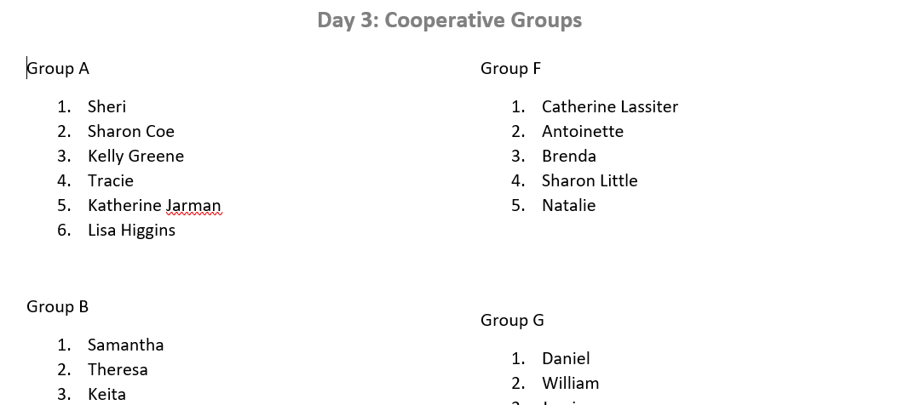
The Jigsaw Technique: New Groups Today!
Cooperative Learning
in practice
On the Cooperative Group handout, please note your group letter and your number.

Slide 6
The Jigsaw Technique
Group Meeting #1 10 minutes
Preparation Pairs 20 minutes
Group Meeting #2 45 minutes

Slide 7

Questions and discussion

Slide 8
Let’s test your knowledge!
?
?
?
?
The Six Facets of Understanding Test
[10 minutes]

Slide 9
Group Grade +
Individual Grade
?
?
?
?
Write your grade on your paper.
Compare grades with your group.
If everyone made at least 80, give yourself 5 additional points.

Slide 10
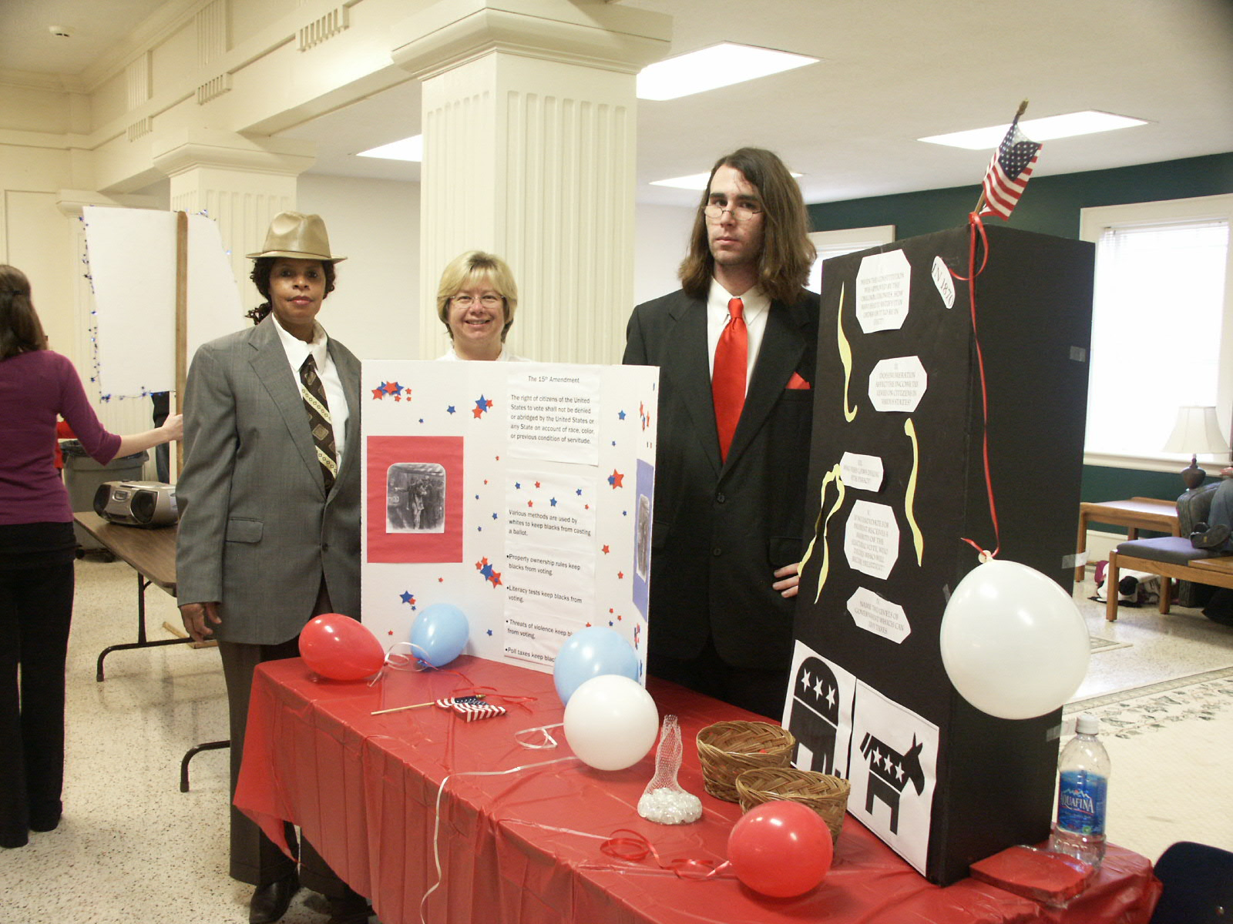
Evaluation of
Group Activity
Consider these questions with your group:
What is one thing that your group did well together?
What is one way you can improve next time?

Slide 11

Lunch & activity

Slide 12
Questions and discussion

Slide 13

Students speak:
“I love learning.
I don’t know why I hate college.”

Slide 14

Faculty speak [paraphrased]
“I love learning about my work, but I hate professional development.”

Slide 15

Students speak:
“A degree is just a piece of paper I have to get for the job I want.”

Slide 16

Faculty speak [paraphrased]
“Professional development is just something I have to do for faculty evaluation.”

Slide 17

I strive never to forget the real world consequences of my decisions on individuals, businesses and government.
Sonia Sotomayor
Supreme Court Justice

Slide 18
The SoTL Process
S
O
T
L
Generate a research question
Design the study
Collect the data
Analyze the data
Share your results

Slide 19
Generate a research question
S
O
T
L
Based on interests & questions about:
Student learning in a course
Student experiences and perceptions
Concepts that students find difficult
Effectiveness of a particular strategy
Many, many possibilities

Slide 20
NEW NC SSC Collaboration Sites
Faculty Development Commons
Instructional & Discipline Associations
Scholarship of Teaching & Learning (SoTL) Commons
Best Practices & Resources
Teaching & Learning Commons
Open Moodle Course
Guest access available now

Slide 21

Your ideas needed
Your experiences
Student learning successes and challenges
How the Center can support your work

Slide 22
Your questions welcome
?
?
?
?
NC Guided Pathways to Success Plan & learning options
Student successes & challenges
Faculty successes & challenges
How the Center can assist you

Slide 23
For a graduate student doing research about CCP students
Describe your experiences teaching CCP student
College name: Optional

Slide 24

Write and rip activity: assessment techniques
Using your sticky notes,
--with ONE item per page--
write all the formal & informal assessment techniques you use in the classes you teach.

Slide 25
Affinity diagram: assessment techniques
When directed, get in your base group and place your sticky notes on a wall by category.
Assemble the notes into affinity diagram or bar graph.

Slide 26
Shared wisdom: learning together
Think about an effective technique or strategy that helps students learn OR a student learning difficulty in a course you teach.
Using markers and paper provided, design a poster to share your idea with your cooperative discipline group at your table. (10 minutes)
When directed, share your poster session with your cooperative group.

Slide 27

Next steps for the cohort
Resource sharing.
Staying connected.
Sharing new ideas.
Planning for college-level collaboration.

Slide 28
Build pathways to learning and success
Participate in upcoming SoTL & NC GPS activities
Review SoTL & NC GPS resources
Stay in touch via the Center’s webpage
Share your insights via collaboration sites

Slide 29

Institute evaluation
Please complete the blue evaluation and leave it in the “Talk Back Box.”
Thank you for your participation today!

