Slide 1
Advising and Transfer Success:
Lessons Learned from the Transfer Advisory Committee
& the Aspen Institute
Stephanie K. Bailey, Director of Community College Partnerships
UNC System skbailey@northcarolina.edu
Wesley Beddard, Associate Vice President – Programs
NCCC System beddardw@nccommunitycolleges.edu

Slide 2
The National Picture
1.7 Million
new students enroll in a
community college each year
80%
plan to get a
bachelor’s degree or higher
Notes:
Sarah

Slide 3
Transfer Data:
What Do We Know?
The overall transfer in graduation rate of community college transfers at UNC is 61%
The graduate rate of transfer students who have earned an AA/AS is 72%
Most community college students transfer to UNC without an AA/AS degree

Slide 4
State Policy
Recommendations
Presented to UNC BOG January 25, 2018, by Dr. Robert Templin, NCSU and The Aspen Institute
Incentivizing AA/AS completion prior to transfer
Incentivizing transfer in high-demand fields
Guaranteeing admission to specific institutions
Encouraging the development of non-traditional pathways for AAS graduates, competency-based learning, and on-line degree programs
Using the metric of baccalaureate completion rather than transfer as a measure of community college student success

Slide 5
I. Transfer is Important to North Carolina
North Carolina will not reach its college completion goals without increasing NC community college transfer student enrollments.
UNC cannot achieve its access and baccalaureate completion goals for underserved students without increasing transfer student admissions.
Transfer students now compose over 30% of annual fall admissions to UNC.
For 27 NCICU’s, CC transfers are an important and growing student population.
For many community colleges, CCP is the primary area of enrollment growth. The College Transfer Pathway is the area of greatest growth in CCP.
11,955 students were enrolled in CCP CTP in Fall 2016.

Slide 6
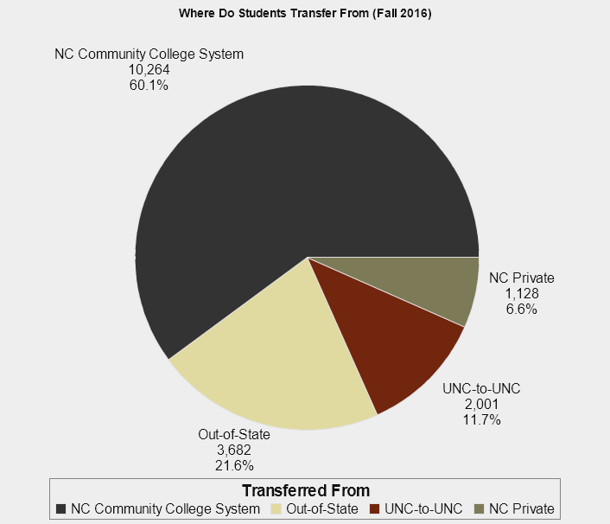
UNC System
Where Do Students Transfer From?
Notes:
Sarah

Slide 7
Transfer Data:
What Do We Know?
Community college transfers to UNC have increased by 66% in the last decade
Nearly half of community college transfers to UNC are eligible for federal Pell Grant assistance
The fastest growing segment of transfer students are those who have earned an AAS degree
2000+ students transfer from NCCCs to NCICUs annually
Notes:
Sarah

Slide 9



The Transfer Playbook
STRATEGY 1: Prioritize Transfer
STRATEGY 2: Create Clear Programmatic Pathways with Aligned High-Quality Instruction
(CAA and BDPs!!!!)
STRATEGY 3: Provide Tailored Transfer Student Advising
Copyright © 2016 Public Agenda, Community College Research Center, The Aspen Institute

Slide 10
II. Associate Degree Completion Prior to Transfer is Important
Most of the guarantees within the CAA are based on Associate Degree completion
Transfer Assured Admissions (TAAP)
Junior Status
Fulfillment of UNC institution’s lower-division general education requirements
MAR and MCR requirements*
BDPs guaranteed for four years from initial CC enrollment
AP transfer course credit

Slide 11
Transfer Student Performance

Slide 12
Degree and Credit Hour Completion Correlate to Academic Performance after Transfer
GPA Comparison
NCCCS Transfers to Native UNC Students
Less than 30 hours (2.60/2.93)
30+ hours-no degree (2.75/3.00)
AA/AS Degree (3.03/3.06)

Slide 13
III. Transfer is More than Just the CAA
Independent Comprehensive Articulation Agreement (ICAA)
Uniform Articulation Agreement – Engineering (AE)
Uniform Articulation Agreement – Visual Arts (AFA-VA)
RN-BSN
Independent RN-BSN
Many Bi-lateral Agreements
On the Horizon
Uniform Articulation Agreement – Theatre (AFA-Theatre)
Uniform Articulation Agreement – Music (AFA- Music)
Uniform Articulation Agreement – Early Childhood (AAS)

Slide 14
IV. Informed Advising
&
ACA 122 are Critical!
Advisors must know all transfer options!
(See previous slide)
ACA 122 is essential to Transfer Success
ACA 122 does not replace orientation and informed advising
ACA 122 must focus on Transfer issues (not world peace, or everything mentioned in our QEP, or everything that someone thinks all students need to know, but is not sure where to present it). WB

Slide 15
TAC Charge:
Reimagining ACA 122
Mandate early ACA 122 enrollment
Commit to ACA 122 as Transfer Preparation
Increase student knowledge of CAA (ICAA and other articulation agreements), including Transfer Credit Appeal Process and BDPs
Reduce Soft Skills instruction
Minimize waivers for ACA 122 (only in “extraordinary” circumstances)
Enhance faculty/advisor professional development
Collaborate with university partners on course content and instructional responsibilities

Slide 16
Questions?!?
Stephanie K. Bailey, Director of Community College Partnerships
UNC System skbailey@northcarolina.edu
Wesley Beddard, Associate Vice President – Programs
NCCC System beddardw@nccommunitycolleges.edu

