Slide 1

A-B Tech’s Pathway Project

Slide 2
Why Pathways: Graduation Rates
Students starting in fall 2012:
  2-year graduation rate: 11%
  3-year graduation rate: 22%
  4-year graduation rate: 28%
Source: Integrated Postsecondary Education Data System (IPEDS)

Slide 3
Why Pathways: Progression in Gateway English and Math
Fall 2015 Achieving the Dream Cohort Data (N=601):
  25% enrolled in ENG 111
  30% enrolled in ACA 122
  15% enrolled in a gateway mathematics
  Gateway courses predict completion (Jenkins & Bailey, 2017)

Slide 4

Why Pathways: Potential Causes of Low Completion
Too many choices complicates decision-making (Dhar, 1997; Luce, 1998; Tversky & Shafir,1992)
Complex decisions result in avoidant behavior such as procrastination (Keller, et al., 2011; Luce, 1998)
Students may delay advising and registration or stop out altogether
Source: https://openclipart.org/image/2400px/svg_to_png/274649/Life-Is-A-Maze.png

Slide 5
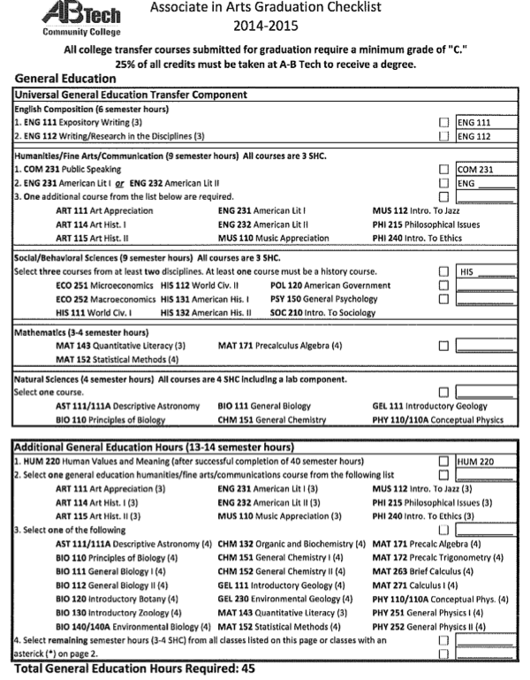
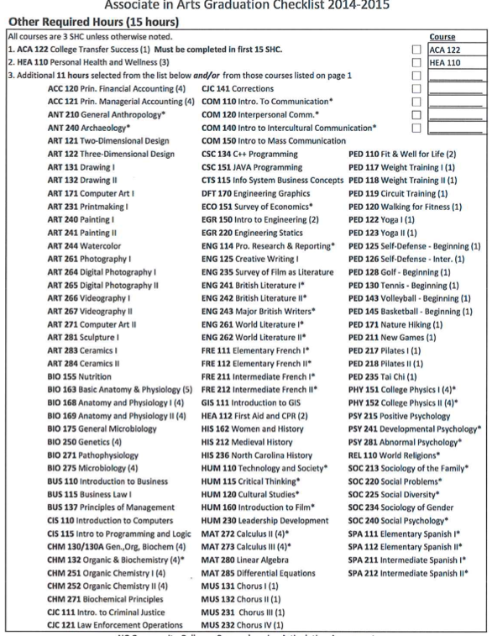

Slide 6
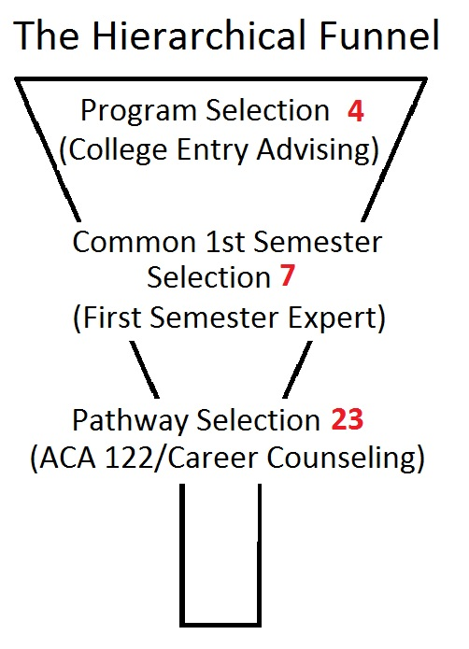
Pathways as a Potential Solution
Hierarchical choice approach (Jenkins & Cho, 2014)
Avoid starting with overwhelming number of options
Students start with broad choices early
Choices progressively narrow to a specific structured curriculum
Each choice is supported by advisors and counselors
Intentional, informed decisions

Slide 7
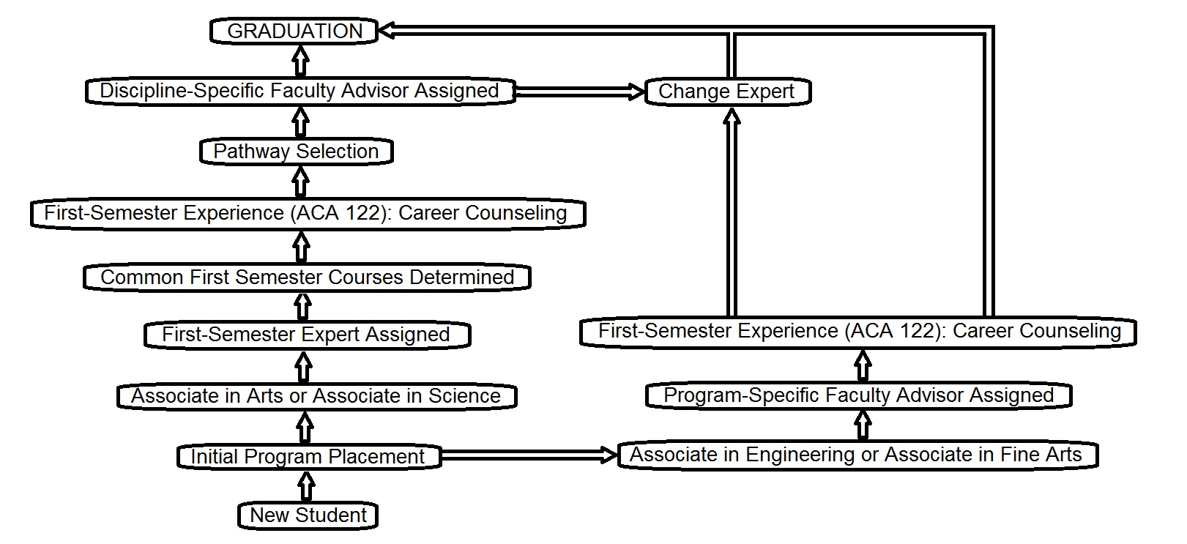

Slide 8
First Semester Expert
Meets with student to discuss goals
Determines discipline area
Determines one of the 7 entry points for student

Slide 9
Common First Semesters
Science Mathematics Business | English Philosophy Education Foreign Language | Communication Psychology Sociology | History Political Science | Creative Arts | Music | General
ACA 122 | ACA 122 | ACA 122 | ACA 122 | ACA 122 | ACA 122 | ACA 122
ENG 111 | ENG 111 | ENG 111 | ENG 111 | ENG 111 | ENG 111 | ENG 111
MAT 171 or MAT 172 or MAT 152 | MAT 143 | MAT 152 | MAT 152 | MAT 143 | MAT 143 | MAT 152
COM 231 | COM 231 | PSY 150 | HIS 111 | PSY 150 | MUS 121 | COM 231
BIO 111 or CHM 151 or ECO 251 | PSY 150 or SPA 111 or FRE 111 | COM 231 or SOC 210 | ART 114 | MUS 110 | MUS 131 | PSY 150
 |  |  |  | MUS 131 | PSY 150

Slide 10
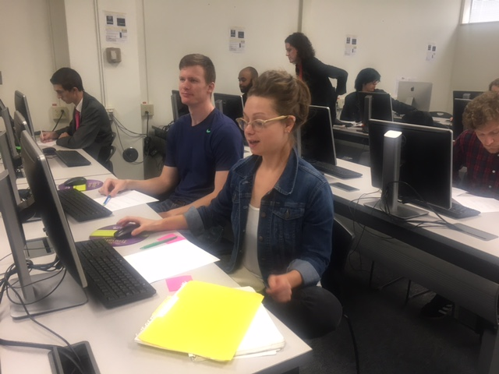
Importance of ACA 122
Career exploration
Credentials needed to enter into the career
Pathway selection

Slide 11
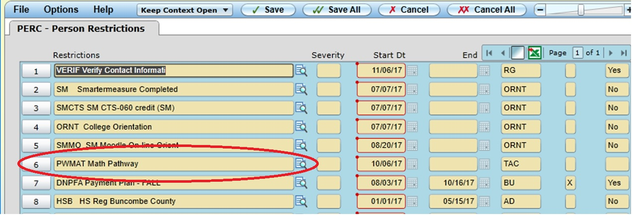
Pathway Assignment in Student Record

Slide 13
Pathways – Structured Curricula
Example: Communication Pathway
1st Semester | 2nd Semester | Summer Semester | 3rd Semester | 4th Semester
ACA 122 | ENG 112 | COM 120 | COM 150 | HIS 112
ENG 111 | SOC 210 | SPA/FRE 111 | JOU 216 | BIO 111
MAT 152 | PHI 240 |  | ENG 232 | COM 140
COM 231 | COM 110 |  | SPA/FRE 112 | HUM 220
PSY 150 | HEA 110

Slide 14
Fall 2015 Cohort Compared to Fall 2016 Cohort
Cohort | ENG 111 Enrollment | ENG 111 Success | ACA 122 Enrollment | ACA 122 Success | Gateway Math Enroll | Gateway Math Success
Fall 2015 | 40% | 25% | 40% | 30% | 28% | 17%
Fall 2016 | 56% | 38% | 74% | 54% | 57% | 28%
 | 16% ↑ | 13% ↑ | 34% ↑ | 24% ↑ | 29% ↑ | 11% ↑
*Numbers represents % of AtD Cohort for Transfer Degrees at the end of the academic year.

Slide 15
Challenges
Some students don’t intend to complete a degree
Visiting students
Student seeking pre-requisites for selective programs at other colleges
Financial Aid
Student interest in specific topics

Slide 16
Best Practices
Pathway Committee for Sustainability
Identify new pathways based on need
Partnerships with 3 Regional Universities
Identify Passionate Early Adopters

Slide 17

Questions?
Notes:
Whistle pig visual taken from https://animalsake.com/facts-about-groundhogs

