Slide 1


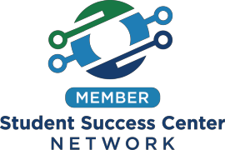

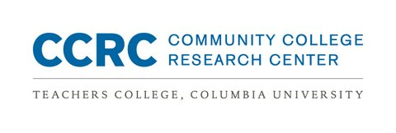
NC Guided Pathways to Success Network 2018 Cohort
NIC Facilitators Institute
May 16th, 2018
GPS Scale of Adoption Assessment
Bobbie Frye

Slide 2

Workshop #1 Goals
COMMUNITY COLLEGE RESEARCH CENTER
Review content and purpose of the assessment and the assessment process
How to introduce your colleges to complete the assessment
Develop a timeline for conducting the assessment, follow-up calls, preparing summary reports

Slide 3
COMMUNITY COLLEGE RESEARCH CENTER
COMMUNITY COLLEGE RESEARCH CENTER
Introducing the Assessment Process

Slide 4
Scale of Adoption Assessment:
A 6-step process
COMMUNITY COLLEGE RESEARCH CENTER
Introducing the assessment
Administering the assessment to colleges
Conducting follow-up calls with college teams
Synthesizing and summarizing the data from assessment and calls
Sharing the findings with colleges
Designing coaching, workshops, and TA activities to supporting scale implementation
Repeat!

Slide 5
Purpose of the Assessment
COMMUNITY COLLEGE RESEARCH CENTER
✓To help colleges reflect on where they are and develop a plan
for next steps
✓To gather information about colleges activities, practices, & challenges
✓To see what other colleges are doing, to learn from other colleges
✓To design coaching, workshops, and technical assistance
activities
✓Track colleges’ progress over time; re-assess college needs and challenges
✓What it is not: An evaluation of college practices

Slide 6
Guided Pathways Practice Areas
COMMUNITY COLLEGE RESEARCH CENTER
Mapping Pathways to Student End Goals
Helping Students Choose and Enter a Path
Keeping Students on the Path
Ensuring that Students are Learning

Slide 7
COMMUNITY COLLEGE RESEARCH CENTER
COMMUNITY COLLEGE RESEARCH CENTER
Scale of Adoption Assessment Review

Slide 8

What is the “Pathways Model?”
The Pathways Model is an integrated, institution-wide approach to student success based on intentionally designed, clear, coherent and structured educational experiences, informed by available evidence, that guide each student effectively and efficiently from her/his point of entry through to attainment of high-quality postsecondary credentials and careers with value in the labor market.
Central to the pathways model are clear, educationally coherent program maps—which include specific course sequences, progress milestones, and program learning outcomes—that are aligned to what will be expected of students upon program completion in the workforce and in education at the next level in a given field.
Students are helped from the start to explore academic and career options, choose a program of study, and develop a plan based on the program maps. These plans simplify student decision-making, and they enable colleges to provide predictable schedules, frequent feedback, and targeted support as needed to help students stay on track and complete their programs more efficiently. They also facilitate efforts by faculty to ensure that students are building the skills across their programs that they will need to succeed in employment and further education.

Slide 9
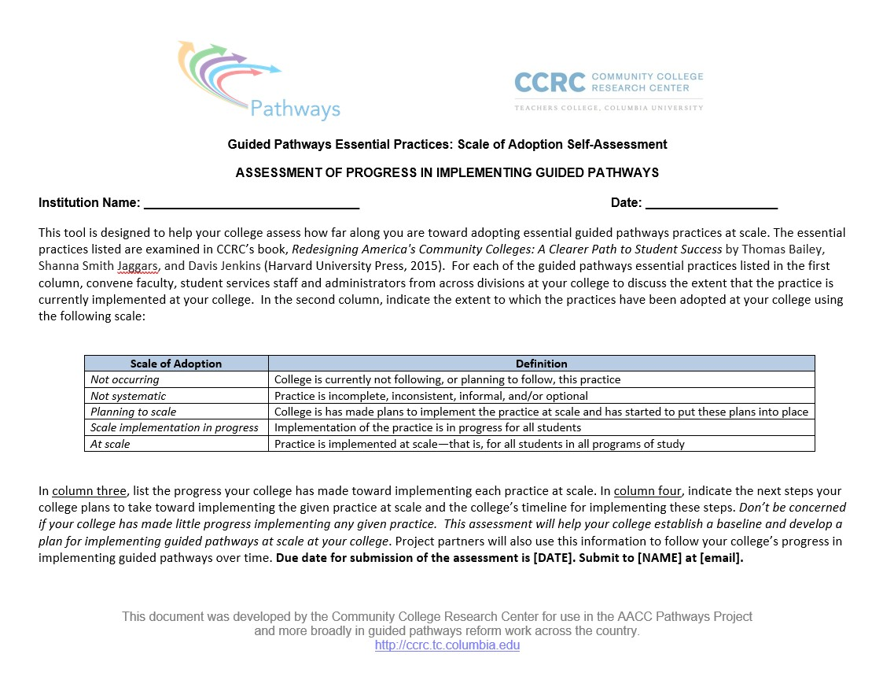
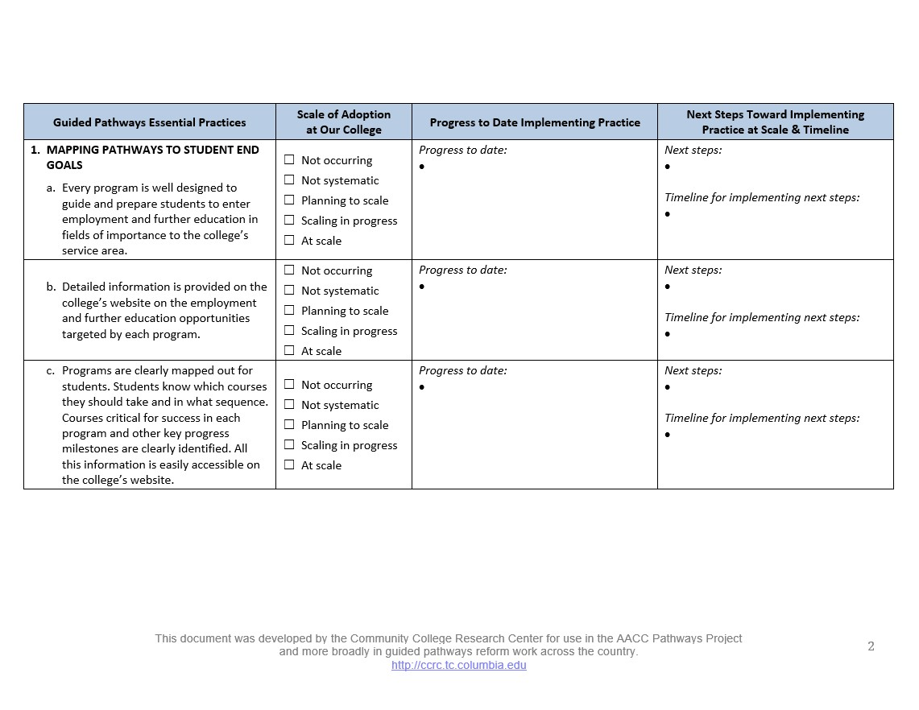
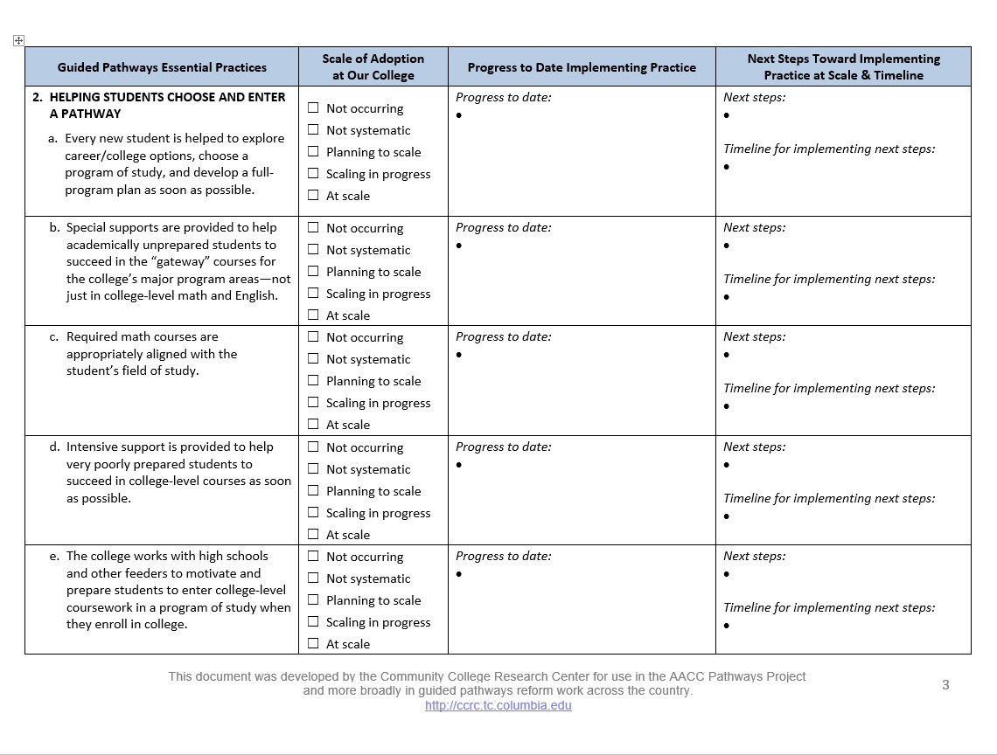
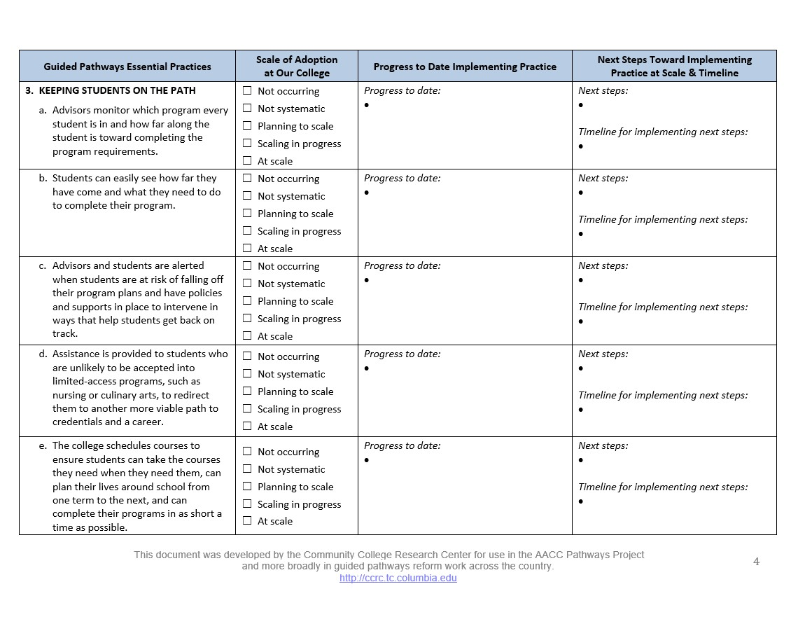
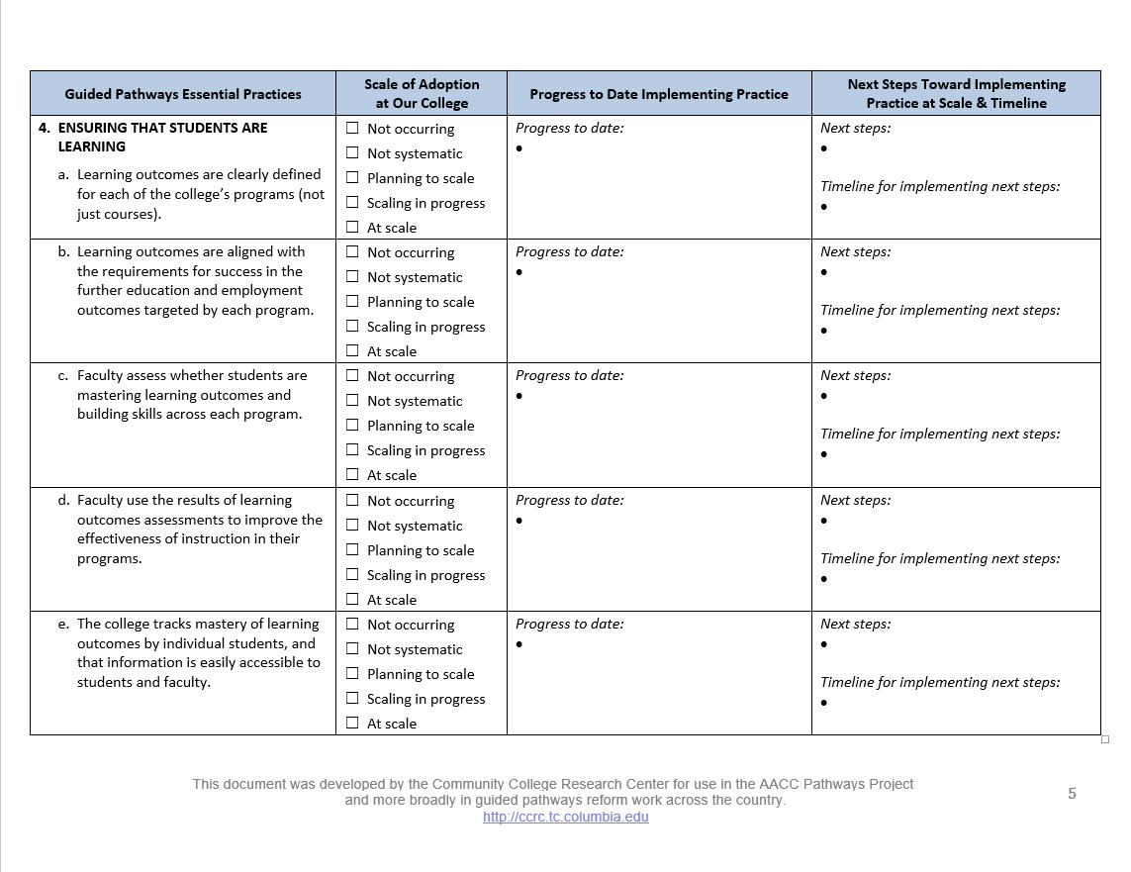
Guided Pathways Scale of Adoption
COMMUNITY COLLEGE RESEARCH CENTER

Slide 10
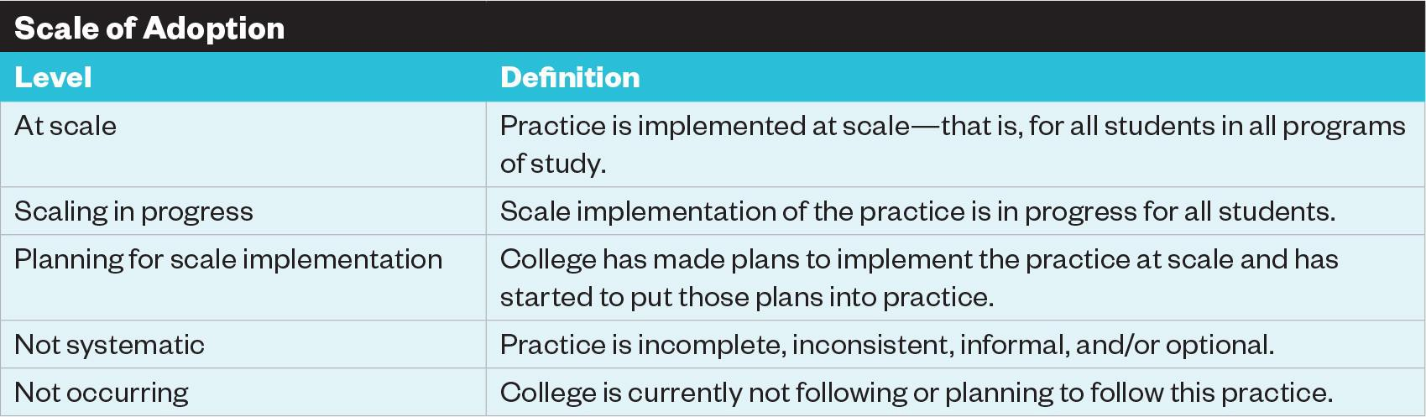
Assessing Scale
COMMUNITY COLLEGE RESEARCH CENTER
Q&A: Scale of Adoption Assessment
What questions do you have about the assessment?
What practices need clarification?

Slide 11
COMMUNITY COLLEGE RESEARCH CENTER
Sharing Assessment Results
“Megatemplate”
  Shows where every college is on each essential practice
  Can be updated each time the assessment is used
Summary memo
  Summarizes common areas of progress and challenges within the 4 areas
  Include recommendations for next steps
Graphs showing distribution of colleges across the practices

Slide 12
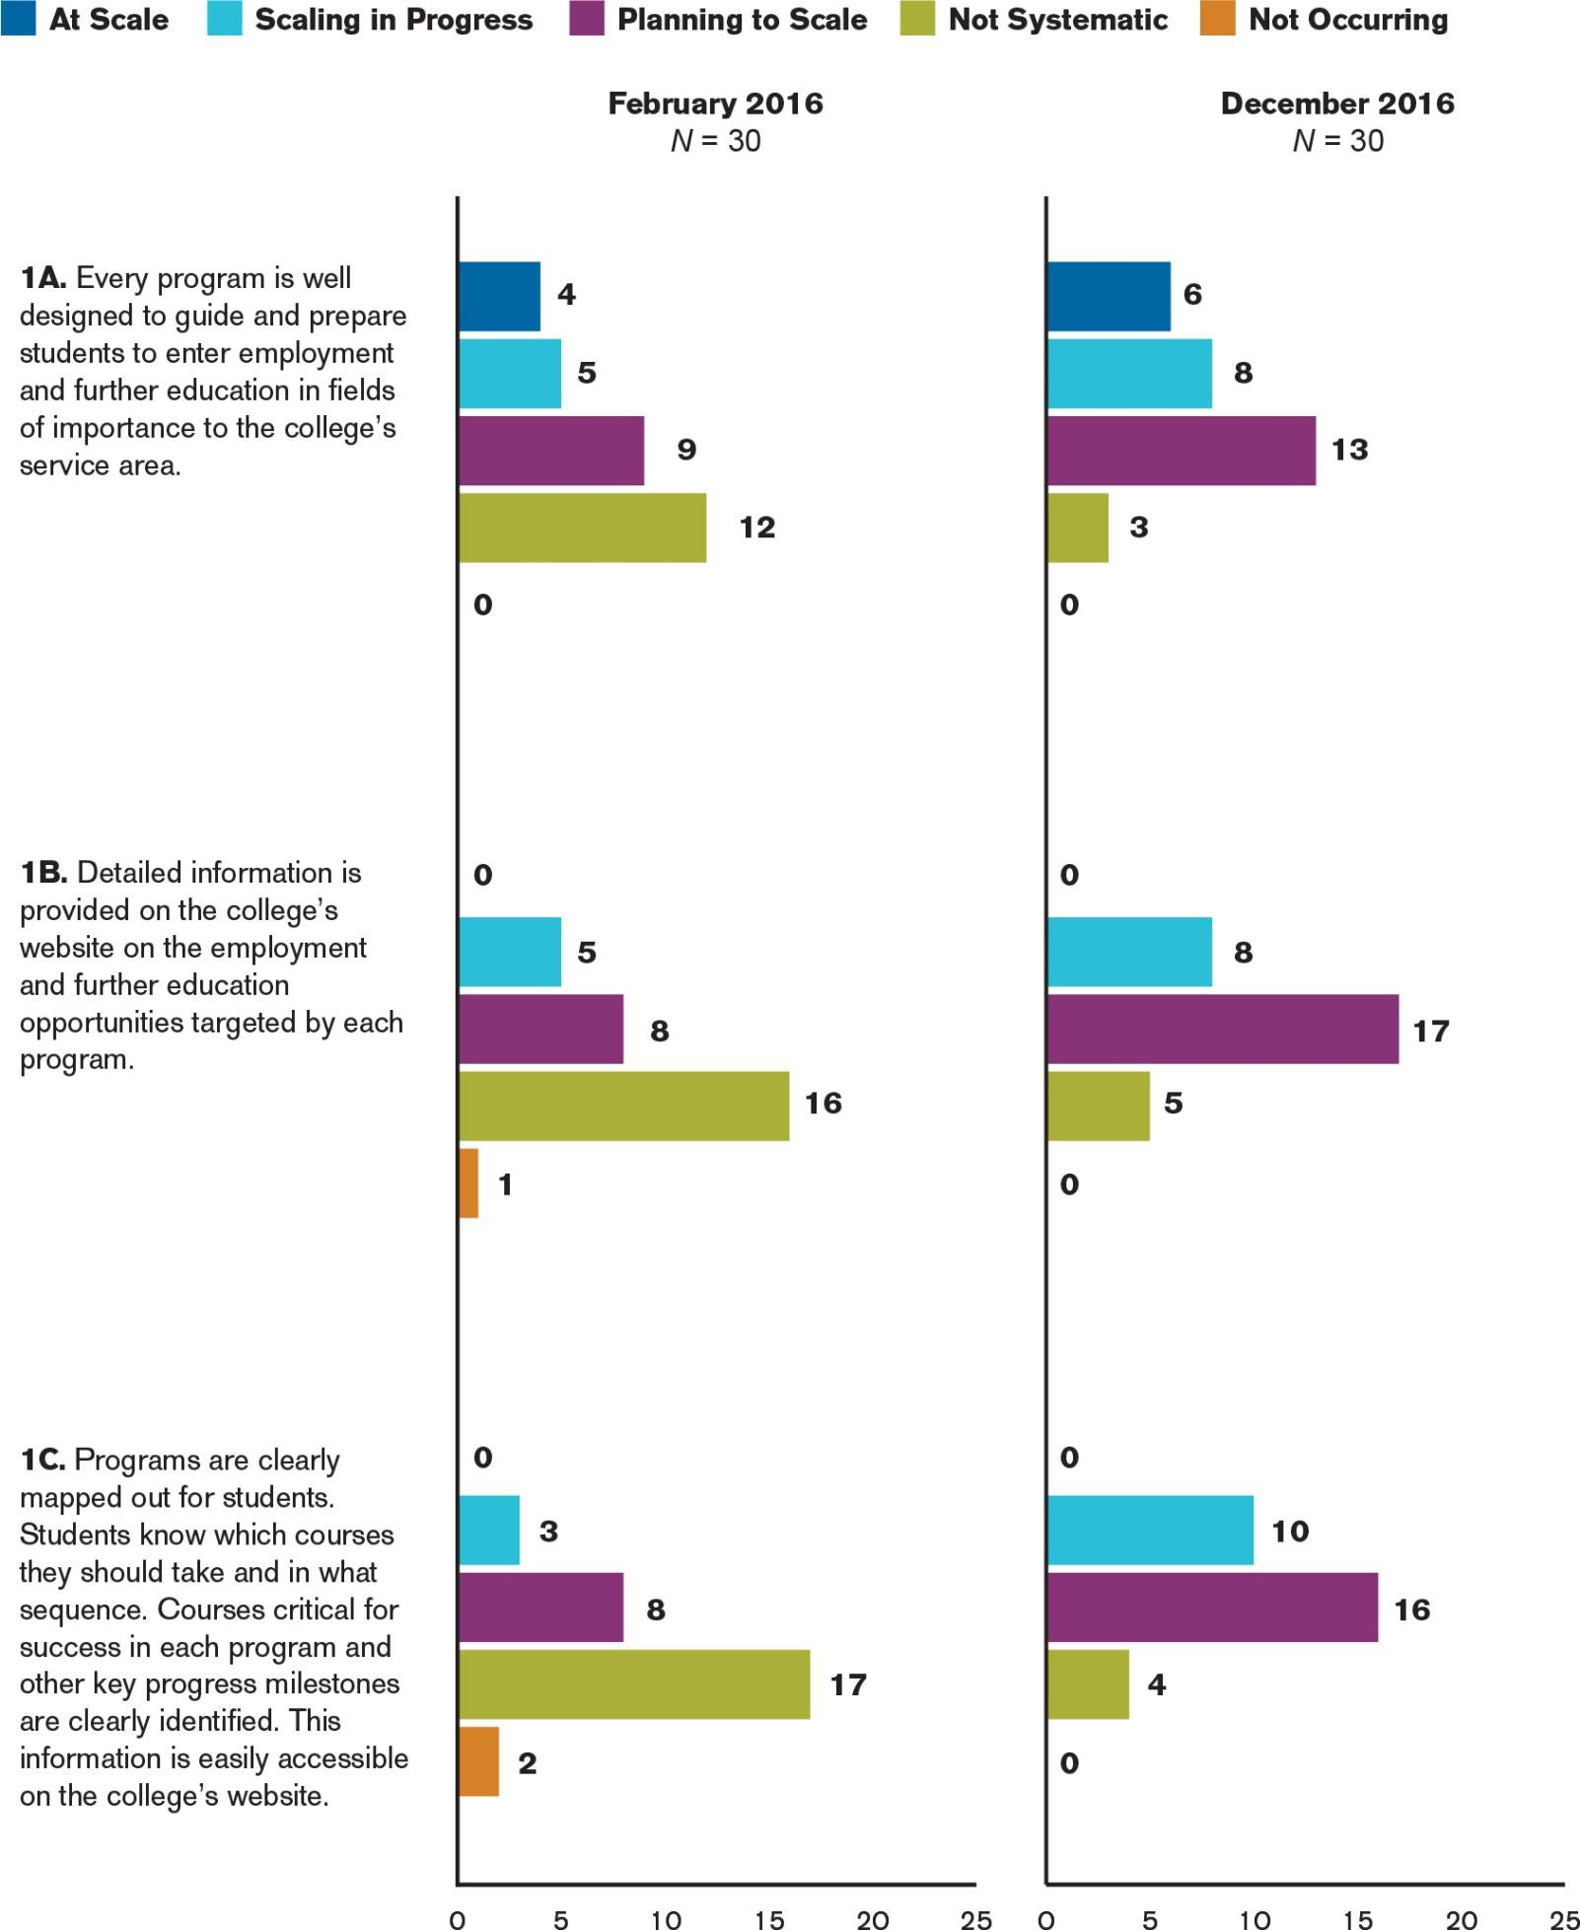
COMMUNITY COLLEGE RESEARCH CENTER
Mapping pathways to Student End Goals
Sources: Jenkins, Lahr, & Fink, 2017

Slide 13
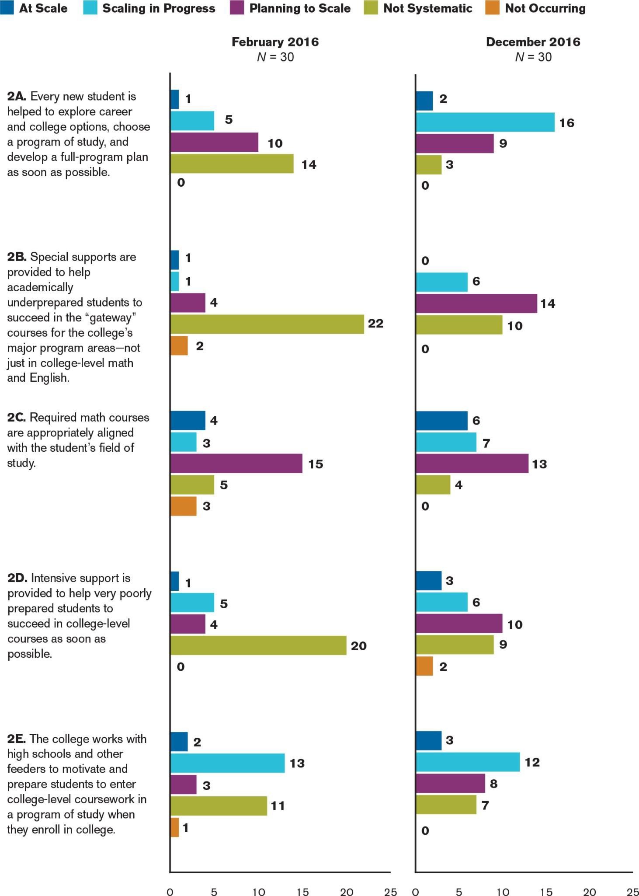
COMMUNITY COLLEGE RESEARCH CENTER
Helping Students Choose and Enter a Path
Sources: Jenkins, Lahr, & Fink, 2017

Slide 14
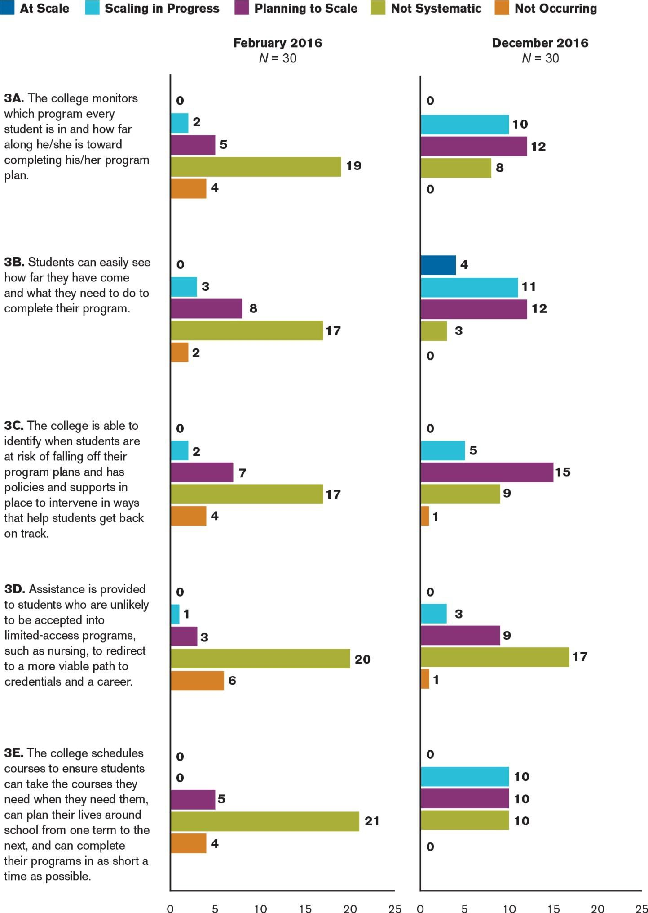
COMMUNITY COLLEGE RESEARCH CENTER
Keeping Students on the Path…
to Finish Strong
Sources: Jenkins, Lahr, & Fink, 2017

Slide 15
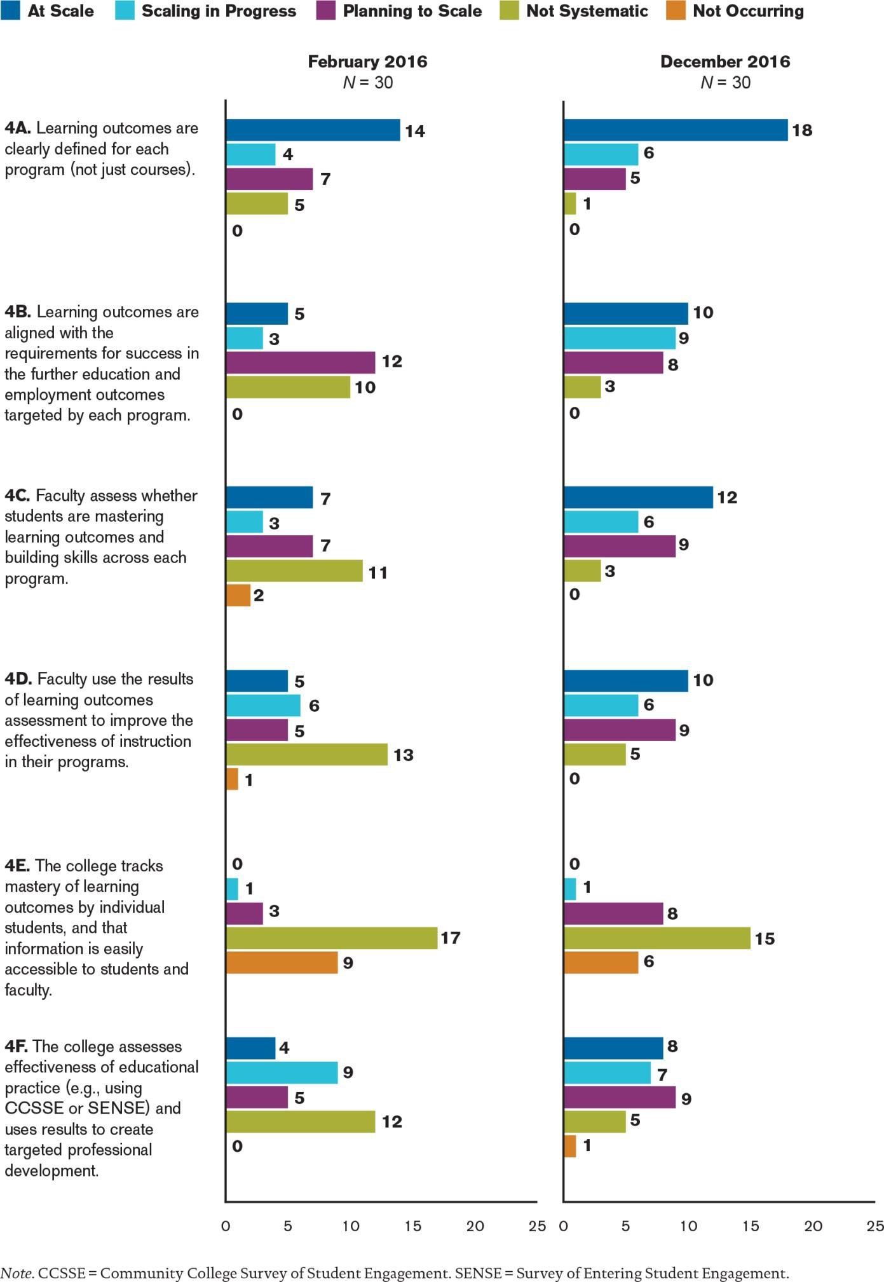
COMMUNITY COLLEGE RESEARCH CENTER
Ensuring that students are Learning
Sources: Jenkins, Lahr, & Fink, 2017

Slide 16
Scale of Adoption Assessment Timeline
COMMUNITY COLLEGE RESEARCH CENTER
Assessment Stage | *Estimated time
1) Introducing the assessment to colleges | 2-3 weeks
2) Administering the assessment | 4 weeks
3) Scheduling and conducting the follow-up calls | 4-6 weeks
4) Synthesizing data, writing summary report | 3-4 weeks
5) Sharing findings with colleges
Planning Stage
6) Designing coaching, workshops, and TA activities Ongoing to support scale implementation
*Every state will have a different timeline. Based on our research, we’ve found that it takes 3-4 months for the full process. This doesn’t include planning time before launching the assessment.

Slide 17
Your State Timeline
COMMUNITY COLLEGE RESEARCH CENTER
Assessment Stage
Introducing the assessment to colleges
Administering the assessment
Scheduling and conducting follow-up calls Synthesizing data, writing summary report Sharing findings with colleges
Timeline

Slide 18
COMMUNITY COLLEGE RESEARCH CENTER
COMMUNITY COLLEGE RESEARCH CENTER
Developing a Timeline

Slide 19
Introducing the Assessment to Colleges
COMMUNITY COLLEGE RESEARCH CENTER
Review the full assessment process
  Colleges will complete the assessment by [DATE]
  NIC Facilitators will conduct follow-up calls with each college leadership team (~75 minutes) by [DATE]
  CFAR staff will synthesize information and produce a “megatemplate” and summary report
  CFAR/NC-SSC will share findings with colleges [~DATE]
  NC-SSC will begin planning workshops, coaching, and Technical Assistance activities

Slide 20
Introducing the Assessment to Colleges
COMMUNITY COLLEGE RESEARCH CENTER
Background and Overview
  Background of assessment
  Purpose of the assessment (“Why are we doing
this?”)
  Review the four pathways practice areas
    Mapping pathways
    Helping students choose and enter the path
    Keeping students on the path
    Ensuring that students are learning
  Review/define the scale

Slide 21
Introducing the Assessment to Colleges
COMMUNITY COLLEGE RESEARCH CENTER
Instructions: Who should fill out the assessment and how?
  College leadership team: Provost/VPAA, VP Student Services,
Deans (CTE and transfer), Director of Advising, Registrar, (program chairs and dev ed), IT, IR, and [???]
What’s the process for completing the assessment?
  Survey college members; leadership team reviews practices/template
  Team meeting to work through each practice
– What information to include in the template?
Faculty
Progress to date (Column 3): What is the college currently doing related to the essential practice?
Next steps and timeline (Column 4): What are the college’s plans
related to the essential practice and in what timeframe?

Slide 22
_{CeRe} COMMUN ITY COLL EGE
RESEARC H CENTER
T ACIIll\ ("Q l lbGL , COLUMI'!IA U 'IVI R ITY
Guided Pathways, Implementation Stages and Ti·m,eline
Stage
Actions
Timeline
Laying the groundwork
Develop st rategic plan with dear₁ measurable goa ls for improving stude nt comp letion t ransf.er₁ w.orkforce₁ learning and equity
outcomes
Build capacity to collect,analy.ze₁ report,and use data to improve student outcomes
Make the case for change highlighting rates of student attrition, excess credits, inefficient transf.er₁ etc .
Broadlyengag·e facul'ty and staff in scrutinizing current practice, focusing on how it affects students' ability to enter a nd comp lete
programs affordahly and advance to further education and employment
Implement at least one majo r innovation in practice at sca le {t hat is₁ for all degree-seek ing students)
3+ years
IMapp,ing program pathways
Map course sequences for all programs 1denttfying gateway courses and co-curricular milestones
Organize programs into career-focus·ed umeta-majors" and conne·ct to job and transfe r opportunities
1-2 years
Intake a nd advising redesign
Cont inue to communicate the vision and ·engage participat ion broadly
Ref ne course seq uences for all programs including gateway courses and co-c urricular milestones
Plan redesign and pilot inta ke system as /ton-ramp" using¹'meta-majors'¹ as a framework to facilitate
career/college ex ploration and planning
Plan and pilot integrated a nd contextualized academic sup,port for program gateway cours·es
Plan reorg of advising to support timely program complet ion
Plan upgrade of information systems to support student progress monitoring and e-advising
Train faculty and advisors for initial scale impleme ntation
1-2 years
Initial scale
implementation
Continue t·o communicate the visio n and engage participation broadly
Begin scale implementation for a ll first-t ime students of:
l-2 years
- Program maps and meta-majors (clearly accessible with job/transfer information on website)
-
-
-
Reorganized college intake focused on career/college exploration and program planning
lntegrated/context ualized academic sup,port for criticalcollege-levelcourses
Redesigned program advising system, including e-advising
Plan extension of program pathways into high schools {sta rting w ith dualcredit) and adult ed programs
•
Provide training and professionaldevelopment to support implementation
₋• Formative ly evaluate initial implementation
Continue to communicate the vision and engage participation broadly
Refine and expand scale implementation for all students
•
•
•
•
•
r---
-
lmproved scale
implementation
1-2 years
Extend program pathways into high schools (starting with dual credit) and adult ed programs
Continue training and professional developme nt to support implementation
Organize program review,improvement, and professiona ldevelopment within and across meta-majors
1---- --
1
Continue formative evaluation of pathways implementation,including program-level assessment of learning
On-going
improvement
Institutionalize program review, improvement and professionaldevelopment within and across meta-majors
On-going
NOTE: Phases where we expect to see substantial improvements in student momentum .and progression
indicated in gn en-dark,er sl'l.ades indicate higher impacts expected! in later phases.
WORKING DRAFT 04/21/17

Slide 23
Workshop #2: After Break
COMMUNITY COLLEGE RESEARCH CENTER
Introducing the assessment
Administering the assessment to colleges
Conducting follow-up calls with college teams
Synthesizing and summarizing the data from assessment and calls
Sharing the findings with colleges
Designing coaching, workshops, and TA activities for supporting scale implementation
Monitoring progress among the colleges using CCRC’s early momentum metrics/KPIs

Slide 24
For more information
COMMUNITY COLLEGE RESEARCH CENTER
COMMUNITY COLLEGE RESEARCH CENTER PRESENTATION TITLE IN HEADER / JUNE 8, 2012
24
Please visit us on the web at
http://ccrc.tc.columbia.edu
where you can download presentations, reports, and briefs, and sign-up for news announcements. We’re also on Facebook and Twitter.
Community College Research Center Teachers College, Columbia University
525 West 120th Street, Box 174, New York, NY 10027 E-mail: ccrc@columbia.edu Telephone: 212.678.3091
Hana Lahr
Davis Jenkins
John Fink
Soumya Mishr

