Slide 1
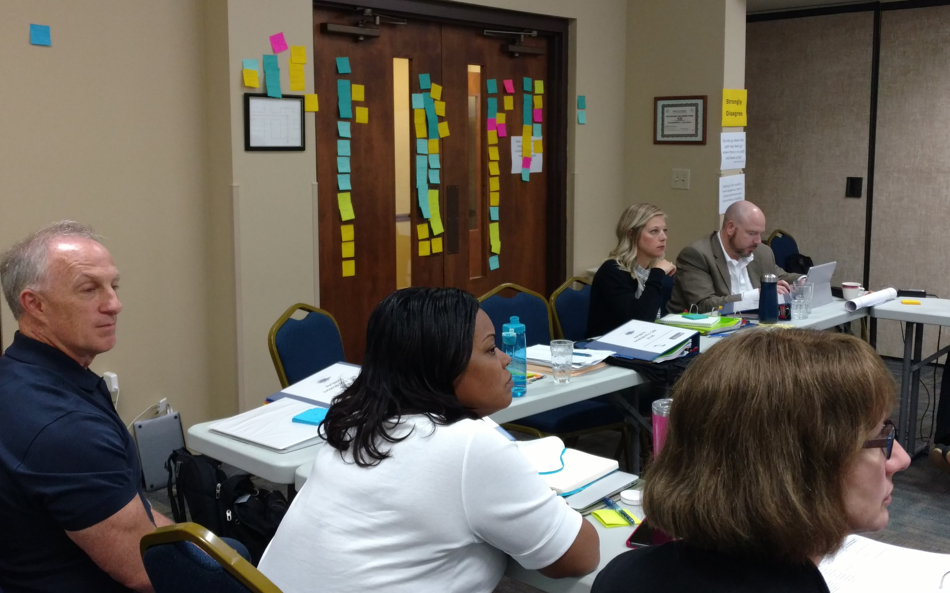



NIC Facilitators
Monthly Updates
Webinar
June 13, 2018
Serving 58 Community Colleges

Slide 2
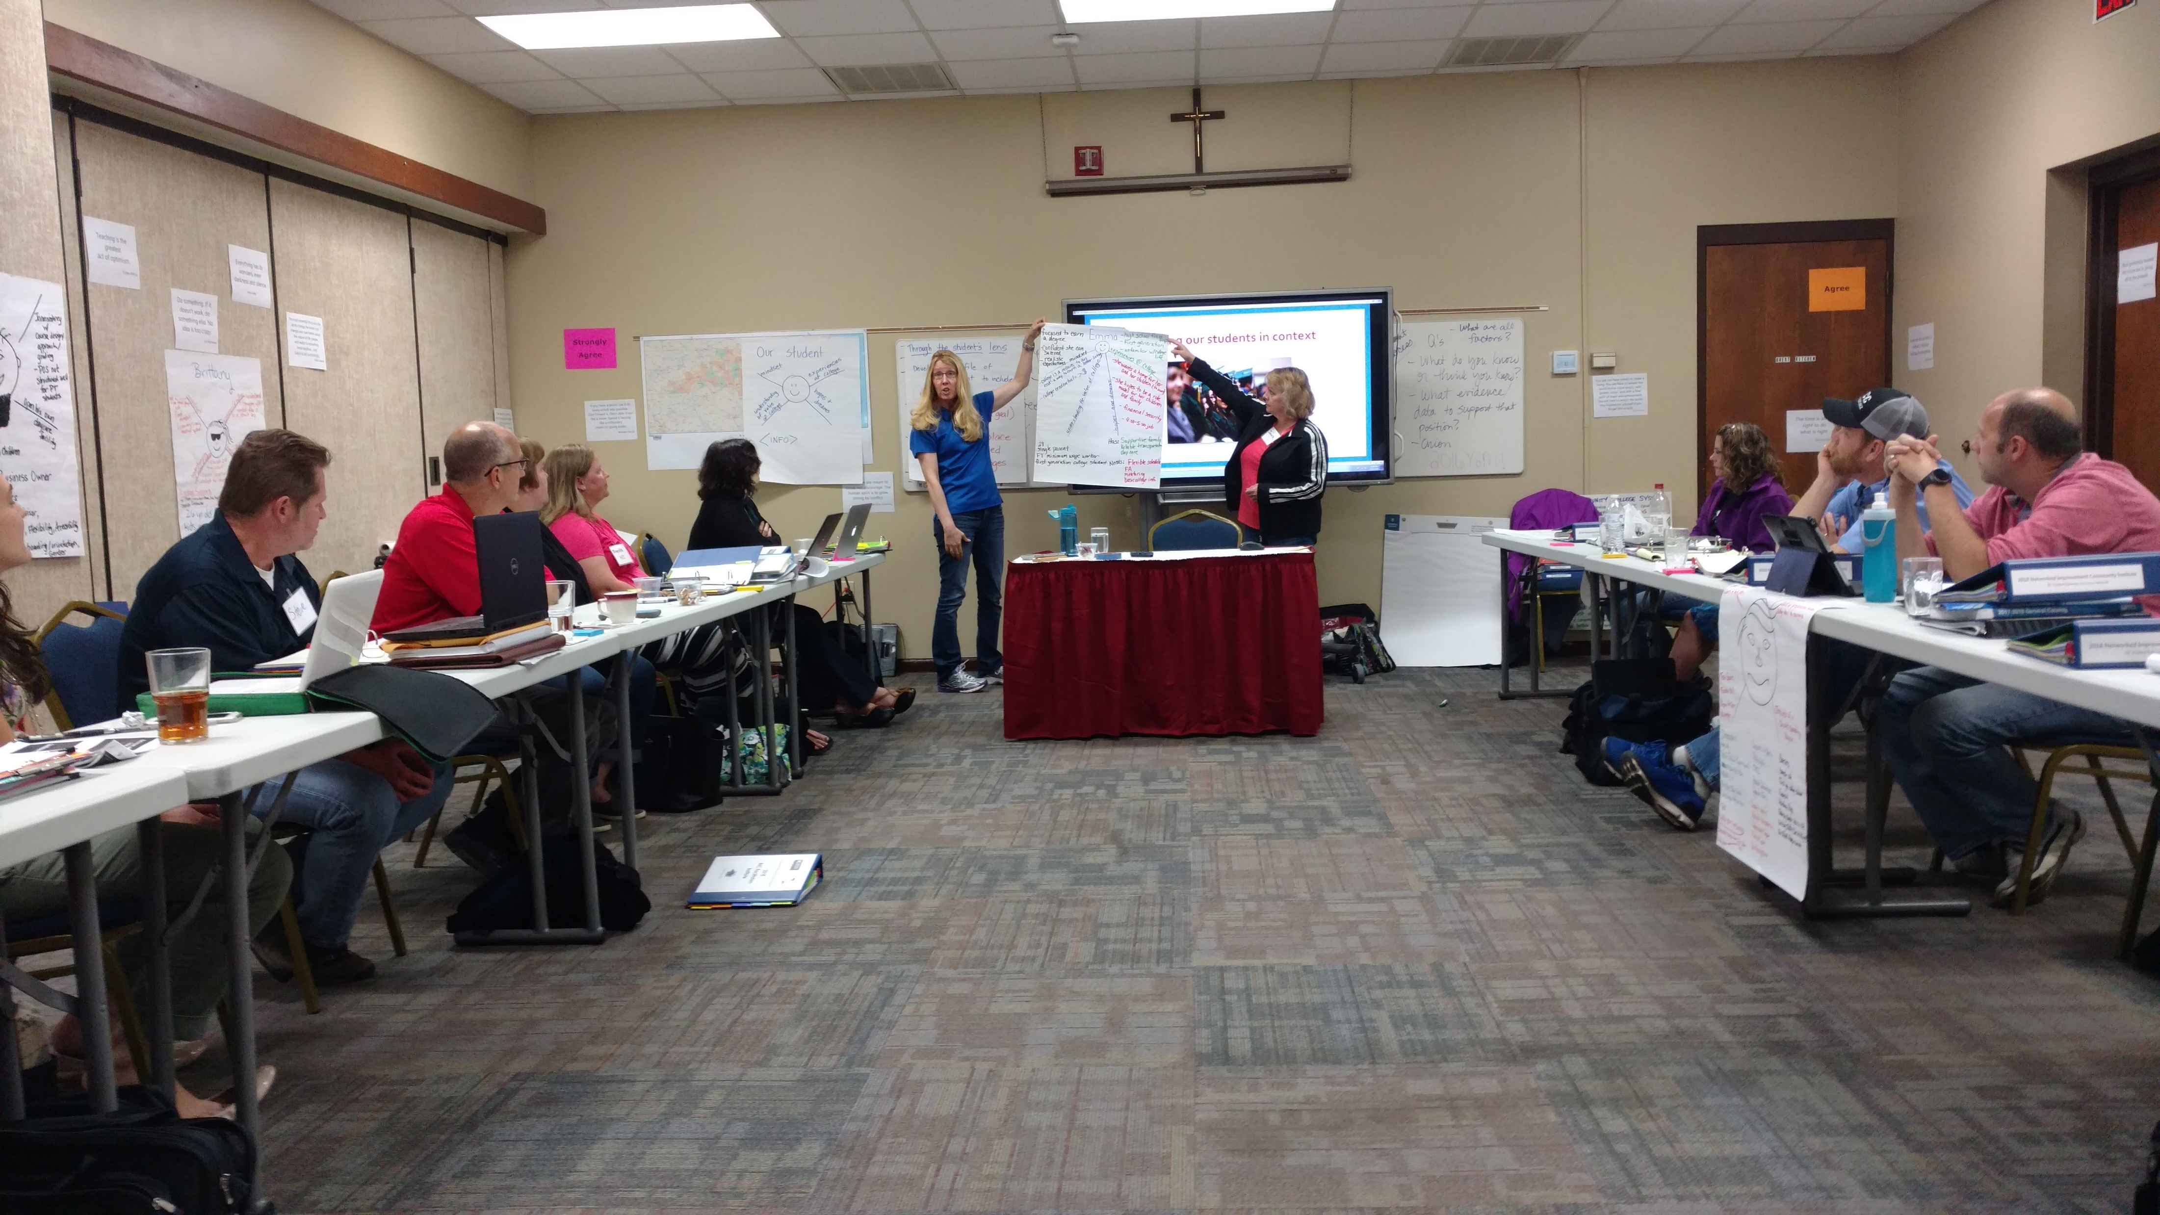

Slide 3
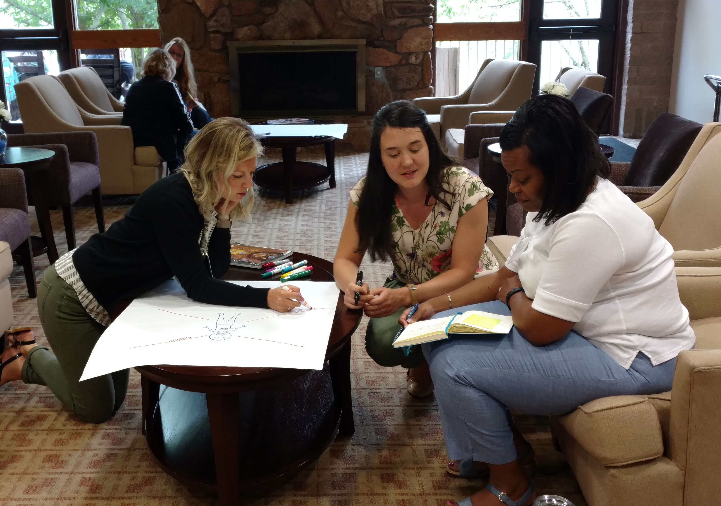
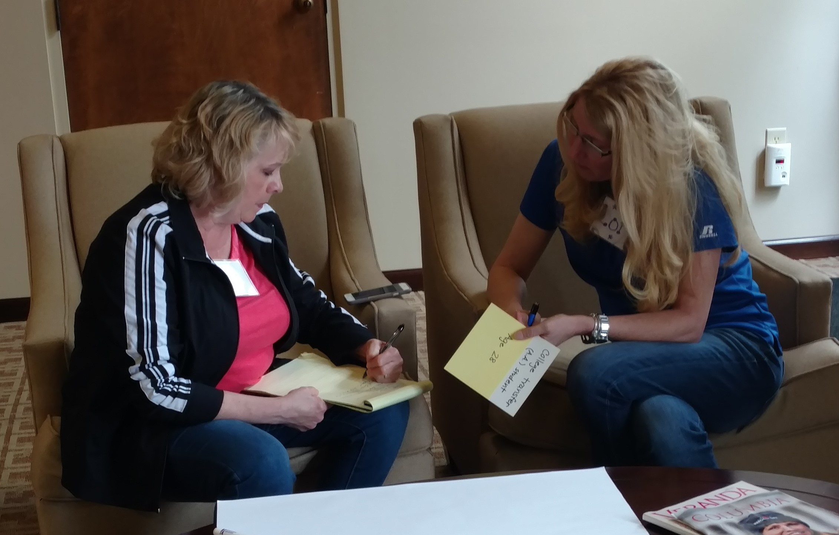
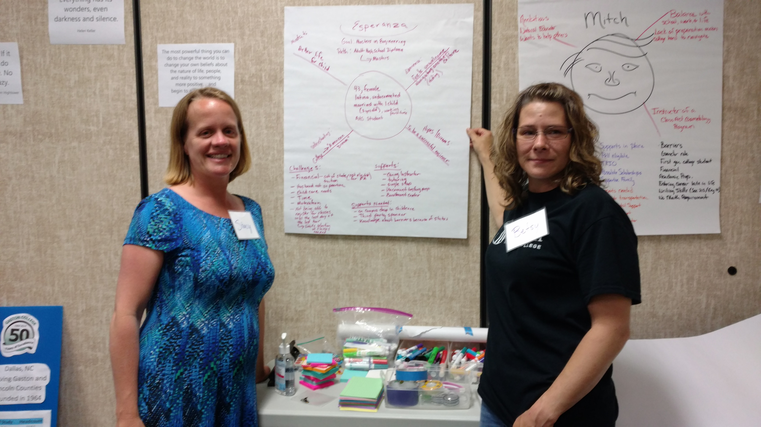
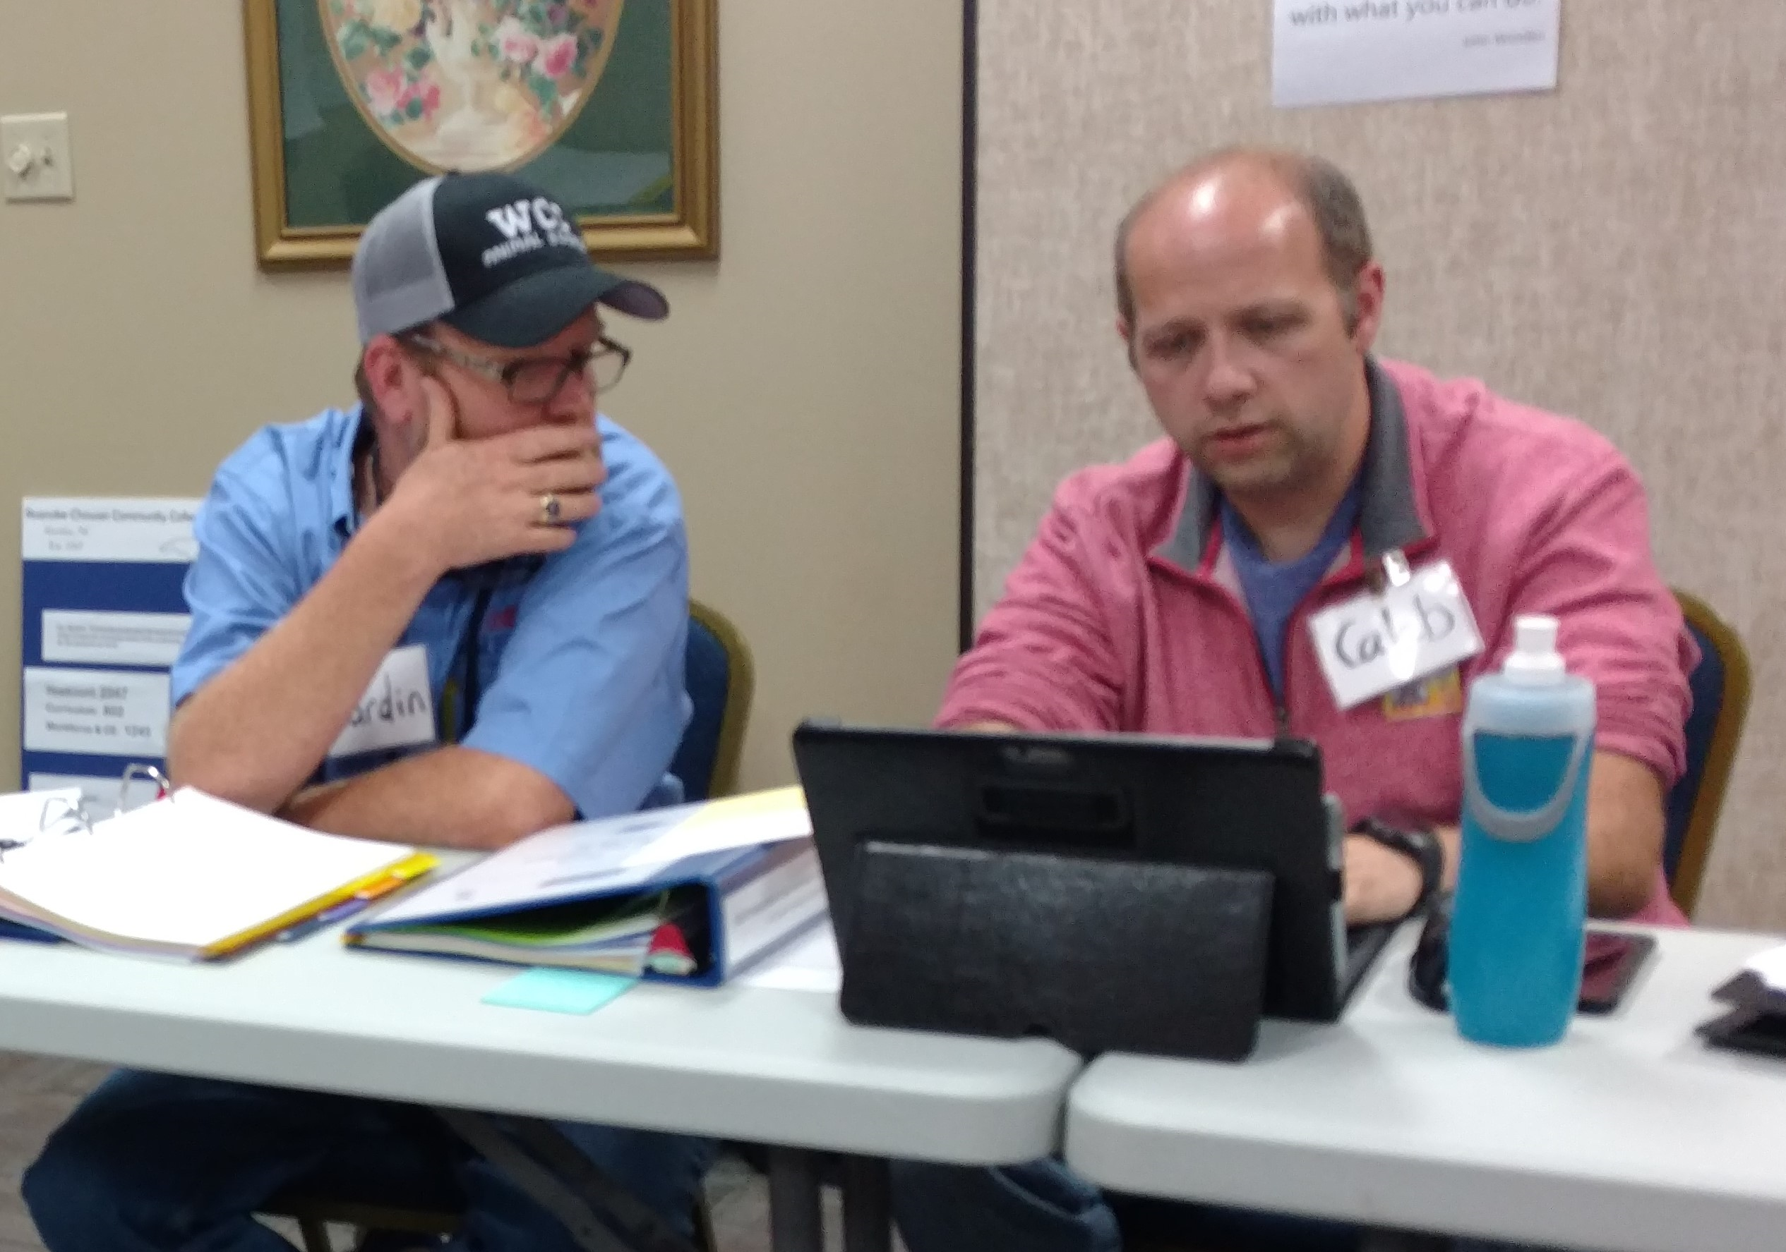

Slide 4
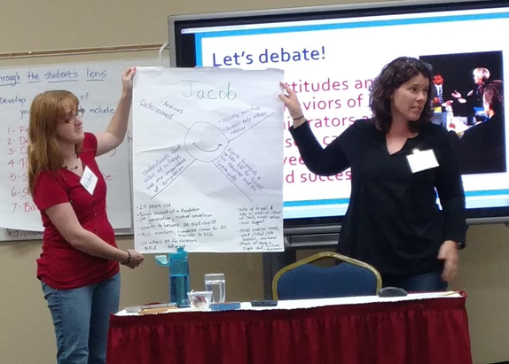
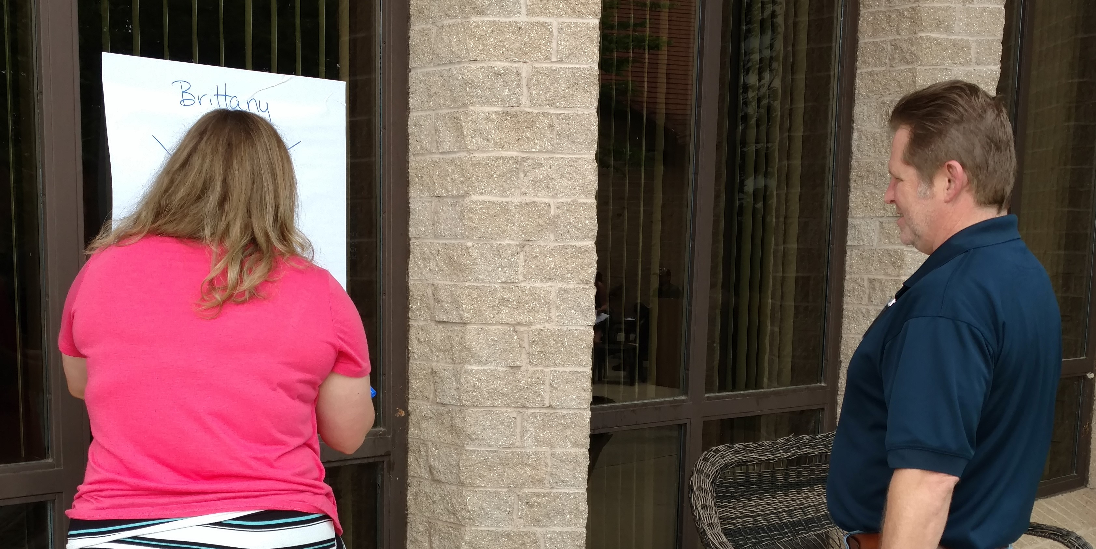
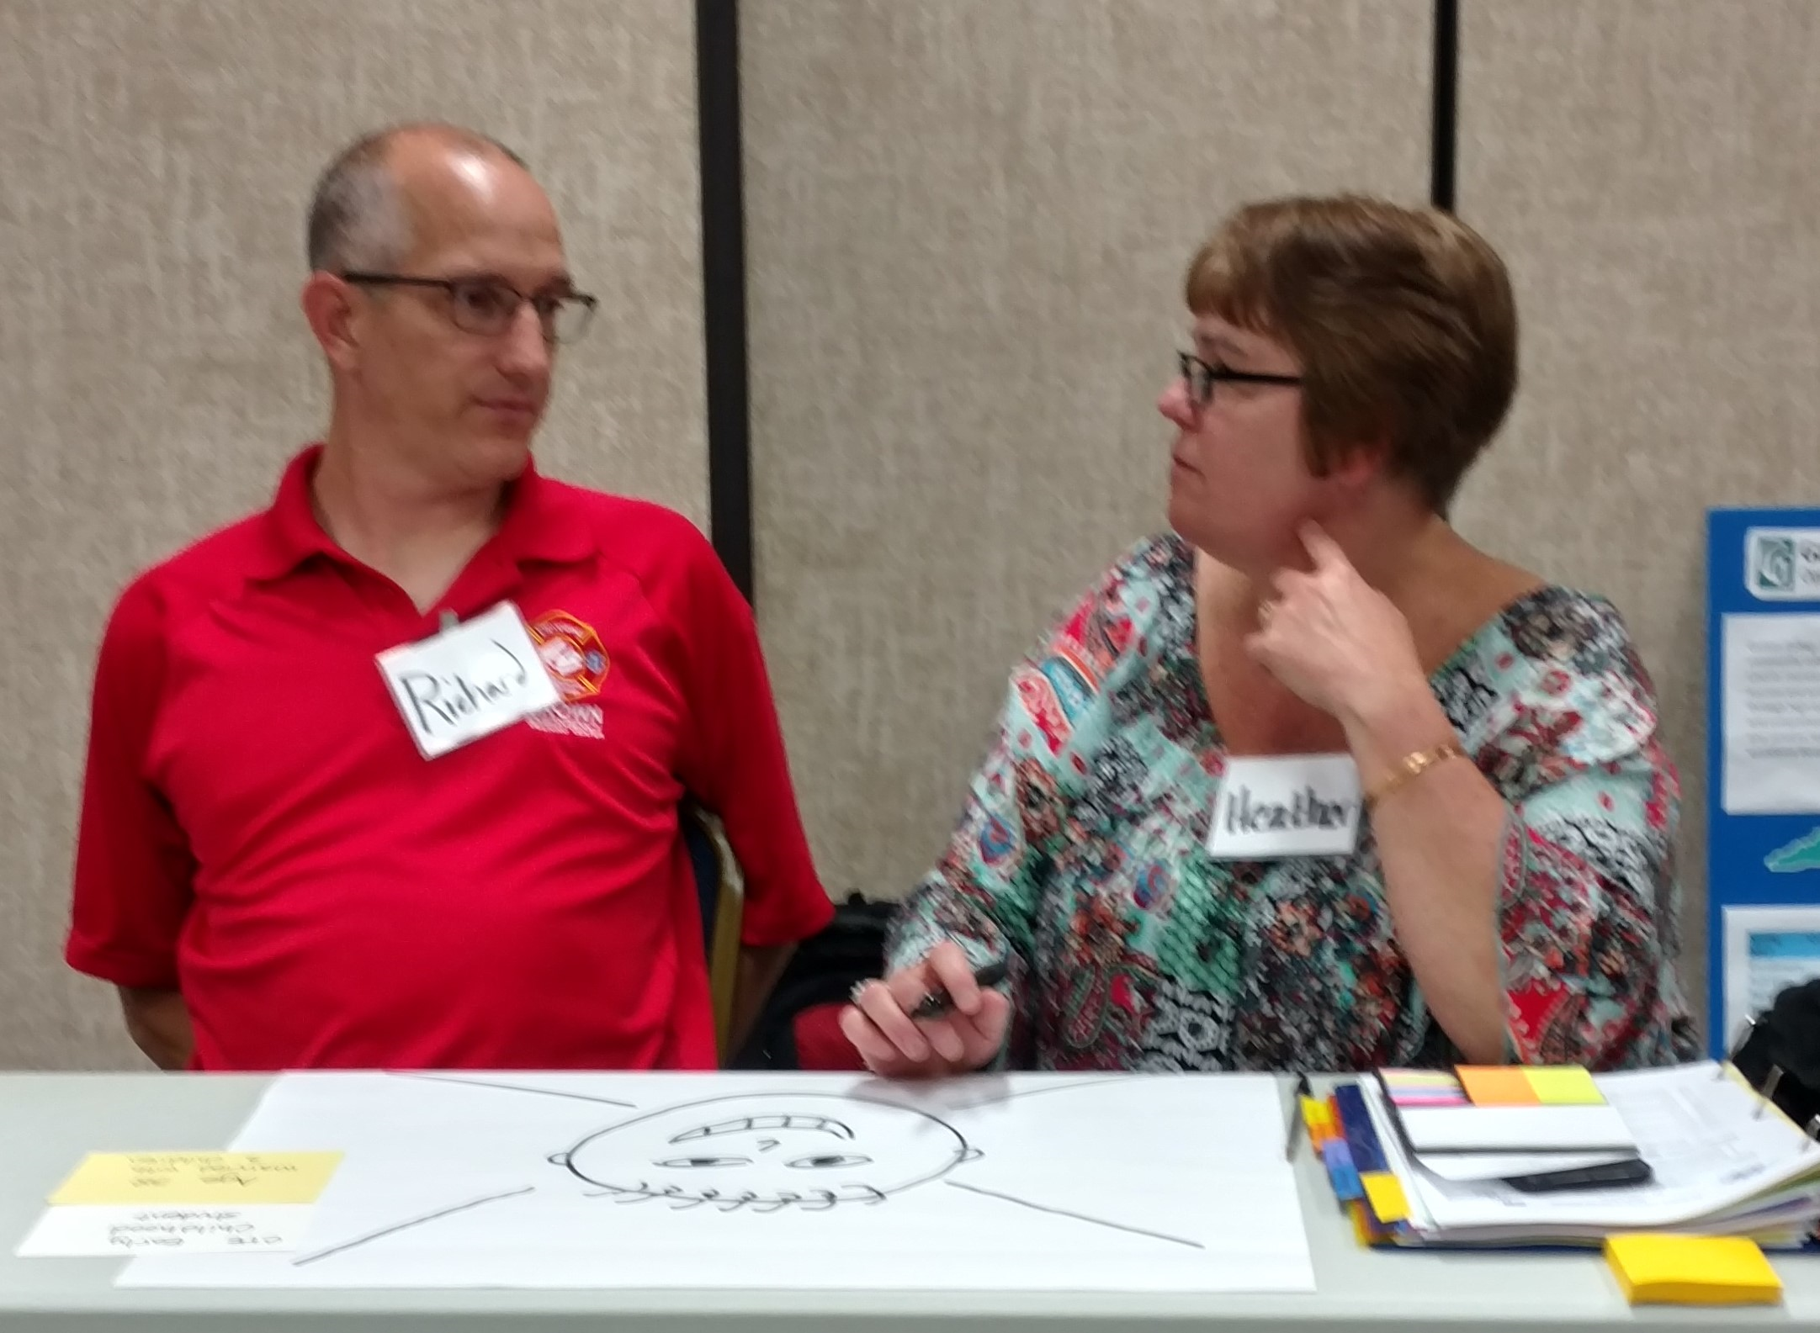
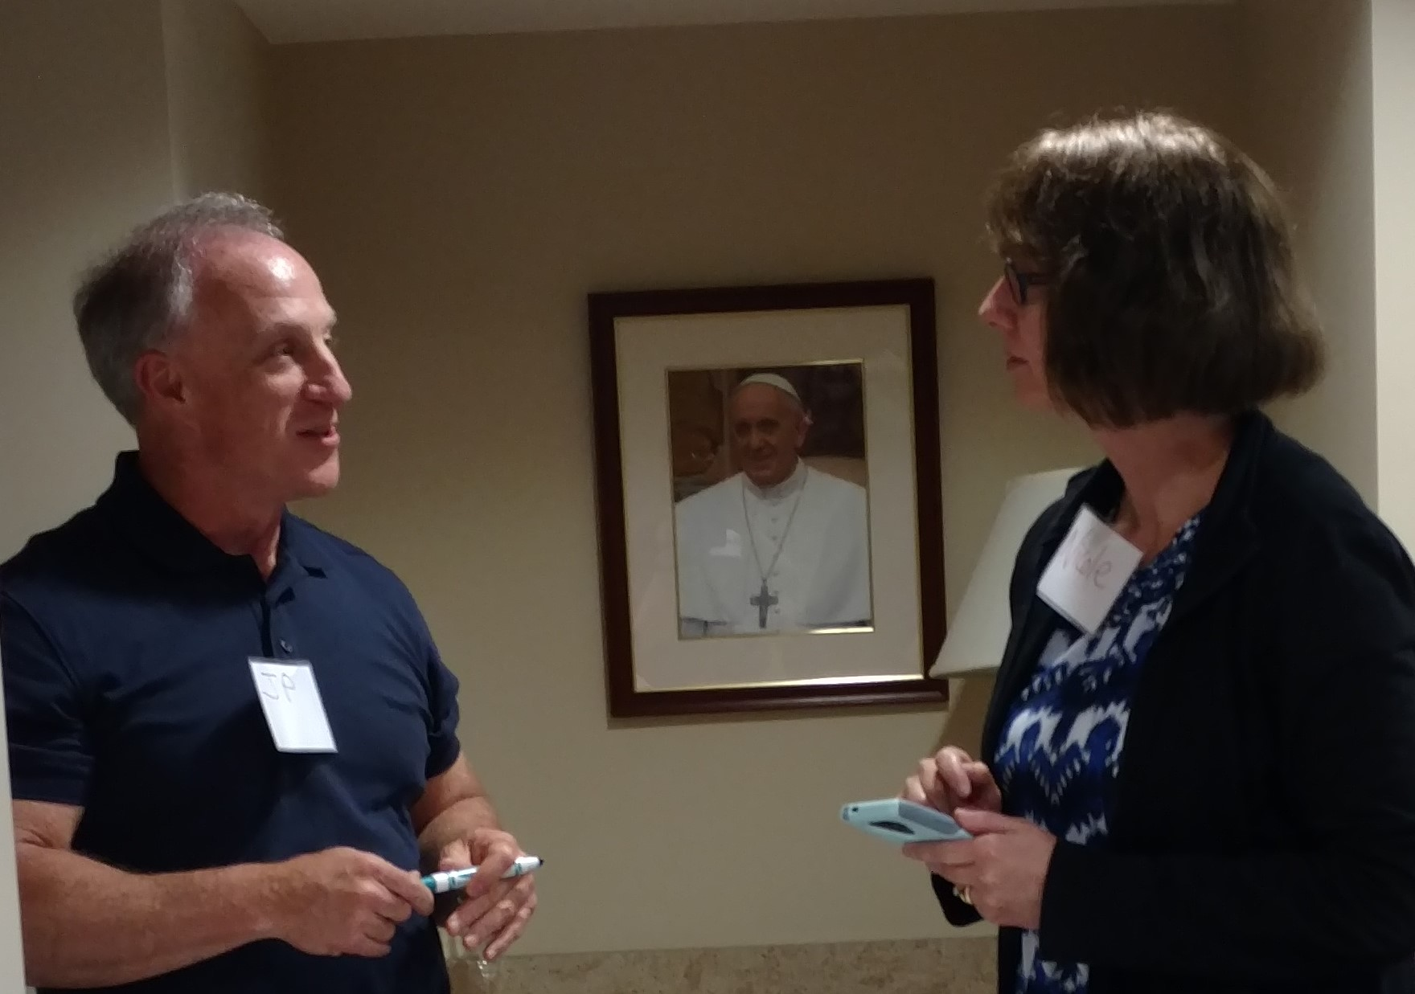

Slide 5

Agenda
Today we will discuss
EdX course
SOAA project
Mapping pathways assignment
IES survey
Timelines and activities

Slide 6
!
!
!
!
Questions about these or other topics?
Comments or suggestions?
?
?
?
?

Slide 7

Next steps
Virtual meetings?
Resource sharing?
Communication options?
Engage with others.
Stay connected.
Share ideas and . . .

