Slide 1
Improvement
Science
James E. Bartlett, II, Ph.D.
North Carolina State University

Slide 2
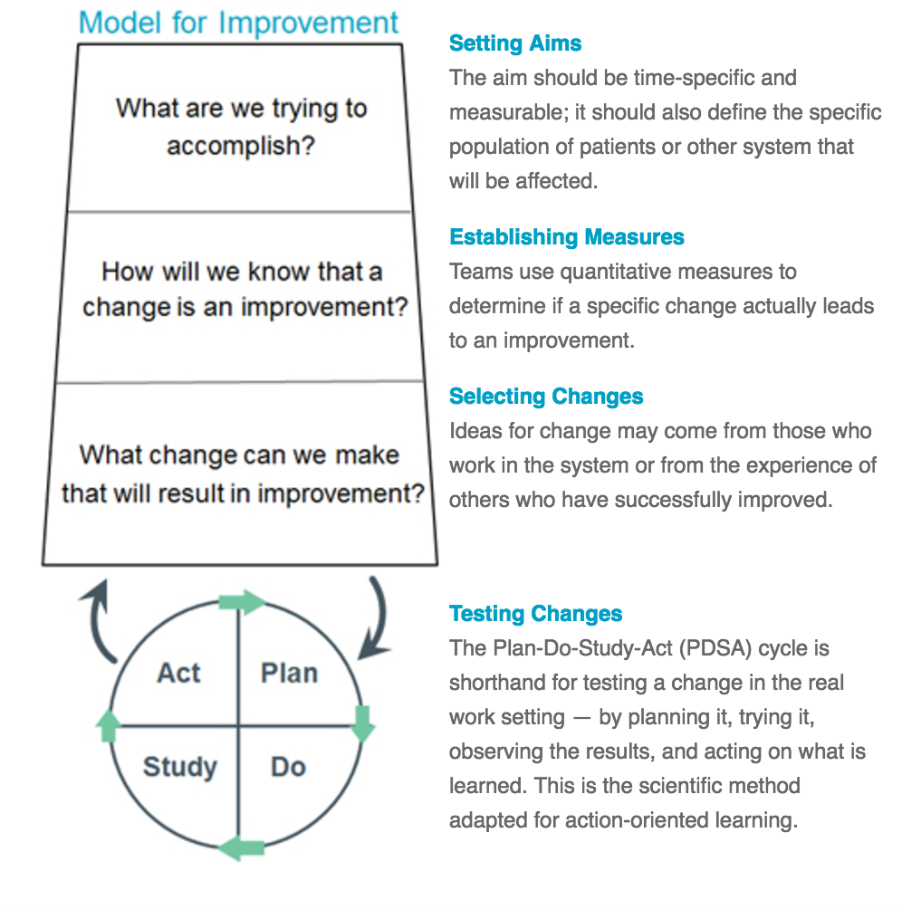
What is Improvement Science
  It represents a field of study focused on the methods, theories, and approaches that facilitate efforts to improve quality in context-specific work processes, and centers inquiry on the day-to-day “problems of practice that have genuine consequences for people’s lives” (Bryk, 2009: 598; Health Foundation, 2011)

Slide 3

Where Was Improvement Science Born
  Improvement Science is an applied science that seeks to make improvements to practices
  Manufacturing
  Healthcare
  Education

Slide 4
Deming
Parts of System of Profound Knowledge
Appreciation of a system
understanding the overall processes involving suppliers, producers, and customers (or recipients) of goods and services
Knowledge of variation
the range and causes of variation in quality, and use of statistical sampling in measurements
Theory of knowledge
the concepts explaining knowledge and the limits of what can be known
Knowledge of psychology
concepts of human nature
Notes:
Plugging leaks and improving the process are very different

Slide 5
Other Terms
  Kaizen
  Six Sigma
  Lean

Slide 6
Applying Improvement Science in
Education
  Seeks to discern what works
  For a particular problem
  For whom
  under what set of specific conditions
  Highly practice based and is biased towards action
  Berwick, 2008
  Bryk. Gomez & Grunow, 2010

Slide 7
Aims
Student outcomes
  Learning
  Completion
  Transfer
  Equity
  Labor Market Outcomes
Process inside of the organization

Slide 8
Six
Principles of Improvement Science
  Make the work problem-specific and user-centered
  We cannot improve at scale what we cannot measure
  Variation in performance is the core problem to address
  Anchor practice improvement in disciplined inquiry
  See the system that produces the current outcomes.
  Accelerate improvements through networked communities

Slide 9
Methods
Needed for
Improvement
Science
  View Systems and Processes
  Understanding Variation
  Gather Information
  Understanding Relationships
  Organizing Information
  Project Management

Slide 11
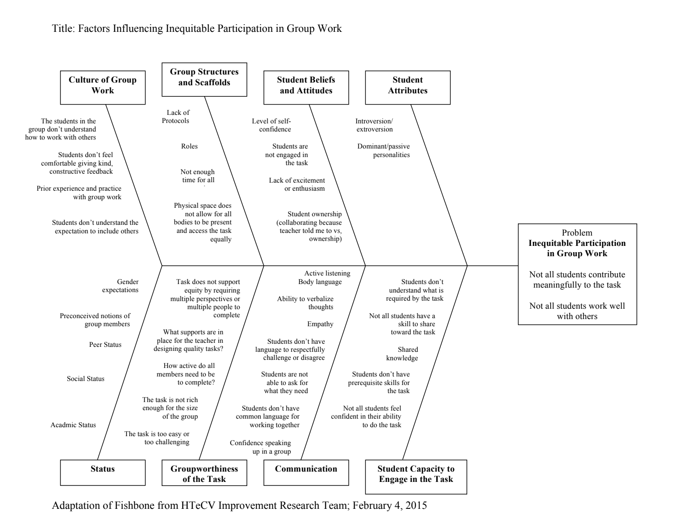

Slide 12
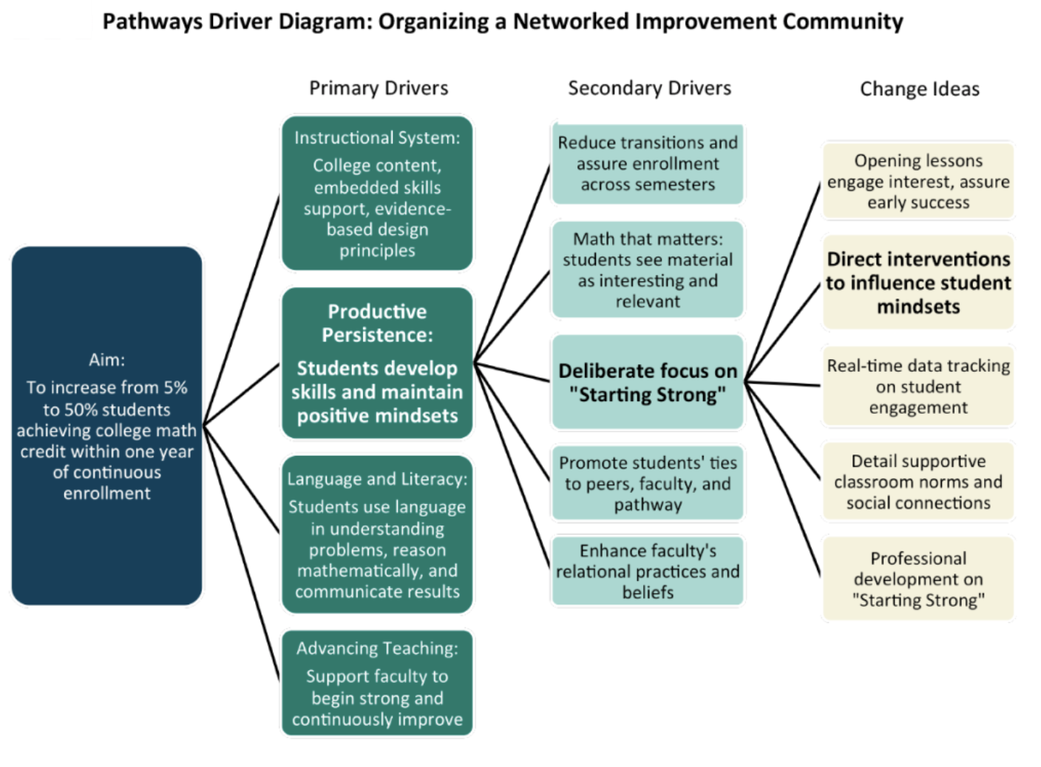

Slide 14
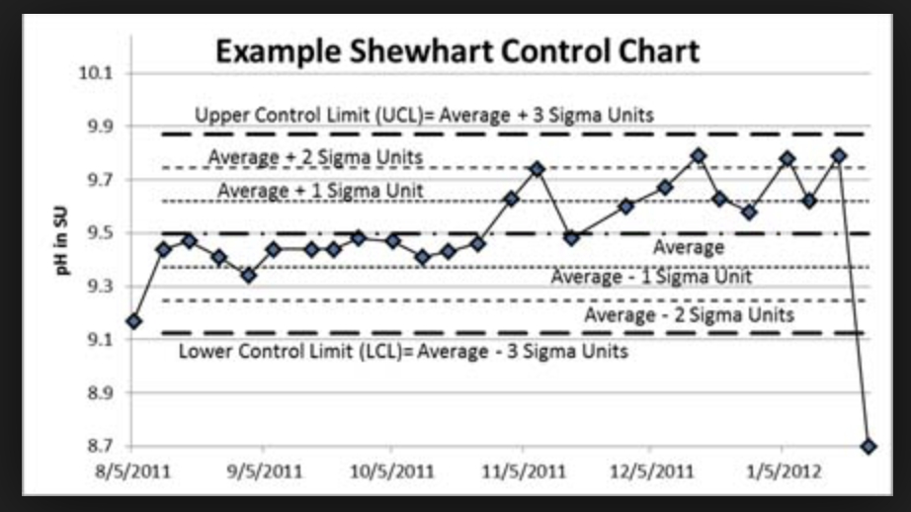

Slide 15
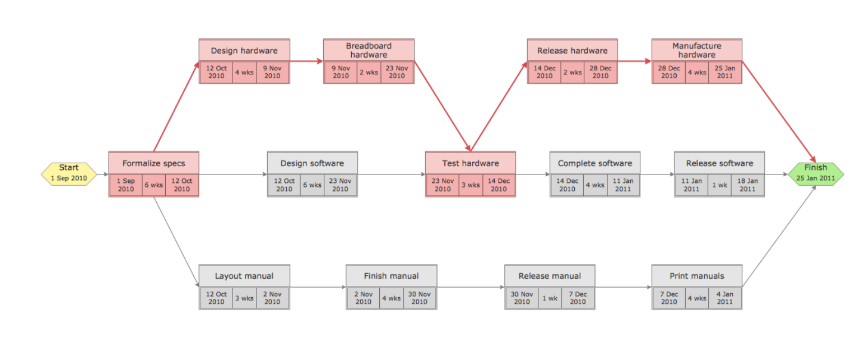
Tools
Project Management
  View Systems and Processes
  Tools
  Gnatt Chart
  PERT Chart
  Work Breakdown
  A3 Diagram

