Slide 1





GPS Network Institute I
Leading Change & Mapping Pathways
May 29-30, 2018
Serving 58 Community Colleges
http://www.nccommunitycolleges.edu/student-services/nc-student-success-center

Slide 2
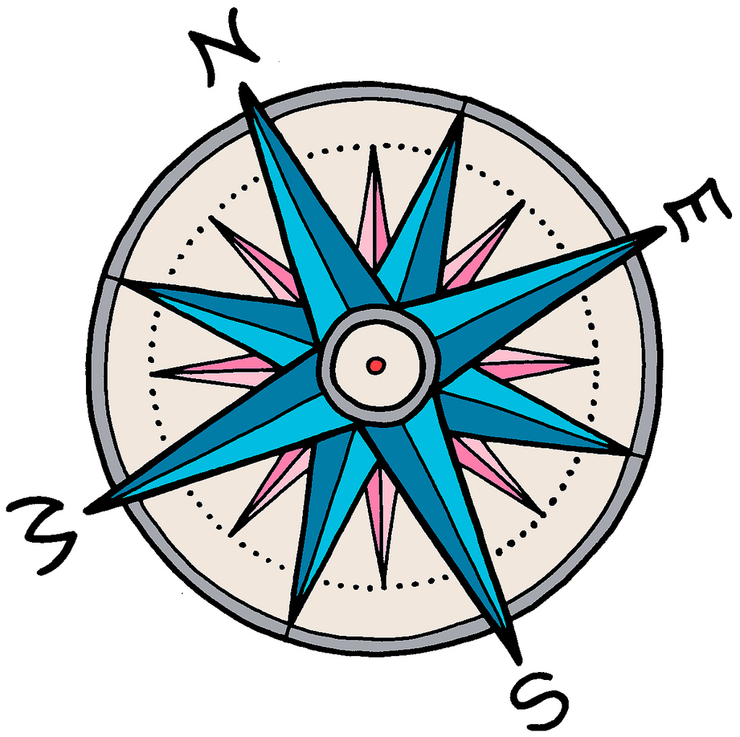
Institute objectives
To learn collaboratively through active
participation in and implementation of
The NC GPS Network (NIC)
Guided Pathways (GPS) practices
Mapping program pathways
Leading change for equitable student outcomes
A culture of continuous inquiry and learning

Slide 3

Questions and discussion

Slide 4

NCCCS Definition of Student Success
Student Success Pathway
Students make informed decisions.
Students progress through effective learning pathways that lead to valuable credentials, without unnecessary detours.
Students are provided integrated, targeted supports and interventions when they are most effective.
Dr. Lisa Chapman
NCCCS Executive VP/CAO
Roadmap to completion that includes
connected courses, programs, and support services
Notes:
how teachers can not only improve their expertise in their fields, but also develop their pedagogical expertise
---what does this mean to you??
Any conflicting emotions or thoughts?
Higher Ed today

Slide 5

NC Guided Pathways to Success (NC GPS)*
integrated, institution-wide approach to creating highly structured student experiences that guide them on the pathway to completion
*Based on the AACC Guided Pathways framework

Slide 6

NC-GPS: Essential Practice 1
Clarify paths to student end goals

Slide 7

NC-GPS: Essential Practice 2
Help students choose and enter a pathway

Slide 8

NC-GPS: Essential Practice 3
Help students stay on path

Slide 9

NC-GPS: Essential Practice 4
Ensure that students are learning

Slide 10

Lunch & presentation
Cultivating a Culture of Continuous Inquiry & Learning
The presentation
will begin at 12:35.

Slide 11
Individual reflection & shared learning
Reflect on our activities. On a notecard or scrap of paper, write down something you’ve learned and a question about GPS. [3 minutes]
Partner with someone you don’t know, introduce yourself, and share your reflections.
[5 mins. each person: 10 minutes.]

Slide 12
Team discussion
Reflect on and discuss:
Your understanding of the GPS model
Your hopes for participating in the NIC
Your concerns about participating in the NIC
How you will share learning at your college
Guidelines:
Each person should participate actively.
NIC Facilitators will record brief notes.
12
12

Slide 13
Cross-team dialogue: partner colleges
With a partner college colleague, discuss:
Your understanding of the GPS model
Your hopes & concerns about participating in the NIC
How you will share learning at your college
Ideas for sharing with your partner college
13
13

Slide 14
Reminders
ALL Institute materials in Moodle by Friday
(link on Center’s website and sent to NIC Facilitators and CAOs)
Review timelines and activities
Institute planning information
SOAA updates
14
14

Slide 15
Questions and discussion

Slide 16
NC SSC Collaboration Sites
Overview
Clarify the paths
Ensure students are learning
Help students get on a path
Help students stay on their path
NC GPS Commons
Open Moodle Course
New content June 1

Slide 17
NC SSC Collaboration Sites
Faculty Development Commons
Instructional & Discipline Associations
Scholarship of Teaching & Learning (SoTL) Commons
Best Practices & Resources
Teaching & Learning Commons
Open Moodle Course
Guest access available now

Slide 18

Your ideas needed
Collaboration strategies
Communication options
Improvements of NIC processes
Information needed
Supports needed

Slide 19
Your questions welcome
?
?
?
?
College team activities
Participating in the NIC
Scale of Adoption Assessment
Accessing & sharing resources
Other questions?

Slide 20

Institute Assessment
Please complete the assessment and place in one of the baskets.
Thank you for participating in our shared learning!

