Slide 1





GPS Network Institute I
Leading Change & Mapping Pathways
May 29-30, 2018
Serving 58 Community Colleges
http://www.nccommunitycolleges.edu/student-services/nc-student-success-center

Slide 2

Welcome to the GPS Institute!
College recognition
Agenda overview
Expectations & guidelines
Materials review
Documentation/record-keeping
NIC Facilitators recognition
Notes:
Daniel

Slide 3
Congratulations to the 2018 Network colleges!
A-B Tech CC
Caldwell CC & TI
Carteret CC
Central Carolina CC
Cleveland CC
Davidson CCC
Durham Tech CC
Gaston College
Halifax CC
Haywood CC
Lenoir CC
Mitchell CC
Nash CC
Piedmont CC
Pitt CC
Roanoke-Chowan CC
Wilkes CC

Slide 4
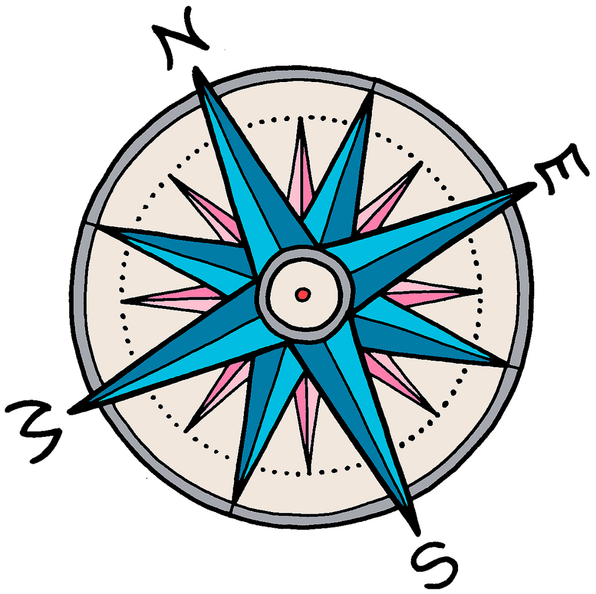
Institute objectives
To learn collaboratively through active
participation in and implementation of
The NC GPS Network (NIC)
Guided Pathways (GPS) practices
Mapping program pathways
Leading change for equitable student outcomes
A culture of continuous inquiry and learning

Slide 5

Personal statement: privilege and power
Why I am here
Where I come from
What I have been given
How I can and must use my privilege and power
Why it matters to me
Notes:
Daniel

Slide 6
Some people are born on third base and go through life thinking they hit a triple.
Barry Switzer

Slide 7
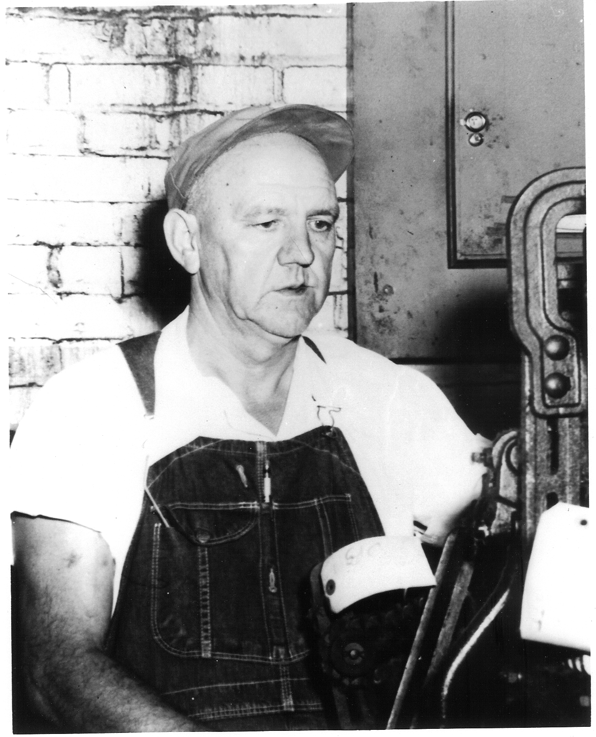
Fred Calloway Phillips, Sr.
(1904-1998)
Weaver
Robert Hoyle Newton
(1900-1967)
Loom Fixer/Machinist

Slide 8
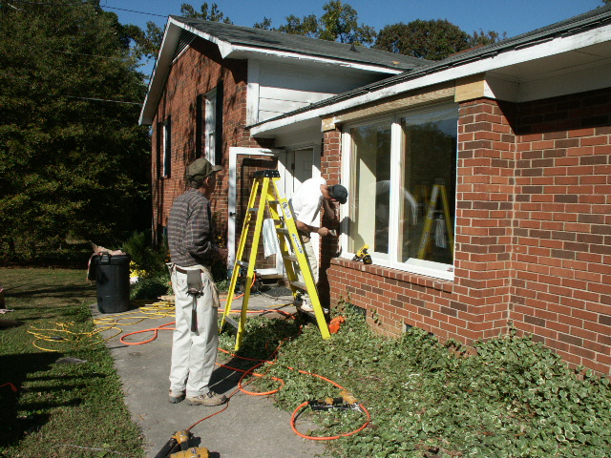
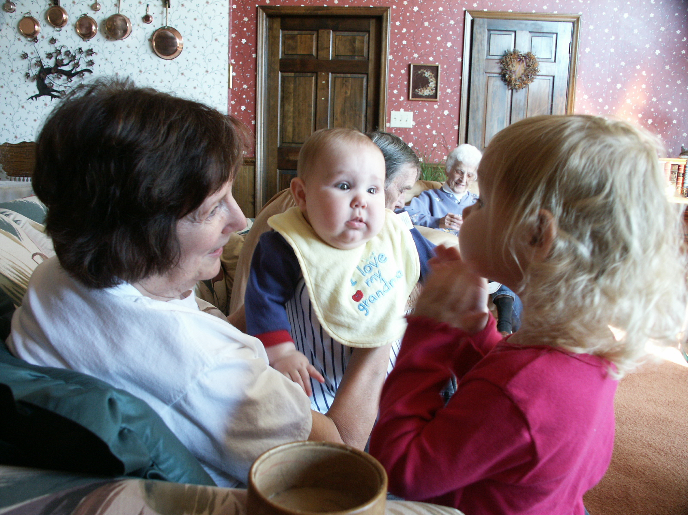
Vernon Sherman Newton
(1935-2011)
Brick mason & carpenter
Joan Phillips Newton
(1938- )
Homemaker, teacher & retail clerk

Slide 9
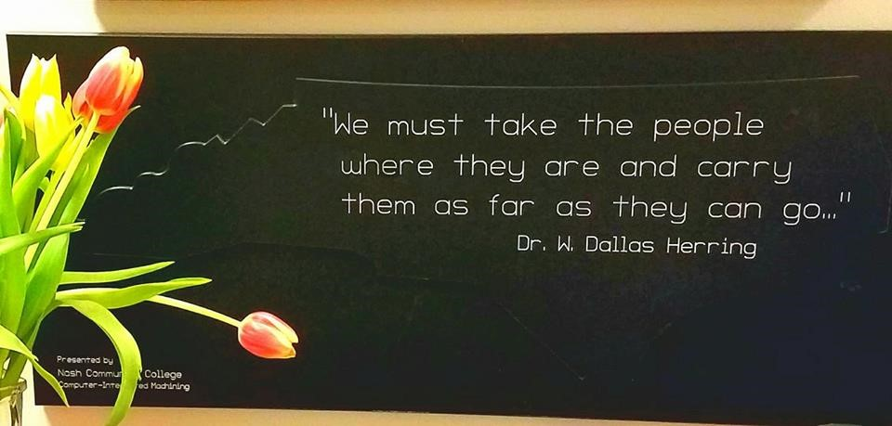
NCCCS Mission & History

Slide 10

NC Community Colleges: a history of innovation
1957 Community College & Industrial Education Center Acts (SBOE)
1981 State Board of Community Colleges established
1996 Re-engineering & CAA 1.0 (UNC articulation)
2010 SuccessNC Strategic Plan & CAA 2.0
2018 NC Guided Pathways to Success (NC GPS)

Slide 11
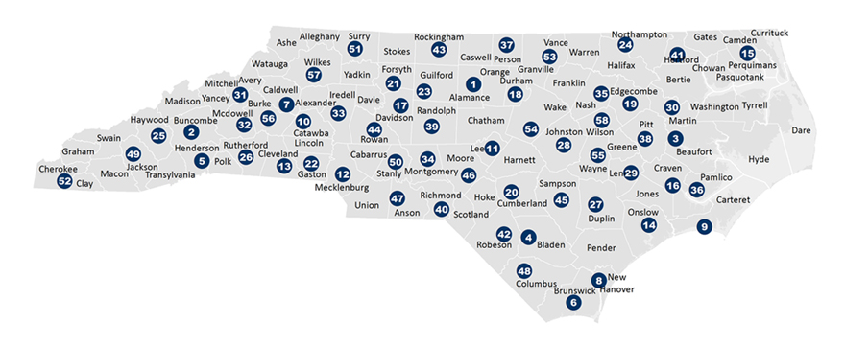
Serving 58 Community Colleges
The NC Student Success Center provides support for all 58 colleges to advance, scale, and sustain student success efforts.
We help colleges align policies and practices to ensure access, equity, significant learning, and completion of credentials.
We also represent the collective voice of NCCCS practitioners in state-level and national policy discussions.

Slide 12

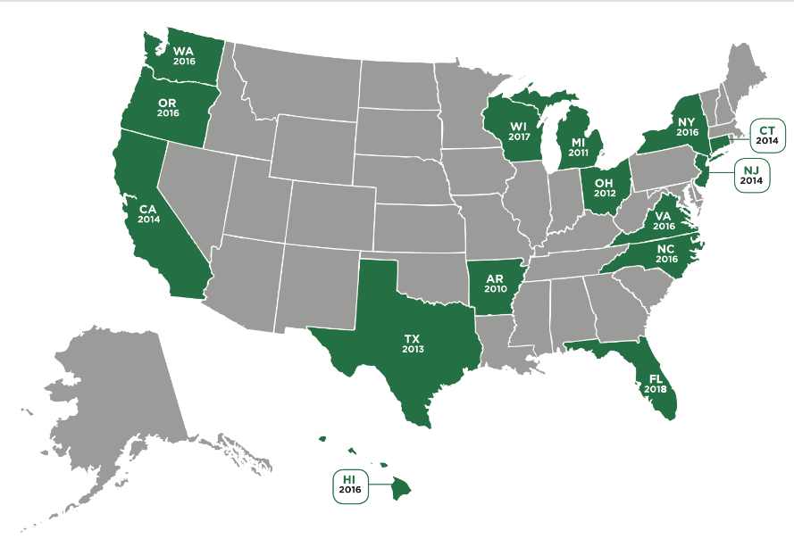

Network of State
Student Success Centers
WI

Slide 13
3-year funding: 100% grant-supported
Bill & Melinda Gates Foundation
Kresge Foundation
John M. Belk Endowment

Slide 14
Governance & guidance
19-member Advisory Board
Internal stakeholders
External education partners
External workforce partners

Slide 15


NC Student Success Center
Faculty & Staff at 58 Colleges
NCCCS & State Board of Trustees
State-level Professional Associations
Leadership & Boards of Trustees at 58 Colleges
Research Centers & CC Leadership Programs
N4CSGA & Students at 58 Colleges
Funders & Advocacy Groups
NCSSC Advisory Board
Collaborative Improvement & Accountability
Framework
Third-Party Evaluation Team
15-State National Learning Network

Slide 16
Professional development
Shared learning & best practices
Organizational development
Technical assistance
Knowledge & data management
Our Scope of Work

Slide 17
NC SSC Priorities
Priority 1
To assist colleges with implementation of Guided Pathways to Success (NC GPS) practices for improved learning and completion rates

Slide 18
NC SSC Priorities
Priority 2
To establish an equity action plan to address achievement gaps of underserved students (first-generation, low-income, students of color, adult students, English language learners, among others)

Slide 19


NC SSC Priorities
Research
Data & evidence
Priority 3
To promote a data-informed culture of continuous inquiry, learning, and improvement
across the System
Student perspectives
Faculty & staff perspectives

Slide 20
NC Community Colleges: a history of innovation
1957 Community College & Industrial Education Center Acts (SBOE)
1981 State Board of Community Colleges established
1996 Re-engineering & CAA 1.0 (UNC articulation)
2010 SuccessNC Strategic Plan & CAA 2.0
2018 NC Guided Pathways to Success (NC GPS)

Slide 21

NCCCS Definition of Student Success
Student Success Pathway
Students make informed decisions.
Students progress through effective learning pathways that lead to valuable credentials, without unnecessary detours.
Students are provided integrated, targeted supports and interventions when they are most effective.
Dr. Lisa Chapman
NCCCS Executive VP/CAO
Roadmap to completion that includes
connected courses, programs, and support services
Notes:
how teachers can not only improve their expertise in their fields, but also develop their pedagogical expertise
---what does this mean to you??
Any conflicting emotions or thoughts?
Higher Ed today

Slide 22

NC Guided Pathways to Success (NC GPS)*
integrated, institution-wide approach to creating highly structured student experiences that guide them on the pathway to completion
*Based on the AACC Guided Pathways framework

Slide 23

NC-GPS: Essential Practice 1
Clarify paths to student end goals

Slide 24

NC-GPS: Essential Practice 2
Help students choose and enter a pathway

Slide 25

NC-GPS: Essential Practice 3
Help students stay on path

Slide 26

NC-GPS: Essential Practice 4
Ensure that students are learning

Slide 27
NC GPS Plan
Essential practices implementation (cohorts of colleges)
Scale of Adoption Self-Assessment (58 colleges)
Technical assistance & professional development (58 colleges)
Networked improvement communities across the System

Slide 28
Working & learning together
NC GPS Cohort colleges
Cross-institutional learning teams
System-wide practitioner engagement
System-wide student engagement
National and state network and research

Slide 29
NCCCS Continuous Inquiry & Improvement Model
Cohort NIC*
Improvement science
Professional learning communities
Scholarship of Teaching & Learning
Practice-based evidence
*Networked Improvement Community

Slide 30

Integrating improvement science
Accelerate learning-by-doing
User-centered, problem-centered approach
Develop capacity at the college and system levels for continuous learning and improvement

Slide 31

Networked Improvement Communities (NICs)
intentionally designed
social organizations
with a distinct
problem-solving focus

Slide 32
Networked Improvement Communities (NICs)
a colleagueship of expertise building on the hard work and creativity of many

Slide 33

Role and Responsibilities of NIC Facilitators
NIC Facilitators are GPS coaches and change leaders.

Slide 34

Leading Change in the NIC

Slide 35
Understanding our students in context

Slide 36
Why do some students succeed. . .
. . .and others don’t?

Slide 37

Understanding our colleagues in context

Slide 38

What informs employees’ beliefs about success?
and students’ beliefs about college & success?

Slide 39

Understanding our colleges in context
Changing demographics
“2 North Carolinas”
Policy changes

Slide 40
Understanding the System in context
Public perceptions of our work
Our perceptions of our work
System Strategic Plan
Education partners’ contexts
Workforce partners’ contexts
State and national policies

Slide 41

Workforce CE
Career & College Ready
Career Credit Programs
Credit Programs: CTE & Transfer
How can we build better bridges between pathways and programs and offer integrated student support?
One-Door, One-College Concept

Slide 42
NC GPS Scale of Adoption Assessment (SOAA)
College teams assess progress in the four practice areas
Goals:
To identify exemplary college NC GPS practices
To prioritize needed services and resources to advance, scale, and sustain NC GPS practices
Timeline: June-August 2018

Slide 43

Lunch & panel discussion
We are moving to BB&T for lunch and later sessions.
Please select your lunch and return to BB&T.
The panel discussion will begin at 12:15.

Slide 44

Leading Change: Peer Perspectives
With your college team, describe your experiences in the sessions and share key takeaways.
[15 minutes]

Slide 45


15-minute break

Slide 46

Questions and discussion

Slide 47

Day One Assessment
Please complete the assessment and place in one of the baskets.
Have a great evening!
See you tomorrow!

