Slide 1

Connecting Equity to Success
NC GPS Network
May 29, 2018
Jairo McMican
Roxanne Newton
Notes:
I’ll introduce you and let you take it to slide 7.

Slide 2
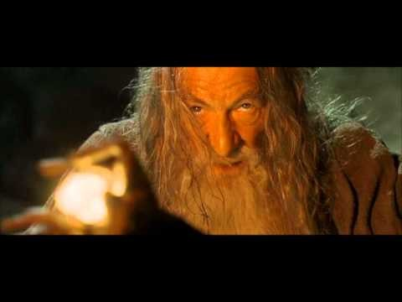
Notes:
We can watch this clip to explain that some schools treat their students like this. Some do it during onboarding, others do it in the classroom, and some do it every chance they get.
Start at 0:45 and stop at 1:45
https://youtu.be/mJZZNHekEQw?t=45s
This is great—although as a LOTR fan, I would point out that the Balroc takes Gandalf with him when he falls. Later in the clip—it may be interpreted that if we let our students fail, we’ll fail along with them.?? (-:

Slide 3

Who helped you?
Notes:
Graduates remember the people as much as the significant learning achieve.
NOTE: I would add here that according to the Gallup longitudinal study that I’ll quote. I’ll give you my brief notes and a longer article.

Slide 4
Your completion experience
Think about who or what helped you be successful and complete your first college credential or program.
Jot it down on a notecard to be collected and (anonymously) shared with the NIC.
When directed, share with a partner.
[5 minutes]
Notes:
Jairo—Do you think we should have partner sharing or just thinking about it and then move into Maslow, etc?
I think we should do partner sharing.
Do we have any one that learned about Maslow’s Hierarchy of Needs? Can you name all 5 levels?

Slide 5
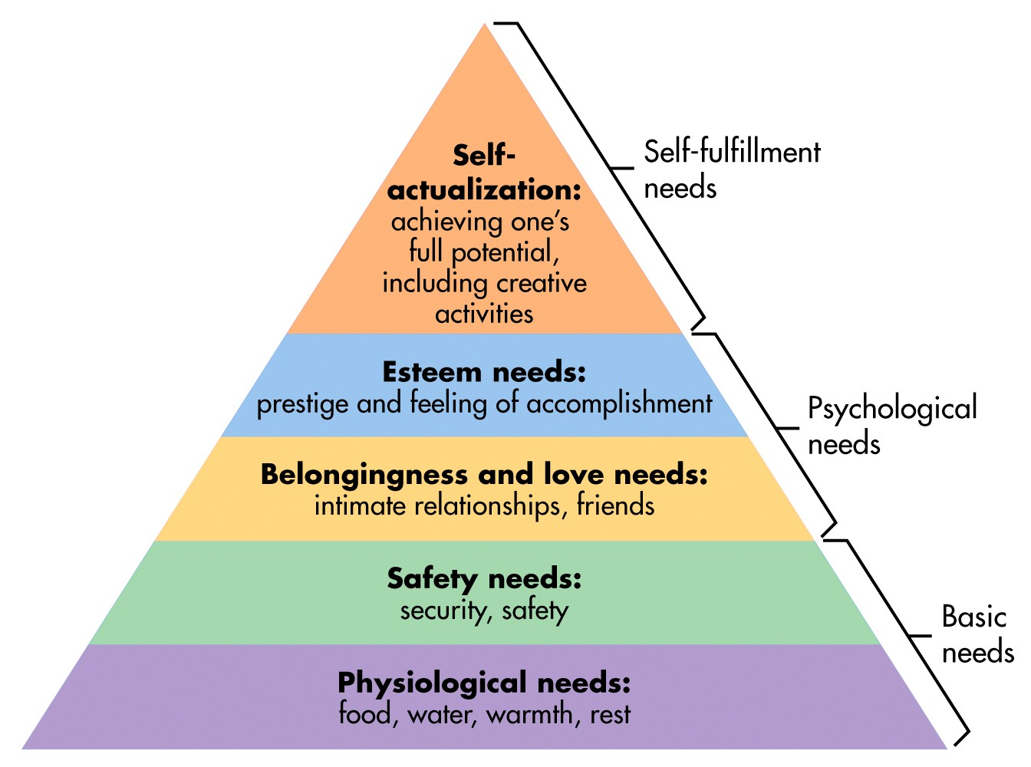
Maslow’s Hierarchy of Needs
https://www.simplypsychology.org/maslow.html
Notes:
The beauty of this is that it doesn’t really matter your ethnicity, gender, age, or socioeconomic status. The degree of those categories changes based on how much more or less you need them.
A lot of student development models reference Maslow. Yes the steps seem logical. We all need these basic necessities to function. Students definitely need the basic needs to be successful.
But what if I told you there was another way to look at this. Who remembers the title of this presentation?

Slide 6
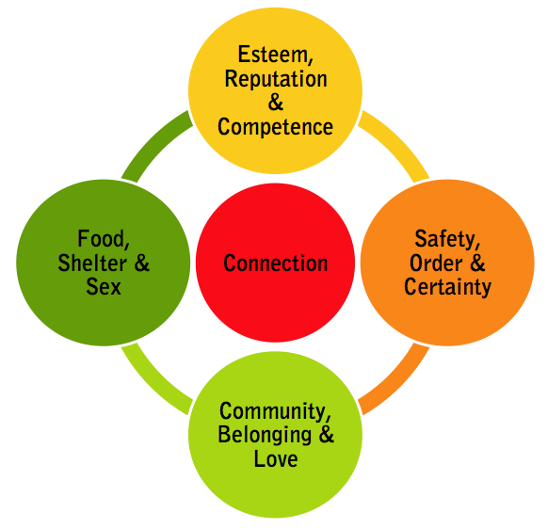
Maslow Rewired
Model
Pamela Rutledge
https://www.psychologytoday.com/us/blog/positively-media/201111/social-networks-what-maslow-misses-0
Notes:
Connecting Equity to Success
Those levels are not sequential. They should look more like Rutledge’s “Maslow Rewired” model. Connections are what allow you to move through the pyramid. As this relates to student success, you are the catalyst. You provide the energy for students to move from one dynamic to another. A student’s background should give you a starting point not a level to keep them on.
This relates to our guided pathways. The key word being guided. We are guided by those that we trust. We trust those we have relationships with. We have relationships with those we are connected to.

Slide 7



Connecting equity to success
Guided Pathways is our best chance to achieve equity.
Rob Johnstone
Notes:
Is it the only way? No. There are many ways to approach and achieve equity, and we need to discover the best learning from all research and perspectives. Guided Pathways is one good way to promote greater equity. This just gives us the best chance given what we have learned so far about equitable student success.

Slide 8




The completion movement
Multiple forces driving change in higher education
      National priorities for community college leaders
      Higher education initiatives in North Carolina
      National and state workforce and economic imperatives
      Performance funding and accountability measures

Slide 9
Why does equity in completion matter?
Completers
Credential holders
Workforce needs
a brighter future
Our future depends on helping more students from all populations succeed.
Notes:
Word Example: You need consonants and vowels to form complete sentences. One does not matter more than the other. They have to work together to be successful when communicating.

Slide 10

Completion matters: NCCCS mission & purpose
= to help students learn and complete credentials that prepare them for careers or transfer. . .
. . .but only 44% of all credit students and only 33% of African American male students graduate or transfer in 6 years
(2010 cohort)

Slide 11

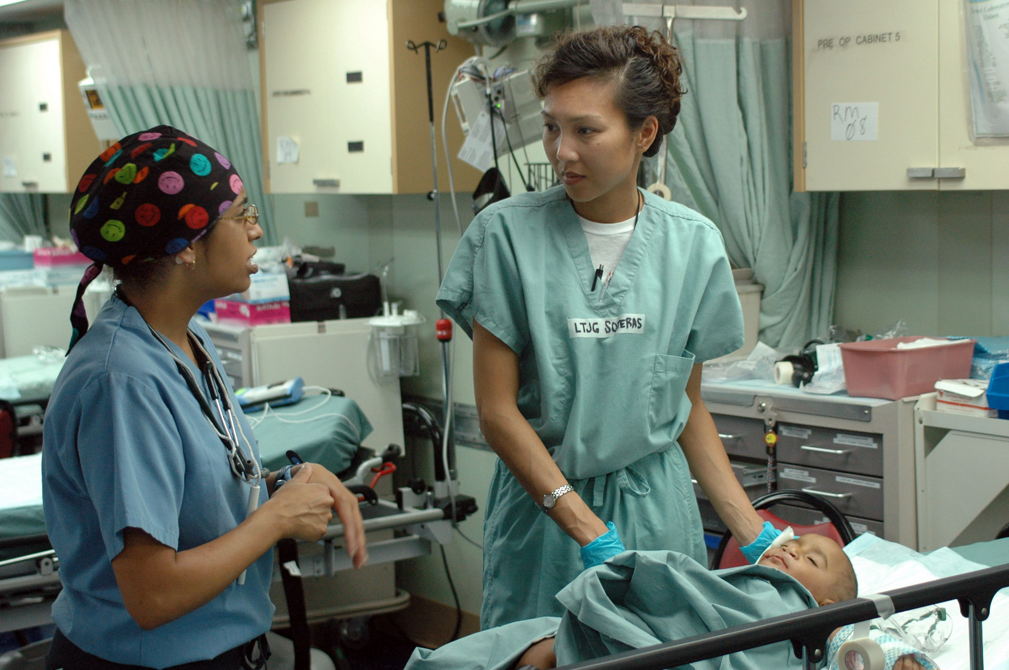
Completion matters: Workforce imperative
By 2025, 2/3 of US jobs will require education beyond high school. At the current completion rate, by 2025, the US will have a shortfall of 11 million skilled workers.
The US is currently rated 6th in the world in college graduates.

Slide 12
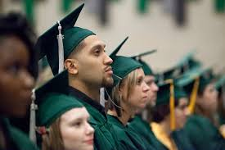
Completion matters: Ethical imperative
Lack of education limits the lives of individuals and families.
Unequal job opportunity and income inequality (the widening equity gap) are directly related to lower graduation rates of students from poorer families and students of color.

Slide 13
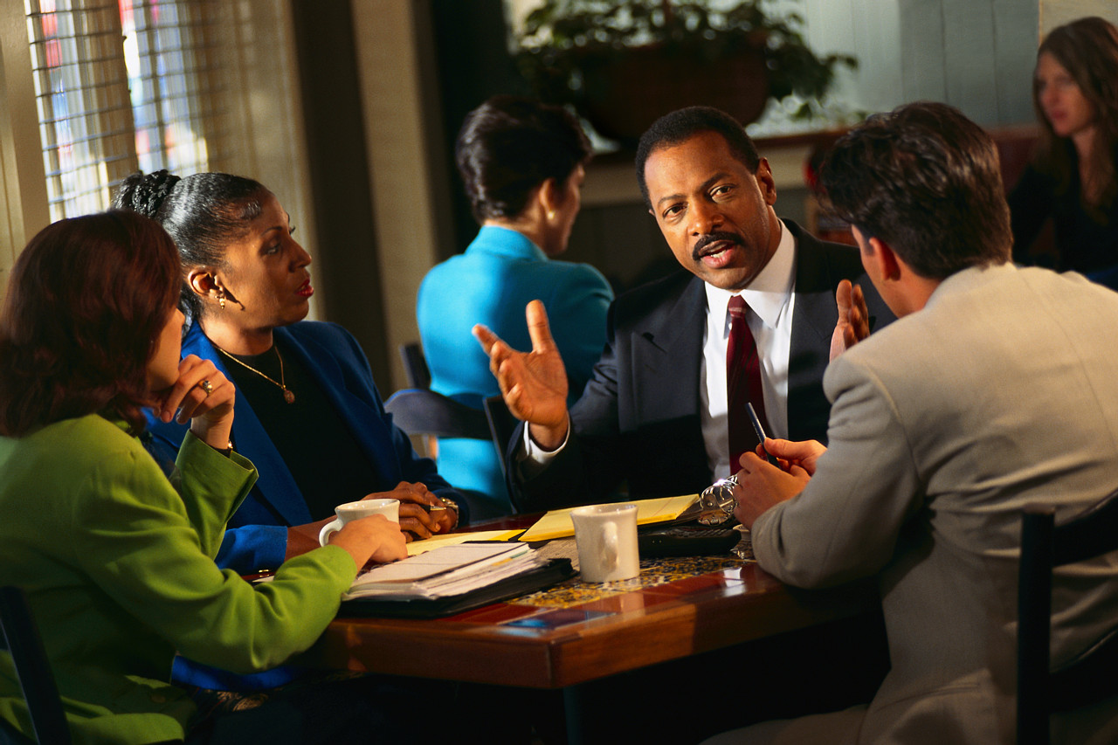
We can and we must do more.
Imperative for Our Future:
NC Student Success Center Equity & Excellence Action Plan

Slide 14

Structural/systems approach to equity
Systems are interactions and interdependencies on a large scale.

Slide 15


Structural equity
Every system is perfectly designed to get the results it gets.
W. Edwards Deming
Notes:
Were you going to include the 2017 success measures data? I think it would help those that need to see the numbers.

Slide 16
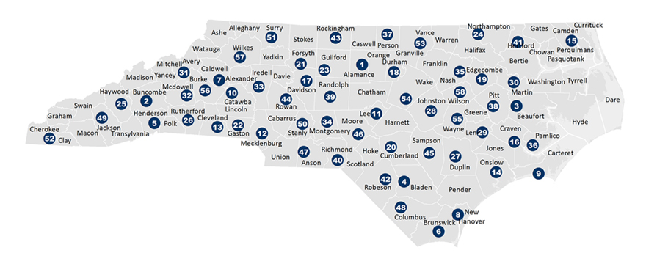
Working within a system
System
Sub-system
Methods
Steps

Slide 17
Shrinking the Equity Gap
(Wood & Harris, 2017; Howard, Douglas, & Warren, 2016)
 | Want to help | Don’t want to help
Know how to help | Choir (15%) | Resisters – Passive (30%) & Active (10%)
Don’t know how to help | Allies (30%) | Defiant (15%)
Notes:
All faculty and staff fall into one of these categories when it comes to helping close equity gaps. The percentages make up the averages that fall into those categories.
Modified from Wood & Harris (2017)
&
Howard, T., Douglas, T., & Warren, C., (June 2016). “What works”: Recommendations on improving academic experiences and outcomes for black males.” Teaching College Record, 118, 1-10
When working with Black males institutions fall into one of 4 catagories.
This is awesome! Thanks so much for adding this valuable perspective and help us learn!

Slide 18
College team discussion [20 minutes]
Review Aspen’s Structural Equity strategies. Based on these strategies:
What has your college accomplished so far?
What have you learned & can share with the NIC?
What assistance is needed to advance this important work?
Record/retain your responses for later planning.
Notes:
I may provide a handout/template for the discussion to record their responses. What do you think?
I read this book on how to present a long time ago. It said the most successful presentations do 3 things:
They make you think – This presentation makes you think about equity and why it is important.
They make you feel – Who helped you succeed should bring the good feelings associated with nostalgia
They ask you to do something – A handout will help them focus on what they need to do next.
Excellent! Thanks so much. We’ll direct them to focus on the Aspen strategies and next steps and set up the plan for future work on equity at each of the Institutes in the GPS Network.

Slide 19



NC GPS Network
The NC Student Success Center
Serving 58 Community Colleges
http://www.nccommunitycolleges.edu/student-services/nc-student-success-center

