Slide 1

Change Leadership for Guided Pathways: The President’s Role
Bob Templin & Keith Witham
North Carolina Guided Pathways to Success Institute
May 29, 2018

Slide 2


The Aspen Institute College Excellence Program Framework for Student Success
Learning
Completion
Labor Market Outcomes
Equity
Do colleges strive for equitable access and outcomes for underserved minority and low-income students?
Do students earn degrees and other meaningful credentials, and do those who transfer go on to earn bachelor’s degrees?
Do graduates find strong employment opportunity in well-paying jobs?
Do colleges set expectations for learning, measure what is learned, and use that information in a process of continuous improvement?
Notes:
KEITH

Slide 3


      Leadership Matters: What qualities do leaders need to enact and sustain transformational change to improve student success?
Notes:
KEITH

Slide 4
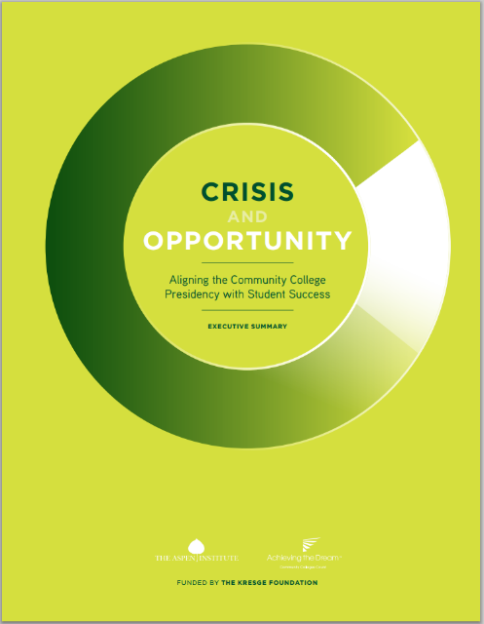

Research in partnership with Achieving the Dream
Notes:
KEITH

Slide 5
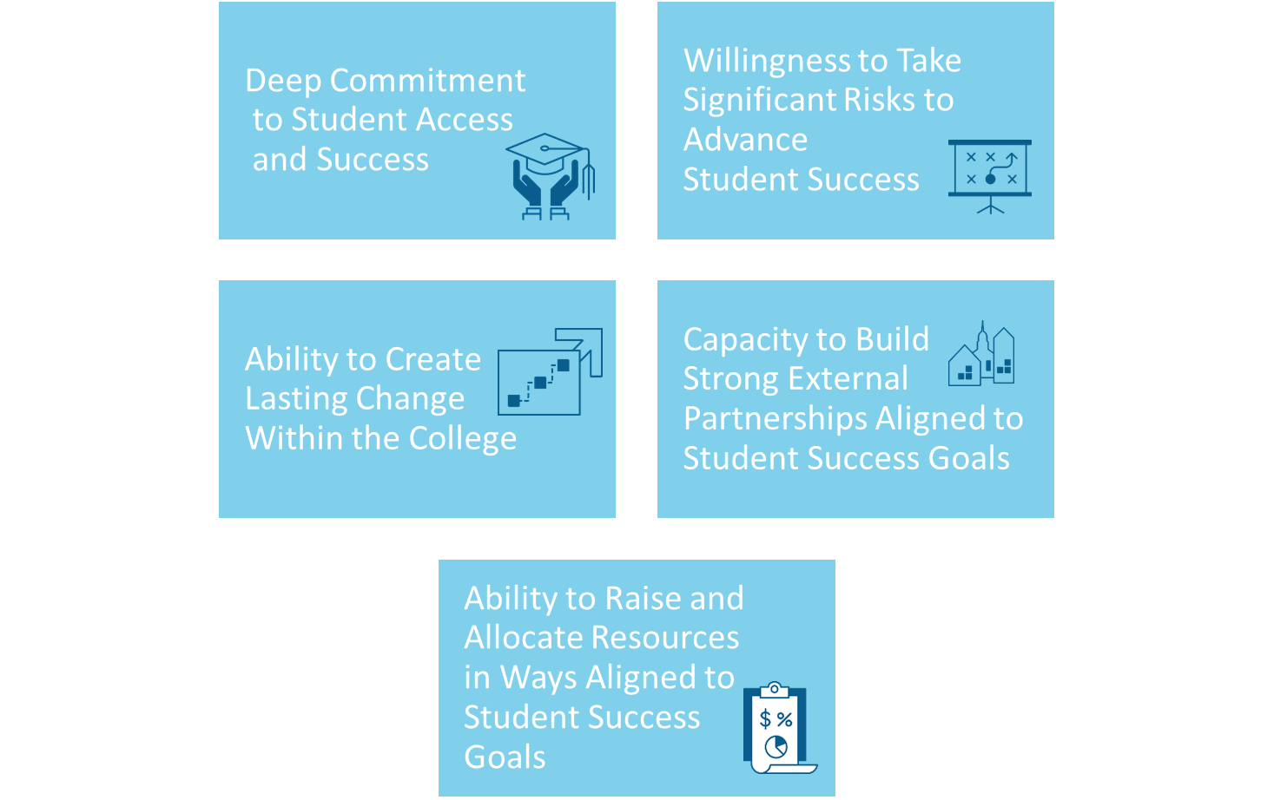




Qualities of Transformational Leaders
Notes:
KEITH

Slide 6
Qualities of Transformational Leaders
Notes:
KEITH

Slide 7
Why transformational leadership?
  Guided pathways is institutional transformation…
  Alters the culture of the institution by changing select underlying assumptions and institutional behaviors, processes, and products.
  Is deep and pervasive, affecting the whole institution.
  Is intentional.
  Occurs over time.
Eckel, P., Hill, B., & Green, M. (1998). On Change: En Route to Transformation. Washington DC: American Council on Education.
Notes:
KEITH
So why is Aspen here talking about leadership for transformational change in the context of North Carolina GPS? – Because pathways reform is whole school reform for community college – it is transformational change. Also, it is hopefully the first of many executive development activities we will be doing with the NC Student Success Center and NC State (reference Audrey Jaeger & Ryan Knight)

Slide 8
“Guided Pathways” Myths & Misconceptions
…and why change leadership is vital
“Pathways” is an initiative
Pathways is just about mapping course sequences
Pathways are the end goal
“Structure” is a self-evident rationale for reform
Notes:
KEITH

Slide 9
When Guided Pathways is Most Successful
Pathways is an initiative
Pathways is an organizing framework for a holistic array of reforms intended to fundamentally change the student experience
Notes:
KEITH

Slide 10
When Guided Pathways is Most Successful
Pathways is just about mapping course sequences
Transformation requires realignment of core business processes required to operationalize the student experience of guided pathways
Notes:
KEITH

Slide 11
When Guided Pathways is Most Successful
Pathways is the end goal
Pathways is an organizing framework for aligning practices to a unique institutional vision for how redesigning the student experience will lead to greater equity and better outcomes
Notes:
KEITH

Slide 12
When Guided Pathways is Most Successful
“Structure” is a self-evident rationale for reform
Creating greater structure is the means, not the end – true institutional transformation requires a more fundamental “why” to build urgency and provide the integrative foundation for reform
Notes:
KEITH

Slide 13

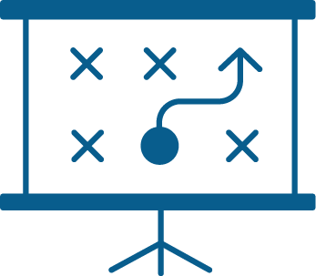



Leading Internal Transformational Change Aligned to Student Success Goals
Communicate a Vision and Create Urgency
Build College-Wide Ownership for Change
Align Structures and Resources
Build a System to Support Disciplined Execution
Establish Routines of Inquiry and Evidence Use
Create Routines of Effective Communication
Notes:
KEITH

Slide 14

How can presidents lead for change in the context of Pathways implementation?
      How can you communicate the why and create urgency around Pathways reform?
      How can you align structures and resources to the Pathways reform agenda?
      What are some of the reasons that Pathways implementation might fail, and what can you do as a leader to pre-empt those reasons?
Notes:
KEITH

Slide 15
How can you communicate the why and create urgency around Pathways reform?
Notes:
BOB

Slide 16
Communicating the “why” and creating urgency
In 22 of North Carolina’s 24 economic regions, the rate of economic mobility is in the bottom quarter nationally.
North Carolina’s Economic Imperative: Building an Infrastructure of Opportunity (2016)
Notes:
BOB

Slide 17
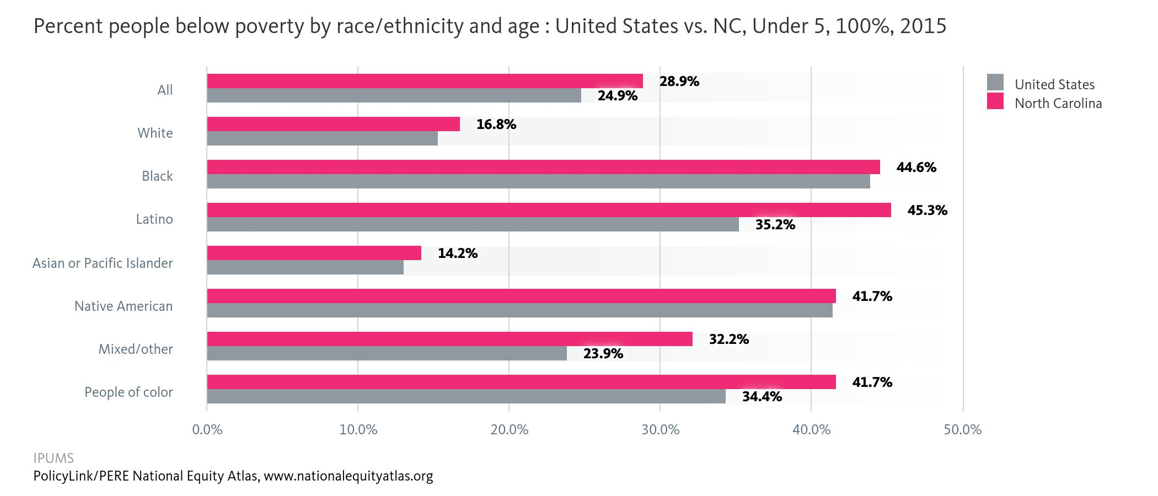
Communicating the “why” and creating urgency
Notes:
BOB

Slide 18

“If you are born poor, you have a worse chance of escaping that poverty growing up in Charlotte than any other sizable city in America.”
The Charlotte Observer – March 27, 2017
Notes:
BOB

Slide 19

“Upward mobility in North Carolina lags the rest of the nation, leaving most children of low-income families stuck at the bottom of the economic ladder without a discernible path forward.” The News and Observer – April 6, 2016
Notes:
BOB

Slide 20
How do transformational leaders build urgency?
Do the data…
Relate to outcomes that, if improved, would lead to students’ ultimate goals?
Elicit a “no” response to the question, “Is this outcome level acceptable?”
Include some indicators or trends that can be changed in a reasonable period of time?
Inspire action, rather than assign blame?
Draw attention to institutional responsibility, rather than student deficits?
Are these data easy to understand?
Broadly share clear, limited, and important data points.
Notes:
BOB

Slide 21
Curriculum Completion
NC Community College System
% Graduate, Transfer, or Retained (36 hrs)
Cohort
48%
47%
43%
44%
Source: NC Community College System, 2017 Performance Measures for Student Success
Notes:
KEITH & BOB

Slide 22

How do transformational leaders build urgency?
Broadly share clear, limited, and important data points.
Activate the student voice.
Secret shopper programs
Student surveys
Focus groups
Notes:
BOB

Slide 23
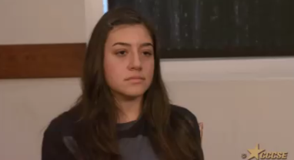

How do transformational leaders build urgency?
Broadly share clear, limited, and important data points.
Activate the student voice.
Tell a human story.
Remind the audience of the reason for the work, and inspire them to action.
Notes:
BOB

Slide 24


Slide 25
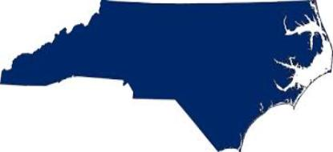
Building ownership for change
Lessons from the Field
How have you built urgency and made a compelling case for Pathways reform at your college?
How have you changed the conversation around Guided Pathways?
Notes:
Bob invites Jeff Cox to share how he has tried to create urgency around the need for change
Bob invites Bill Ingram to share how he is trying to “change the conversation” around guided pathways

Slide 26
See Handout
Activity: “Dear Abby” Letter
With your table, read the letter on your handout from an imaginary faculty member who is resistant to guided pathways implementation. Tables will discuss the following questions:
What are the truths in this sentiment that presidents need to acknowledge? How would you respond?
How can the president change the conversation around pathways implementation?
How can the president engage faculty in guided pathways so they feel they “own” the redesign?
Take 15 minutes to discuss.
Notes:
.KEITH

Slide 27
See Handout
Activity: “Dear Abby” Letter
Debrief:
What are the truths in this sentiment that presidents need to acknowledge? How would you respond?
How can the president change the conversation around pathways implementation?
How can the president engage faculty in guided pathways so they feel they “own” the redesign?
Notes:
KEITH & BOB

Slide 28
Building ownership for change
Lessons from the Field
How will you engaged faculty in guided pathways so that they feel they “own” the redesign?
Notes:
Keith invite Mary Rittling to share how she has engaged her faculty in guided pathways

Slide 29
How can you align structures and resources to the Pathways reform agenda?
Notes:
Bob

Slide 30
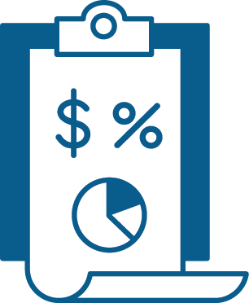

Building an institutional culture around student success
Strategic finance
Human resources policies
Data use protocols
Notes:
Bob

Slide 31
What are some of the reasons that Pathways implementation might fail, and what can you do as a leader to pre-empt those reasons?
Notes:
KEITH

Slide 32


Handout 2
Why Reforms Fail: Pre-Mortem Analysis
Goal: In the next 5 years, the college will increase the percentage of students who complete credentials while reducing excess time and credits-to-degree, and closing equity gaps.
  Strategy – Guided Pathways
      Build clear pathways
      Get students on a pathway
      Help students stay on the pathway
      Ensure students are learning
Take 15 minutes with your table. Assume that, five years from now, your college has failed to achieve this goal.
Identify the likely major causes of that “mortality.”
What specifically might happen that could derail the effort? Consider the areas of institutional culture discussed in the previous slides.
For each cause, what strategies could you employ to anticipate and avert or address the challenges?
Notes:
KEITH
Example: Might fail because students are not being adequately advised onto pathways when they enter the institution and are still picking courses “cafeteria style.”
-HR – Advisers are still being evaluated based on how many advising conversations they have, not on whether or not students were effectively counseled onto a pathway that matches their career goals.
-Strategic finance – Not enough money is being allocated to funding advising positions.
-Data protocol – Not regularly looking at metrics re: how many students are entering pathways/what pathways.

Slide 33
Handout 2
Activity: Pre-mortem Analysis
Debrief:
Why might Pathways implementation fail at your college?
What can be done to prevent these potential reasons for implementation failure?
Notes:
KEITH & BOB

Slide 34

Pay attention to why reforms fail.
Reasons Initiatives Fail
People blame the student.
What can be done?
Repeatedly activate the student voice.
Notes:
BOB

Slide 35
Pay attention to why reforms fail.
Reasons Initiatives Fail
People don’t believe this is going to get done—they think it will “blow over” and the college will move on to the next thing.
What can be done?
Persistently repeat the message about why and what, using every possible vehicle.
Notes:
BOB

Slide 36

Pay attention to why reforms fail.
Reasons Initiatives Fail
The college is suffering from a failure to focus and from initiative fatigue.
What can be done?
Maintain discipline for multiple years before taking on major new initiatives.
Notes:
BOB

Slide 37

Pay attention to why reforms fail.
Reasons Initiatives Fail
The college failed to engage external partners so they don’t have what they need to ensure student success.
What can be done?
Build partnerships, considering:
Where is the student coming from?
Where is the student going next?
What students need:
  That may not be within the college’s core strengths.
  That can be more efficiently delivered by others.
  For which external resources may be available.
Notes:
BOB

Slide 38
Pay attention to why reforms fail.
Reasons Initiatives Fail
Lack of infrastructure to know what is working and what isn’t. Goals and measurements are not defined clearly at the outset;
outcomes are not being regularly tracked.
What can be done?
Use common data definitions.
Set a schedule for tracking outcomes.
Frequent communication among stakeholders.
Notes:
BOB

Slide 39
Questions? Reflections?
Given what we’ve discussed today, what is your college’s most powerful asset in moving this work forward?
Notes:
KEITH & BOB

Slide 40



Thank you!
Keith.Witham@aspeninstitute.org
http://highered.aspeninstitute.org
Twitter: @aspenhighered
Notes:
KEITH

