Slide 1

From Zero to Pathway:
A Case Study of A-B Tech’s Pathway Project
Dr. Beth Stewart, VP Instructional Services
Heather Vaughn, Chair of English
Dr. Steven Heulett, Coordinator of Transfer Advising Center
Notes:
Beth

Slide 2
George’s Pizza & Subs
$50 max per table
Something green
Something with pineapple
Pineapple and green must be separate
Include dessert
Realistically feed everyone at table
Notes:
Beth

Slide 3
The Pathways Philosophy
Too many choices complicate decision-making (Dhar, 1997; Luce, 1998; Tversky & Shafir,1992).
Complex decisions result in avoidant behavior such as procrastination (Keller, et al., 2011; Luce, 1998).
Students may delay advising and registration or stop out.
Notes:
Steve

Slide 4

Notes:
Steve

Slide 5
Why Pathways: The Numbers
26% Graduation Rate (IPEDS)
30% Enrolled in ACA 122
25% Enrolled in ENG 111
15% Enrolled in MAT
Notes:
Heather

Slide 6
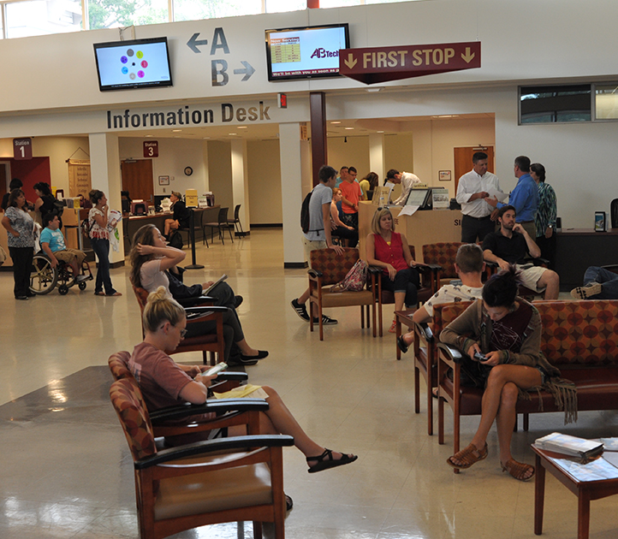
Why Pathways: The Students
Financial Aid
Faculty removed from the advising process
Advisors not in the discipline
Different advisors each time
Not enough time to adequately advise
Course proliferation
Notes:
Heather

Slide 7
Pathways as a Potential Solution
Hierarchical Choice Approach (Jenkins & Cho, 2014)
Advising and the First Semester Experience
Structured Curricula
Notes:
Steve

Slide 8
Guided Pathways Essential Practices
Structured Curricula (A-B Tech Pathways)
Pathway Choice
Staying on the Path
Ensure learning
Notes:
Steve

Slide 9
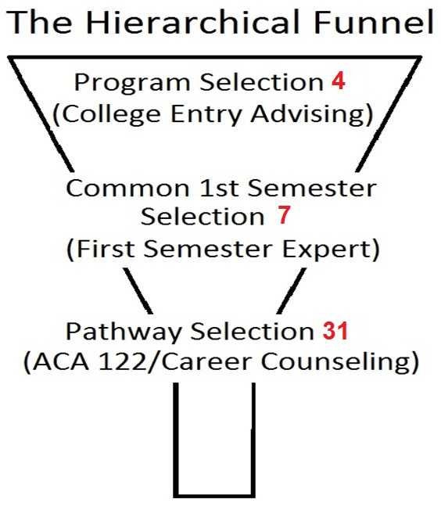
Notes:
Hierarchical choice approach (Jenkins & Cho, 2014)
Avoid starting with overwhelming number of options
Students start with broad choices early
Choices progressively narrow to a specific structured curriculum
Each choice is supported by advisors and counselors
Intentional, informed decisions

Slide 10
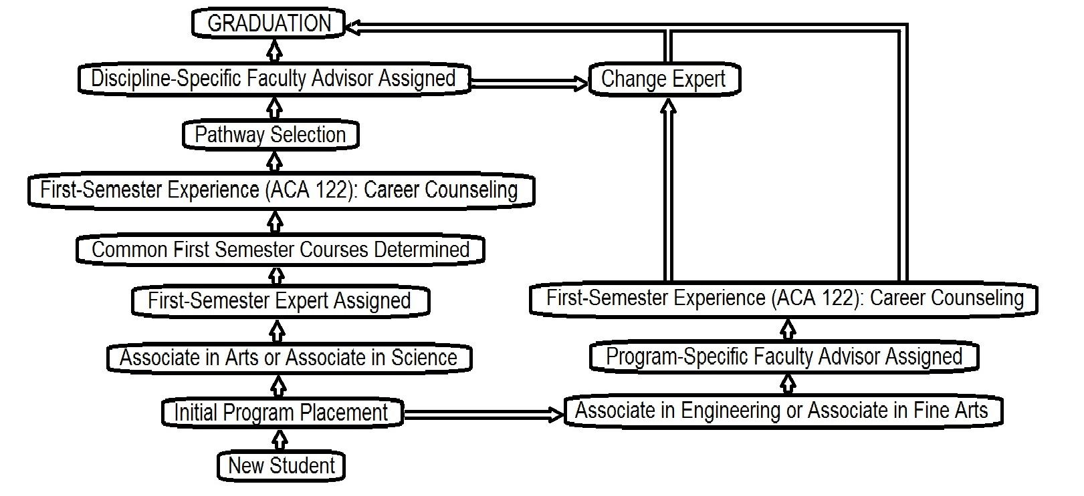
Notes:
Steve

Slide 11
Initial Program Placement
College Entry Advisors
Assist with various aspects of enrollment process
Advise about best program to match career goals
Determine students’ transfer intentions
Refer to Career Services as necessary
Connect students to academic advisors
Notes:
Steve

Slide 12
First Semester Expert
Meets with student to discuss goals
Determines discipline area
Determines one of the 7 entry points for student
Notes:
Steve

Slide 13
Common First Semesters
Science Mathematics Business | English Philosophy Education Foreign Language | Communication Psychology Sociology | History Political Science | Creative Arts | Music | General
ACA 122 | ACA 122 | ACA 122 | ACA 122 | ACA 122 | ACA 122 | ACA 122
ENG 111 | ENG 111 | ENG 111 | ENG 111 | ENG 111 | ENG 111 | ENG 111
MAT 171 or MAT 172 or MAT 152 | MAT 143 | MAT 152 | MAT 152 | MAT 143 | MAT 143 | MAT 152
COM 231 | COM 231 | PSY 150 | HIS 111 | PSY 150 | MUS 121 | COM 231
BIO 111 or CHM 151 or ECO 251 or HIS 111 | PSY 150 or SPA 111 or FRE 111 | COM 231 or SOC 210 | ART 111 or ART 114 | ART 121 | MUS 131 | PSY 150
 |  |  |  |  | PSY 150
Notes:
Steve

Slide 14

Importance of ACA 122
Career exploration
Credentials needed to enter into the career
Pathway selection
Notes:
Steve

Slide 15
Pathways – Structured Curricula
Example: Communication Pathway
1st Semester | 2nd Semester | Summer Semester | 3rd Semester | 4th Semester
ACA 122 | ENG 112 | COM 120 | COM 150 | HIS 112
ENG 111 | SOC 210 | SPA/FRE 111 | JOU 216 | BIO 111
MAT 152 | PHI 240 |  | ENG 232 | COM 140
COM 231 | COM 110 |  | SPA/FRE 112 | HUM 220
PSY 150 | HEA 110
Notes:
Beth

Slide 16
Guided Pathways Essential Practices
Structured Curricula (A-B Tech Pathways)
Pathway Choice
Staying on the Path
Ensure learning
Notes:
Steve

Slide 17
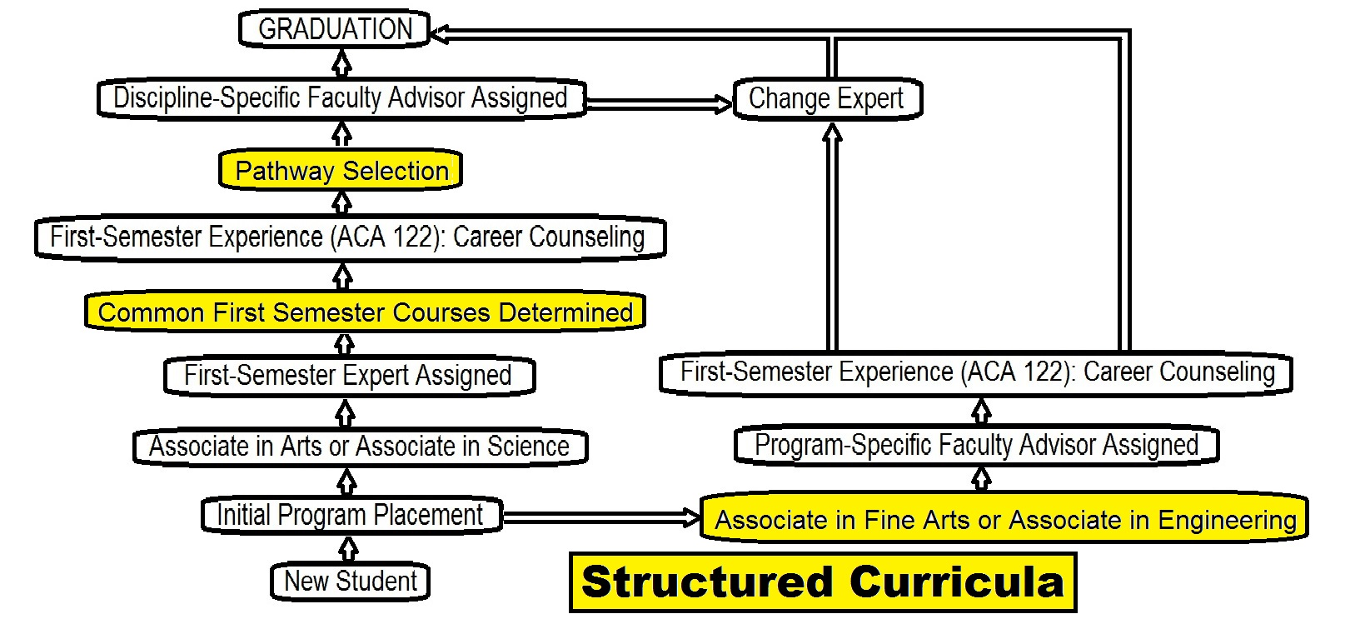
Notes:
Steve

Slide 18
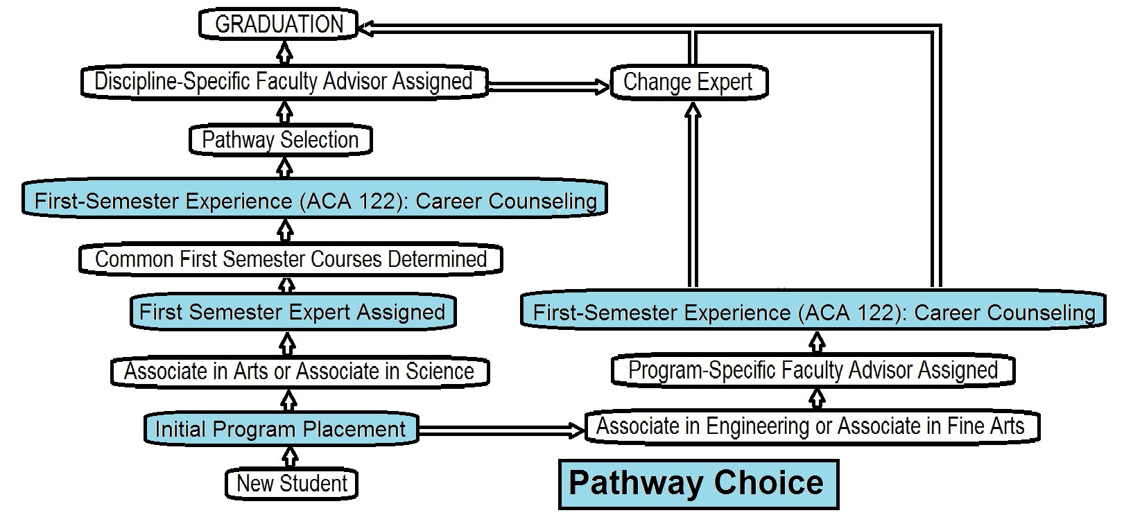
Notes:
Steve

Slide 19
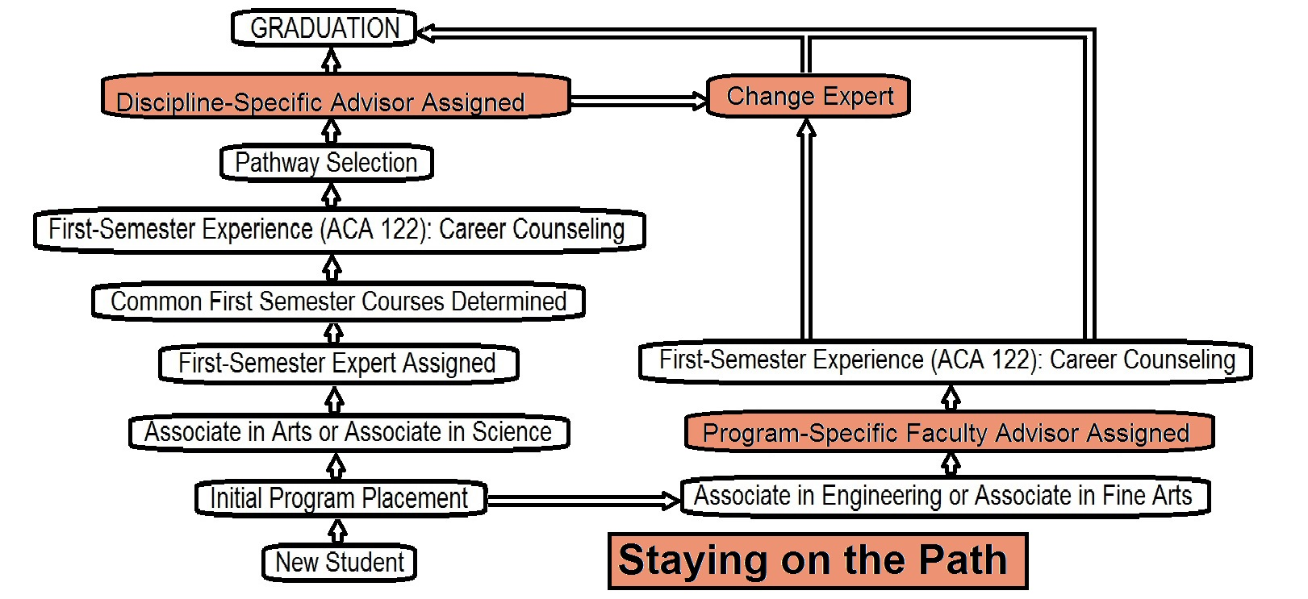
Notes:
Steve

Slide 20
How we developed a Pathway Project
Decided to focus on the AA and AS only
Reduce the number of courses
Create buy-in
Build pathways
Revamp advising
Ask the right questions
Notes:
Beth

Slide 21
Reduce number of courses
Painful
Courses that had not been offered or made in three years or did not fulfill a specific requirement were on the chopping block
Notes:
Beth

Slide 22
2011-2012 Catalog
276 transfer courses
Notes:
Beth

Slide 23
2016-2017 Catalog
139 transfer courses
Notes:
Beth

Slide 24

Create Buy-In
Notes:
Heather

Slide 25
Create Buy-In
Key Stakeholders
  Executive Leadership Team
  Department Chairs
  Faculty
  Student Services
This step initially took approximately three months
Notes:
Heather

Slide 26
Build Structured Curriculum
Guidance
Zero choice
ACA 122, ENG 111, and gateway math in first semester
All students complete in two to three years
Focus on three universities: ASU, UNC-Asheville, & WCU
Notes:
Heather

Slide 27
Build Structured Curriculum
Process
Department chairs reviewed eight semester guides from universities.
Departments then developed full-time and part-time pathways.
Pathways were checked to ensure compliance with the NC Comprehensive Articulation Agreement.
Pathways were published in the catalog and on program sheets.
Notes:
Beth

Slide 28
Build Structured Curriculum
We made metamajors!
Nobody knew what that meant.
We renamed them Common First Semesters
Notes:
Beth

Slide 29
Common First Semesters
Science Mathematics Business | English Philosophy Education Foreign Language | Communication Psychology Sociology | History Political Science | Creative Arts | Music | General
ACA 122 | ACA 122 | ACA 122 | ACA 122 | ACA 122 | ACA 122 | ACA 122
ENG 111 | ENG 111 | ENG 111 | ENG 111 | ENG 111 | ENG 111 | ENG 111
MAT 171 or MAT 172 or MAT 152 | MAT 143 | MAT 152 | MAT 152 | MAT 143 | MAT 143 | MAT 152
COM 231 | COM 231 | PSY 150 | HIS 111 | PSY 150 | MUS 121 | COM 231
BIO 111 or CHM 151 or ECO 251 or HIS 111 | PSY 150 or SPA 111 or FRE 111 | COM 231 or SOC 210 | ART 111 or ART 114 | ART 121 | MUS 131 | PSY 150
 |  |  |  |  | PSY 150

Slide 30
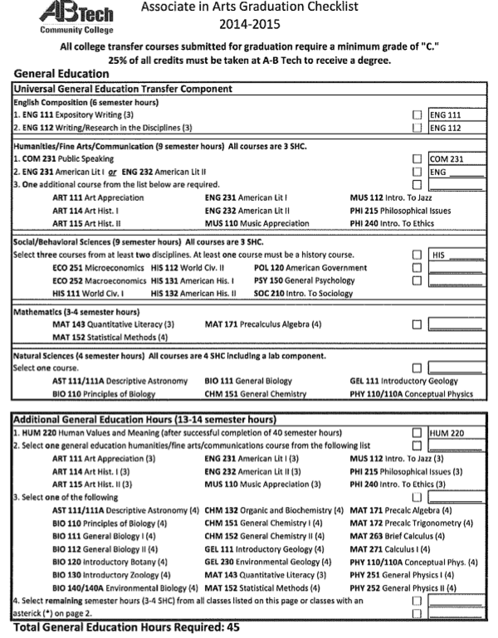
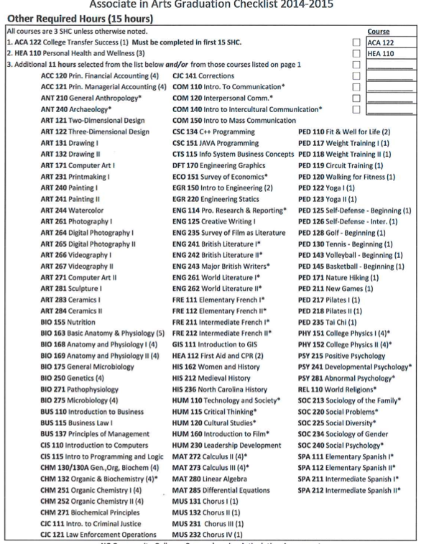
Notes:
Beth

Slide 31
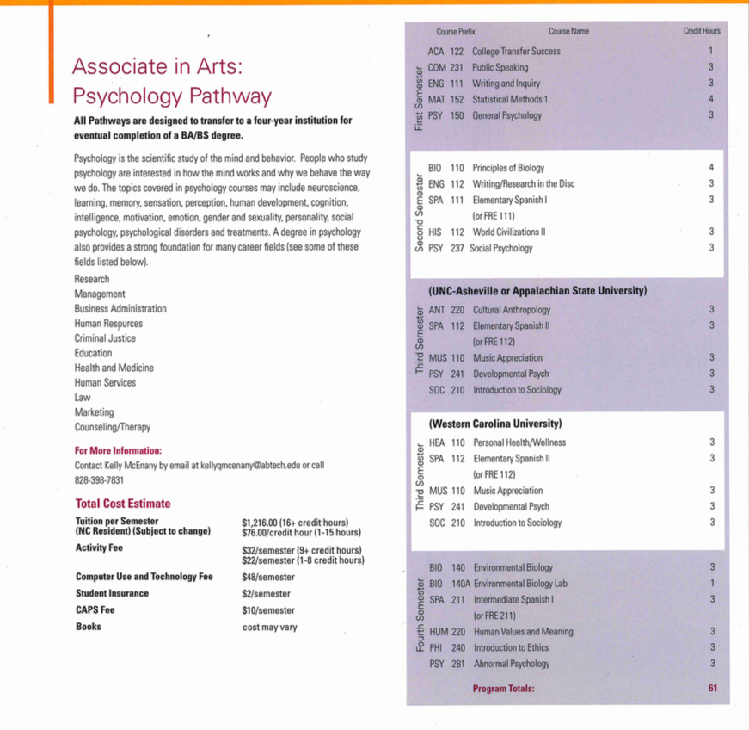
Notes:
Beth

Slide 32
Revamp Advising
Notes:
Steve

Slide 33
Ask the right questions
What is a meta major?
What universities are your students going to?
What are your students majoring in?
What requirements do universities have in common for those majors?
How do we know this is working early on?
Were do we find our data?
Do we have data?
Do we pilot or do we implement at scale?
If it is working how quickly do we move from a pilot to scale?
Notes:
Beth

Slide 34
Challenges: Getting Students in Pathways
Semester | Fall 2016 | Spring 2017 | Summer 2017 | Fall 2017 | Spring 2018
% Students in a Pathway | 34% | 42% | 46% | 50% | 51%
Notes:
Steve

Slide 35
Challenges
Universities requiring more than 60 hours in transfer plans
Enrollment in ACA 122
Pathway/Program mismatch
Limit to education plan
Notes:
Steve

Slide 36
Successes
Cost
First Semester Experts
Process for adding pathways
Model for other colleges
Data
Notes:
Beth - cost
Heather - First Semester Experts
Beth - model
Beth - Data

Slide 37
Successes: Gateway courses predict completion
(Jenkins & Bailey, 2017).
Notes:
Beth

Slide 38
Successes:
ENG 111 Enrollment & Completion
1st Semester | Enrolled | % Enrolled | Completion | % Completion
In Pathway | 235 | 74.1% | 186 | 58.7%
Not in Pathway | 80 | 13.4% | 53 | 8.8%
2nd Semester (cum.) | Enrolled | % Enrolled | Completion | % Completion
In Pathway | 289 | 91.1% | 216 | 68.1%
Not in Pathway | 99 | 16.5% | 81 | 13.5%
First-Time Students in Fall 2016 and Spring 2017; n = 916
Notes:
Beth

Slide 39
Successes:
Math Enrollment & Completion
1st Semester | Enrolled | % Enrolled | Completion | % Completion
In Pathway | 155 | 48.9% | 71 | 22.4%
Not in Pathway | 48 | 8.0% | 27 | 4.5%
2nd Semester (cum.) | Enrolled | % Enrolled | Completion | % Completion
In Pathway | 227 | 71.6% | 103 | 32.5%
Not in Pathway | 71 | 11.9% | 41 | 6.8%
First-Time Students in Fall 2016 and Spring 2017; n = 916
Notes:
Beth

Slide 40
Successes: Credit Accumulation
2016 Fall Not in Pathway (n=402)
2016 Fall In Pathway (n=242)
Credits | After 1 Semester |  | After 2 Semesters |  | After 3 Semesters
0-14 | 363 | 90.3% | 356 | 88.6% | 345 | 85.8%
15-28 | 38 | 9.5% | 42 | 10.5% | 53 | 13.2%
30-44 | 1 | 0.3% | 3 | 0.8% | 3 | 0.8%
45-62 | 0 | 0% | 1 | 0.3% | 3 | 0.3%
63+ | 0 | 0% | 0 | 0% | 0 | 0%
Credits | After 1 Semester |  | After 2 Semesters |  | After 3 Semesters
0-14 | 98 | 24.4% | 93 | 23.1% | 87 | 21.6%
15-29 | 112 | 27.9% | 102 | 25.4% | 87 | 21.6%
30-44 | 32 | 8.0% | 44 | 11.0% | 60 | 14.9%
45-62 | 0 | 0% | 3 | 0.8% | 8 | 2.0%
63+ | 0 | 0% | 0 | 0% | 0 | 0%
Notes:
Beth

Slide 41
Next Steps
Ask more questions
Do a better job of sharing data
Target specific AAS programs
Notes:
Beth

Slide 42
Best Practices
Flexibility
Pathway Committee for Sustainability
Develop Advisor Training
Partnerships with 3 Regional Universities
Identify Passionate Early Adopters
Notes:
Heather

Slide 43

Questions?
Notes:
Whistle pig visual taken from https://animalsake.com/facts-about-groundhogs

Slide 44
Contact Information
Dr. Beth Stewart
Vice President of Instructional Services, Asheville-Buncombe Technical Community College, (828)398-7633, bethstewart@abtech.edu
Dr. Steve Heulett
Coordinator of Transfer Advising Center, Asheville-Buncombe Technical Community College, (828)398-7184, steventheulett@abtech.edu
Heather Vaughn
Chair of English Department, Asheville-Buncombe Technical Community College, (828)398-7315, heatherkvaughn@abtech.edu

Slide 45
References
Dhar, R. (1997). Consumer preference for a no-choice option. Journal of consumer research, 24(2), 215-231.
Jenkins, P. D., & Bailey, T. R. (2017). Early Momentum Metrics: Why They Matter for College Improvement.
Jenkins, D., & Cho, S. W. (2014). Get with the program… and finish it: Building guided pathways to accelerate student completion. Community College Research Center, CCRC Working Paper #66.
Keller, P. A., Harlam, B., Loewenstein, G., & Volpp, K. G. (2011). Enhanced active choice: A new method to motivate behavior change. Journal of Consumer psychology, 21(4), 376-383.
Luce, M. F. (1998). Choosing to avoid: Coping with negatively emotion-laden consumer decisions. Journal of consumer research, 24(4), 409-433.
Tversky, A., & Shafir, E. (1992). Choice under conflict: The dynamics of deferred decision. Psychological science, 3(6), 358-361.

