Slide 1





NC GPS Network
NIC Facilitators Institute
May 15-16, 2018
The NC Student Success Center
Serving 58 Community Colleges
http://www.nccommunitycolleges.edu/student-services/nc-student-success-center

Slide 2
We’re glad you’re here.
Your participation matters.
On a notecard, write a response to the following:
Side A)
1 thing you’d like to learn about the NC
GPS or the NIC
Side B)
1 thing you’d like to share about your work related to student success
We will collect the cards for later sharing.

Slide 3
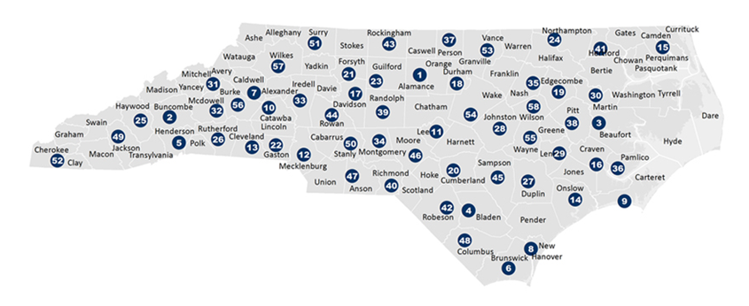

Introduce yourself & your college
Welcome to the NIC Institute!
Your name
Your college
Your position/role
Your college info/poster
Notes:
We’ll make sure folks get to meet others in the room later in the day. With this many participants, it would take about an hour for these introductions for the full group.

Slide 4

Goals of the NIC Institute
NIC Facilitators will collaborate to understand. . .
NC GPS project goals, timeline, activities, and outcomes
Characteristics of NCCC students, colleges, and System (data/SWOT)
Rationale for change (national, state, college contexts)
Theories of change: individuals, institutions, systems
NC Guided Pathways to Success framework and practices
Benefits of improvement science & communities of practice (COP)
How to work, learn, and support each other as a team/COP

Slide 5
Fist to five assessment
5
1
2
3
4
Fist – No knowledge of it
One – Heard of it
Two – Somewhat familiar with it
Three – Basic understanding of it
Four – Can explain it
Five – Can teach and/or apply it

Slide 6
Using the fist to five assessment, rate yourself
NC GPS project goals, timeline, activities, and outcomes
Characteristics of NCCC students, colleges, and System (data/SWOT)
Rationale for change (national, state, college contexts)
Theories of change: individuals, institutions, systems
NC Guided Pathways to Success framework and practices
Benefits of improvement science & communities of practice (COP)
How to work, learn, and support each other as a team/COP

Slide 7


[An educator] affects eternity.
He [or she] can never tell where his [or her] influence stops.
Henry Adams

Slide 8
The world is changing.
The world of work is changing.
Our expectations are changing.
Our students are changing.
What’s expected of educators is changing.
What can we do? What should we do?

Slide 9
The need for change
The significant problems we face cannot be solved at the same level of thinking with which we created them.
Albert Einstein

Slide 10

Networked Improvement Communities (NICs)
intentionally designed
social organizations
with a distinct
problem-solving focus

Slide 11

Networked Improvement Communities (NICs)
a colleagueship of expertise building on the hard work and creativity of many

Slide 12
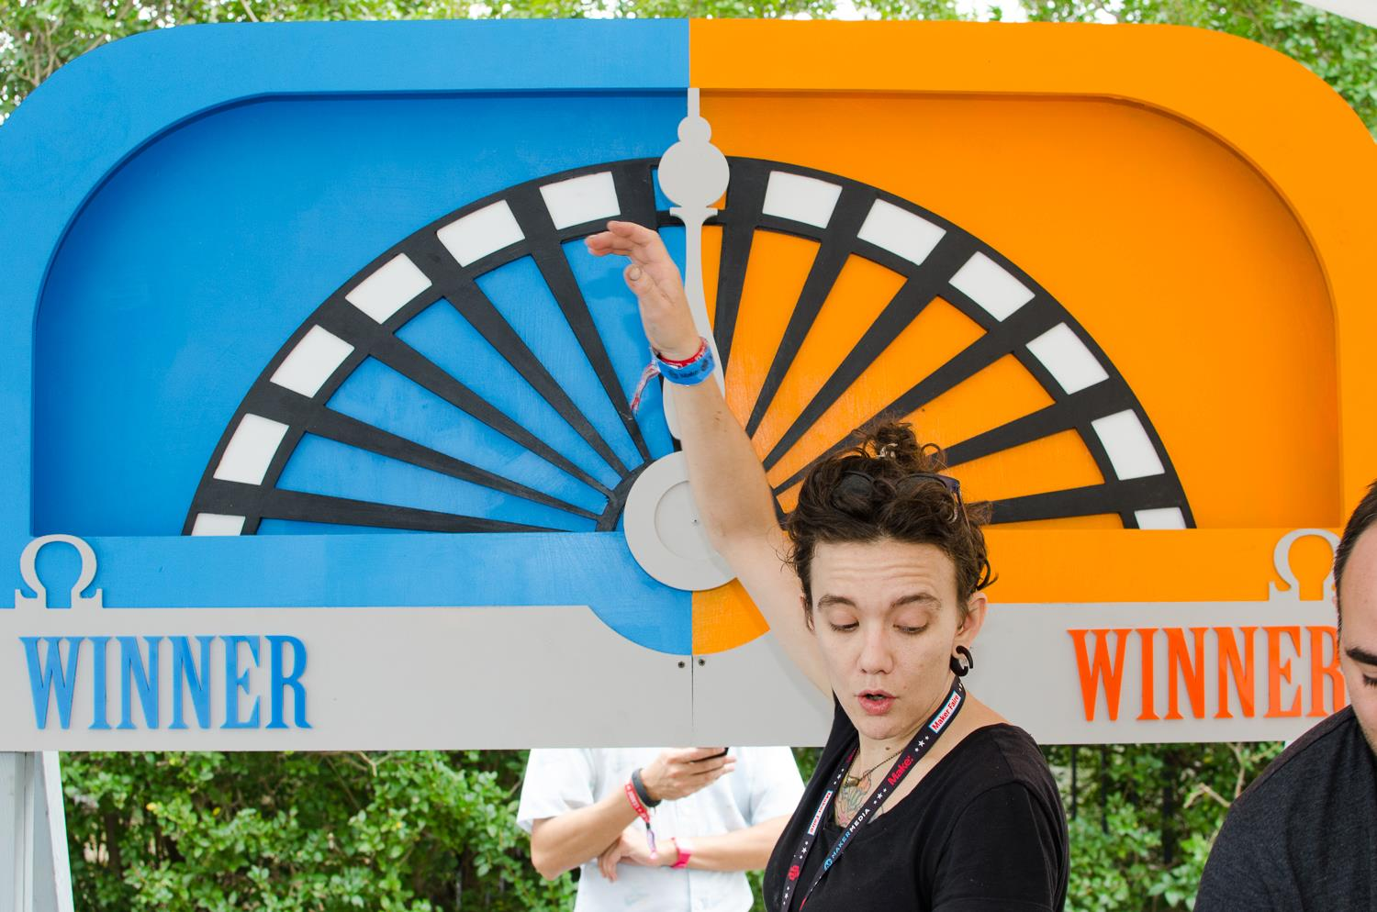
NIC Facilitators are change leaders.

Slide 13
Speaking of learning and change. . .
Review the quotations posted around the room.
Select one that “speaks” to you about learning and change OR create your own quotation.
When prompted, share your ideas with another person. (10 minutes)
“ . . . ”

Slide 14
!
!
!
!
Questions about these topics so far?
Comments or suggestions?
?
?
?
?

Slide 15

Lunch & table topics discussion
A buffet lunch is available in the dining room. Please join others for discussion of table topics handout.
We’ll start the next session at 12:45.

Slide 16


NCCCS mission & purpose
Our values
Our students
Why it matters
Notes:
Bob—We’ll ask folks to introduce themselves with the following slide.

Slide 17

NC Community Colleges: a history of innovation
1957 Community College & Industrial Education Center Acts (SBOE)
1981 State Board of Community Colleges established
1996 Re-engineering & CAA 1.0 (UNC articulation)
2010 SuccessNC Strategic Plan & CAA 2.0
2018 NC Guided Pathways to Success (NC GPS)

Slide 18
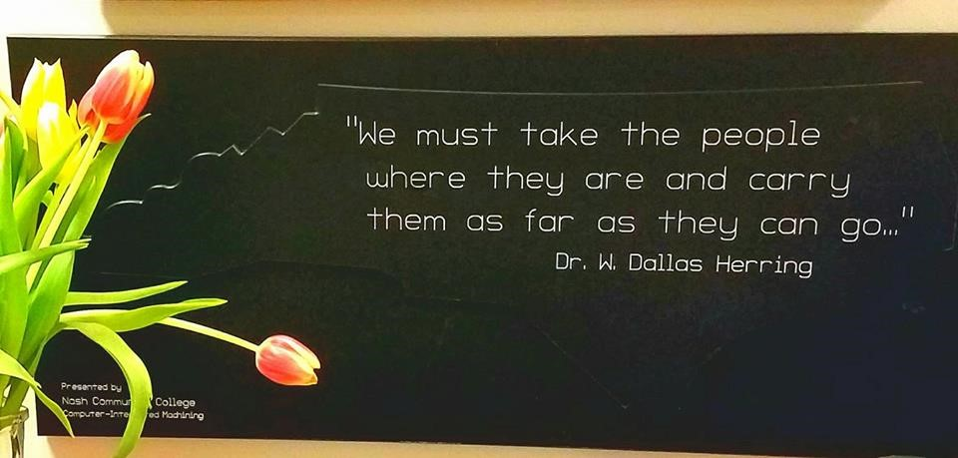
NCCCS Mission & History

Slide 19

NCCCS Mission & History
Think-Pair-Share #1
What did you notice about the film? What are the messages about education?
When directed, share with a partner. [5 minutes]

Slide 20
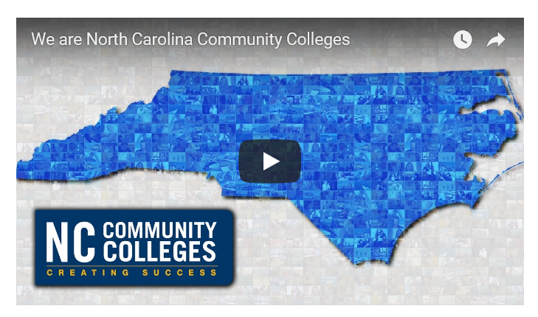
NCCCS Mission

Slide 21

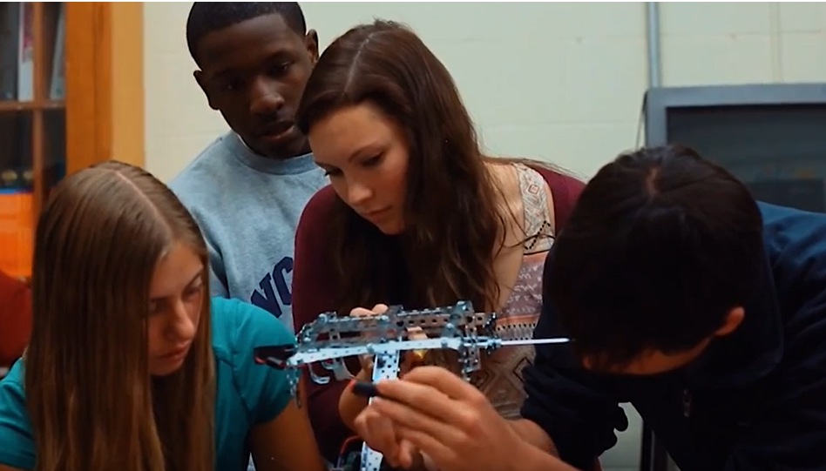
NCCCS Mission & History
Think-Pair-Share #2
What did you notice about the film? What are the messages about education?
When directed, share with a partner. [5 minutes]

Slide 22
Why does student success matter?
?
?
?
?
Let’s take a
student data pop quiz!

Slide 23
The importance of community colleges
The ethical imperative & “democracy’s college”
Equitable access & success for all
Cycles of poverty & economic growth
The American Dream

Slide 24

The value of learning
There is no end to education. It is not that you read a book, pass an examination, and finish with education. The whole of life, from the moment you are born to the moment you die, is a process of learning.
Jiddu Krishnamurti

Slide 25
Students speak:
S
O
T
L
“I love learning.
I don’t know why I hate college.”

Slide 26
Employees speak [paraphrased]
S
O
T
L
“I love learning about my work, but I hate professional development.”

Slide 27
Students speak:
S
O
T
L
“A degree is just a piece of paper I have to get for the job I want.”

Slide 28
Employees speak [paraphrased]
S
O
T
L
“Professional development is just something I have to do for my evaluation.”

Slide 29


15-minute break

Slide 30

Think-Pair-Share #1
What’s an insight about learning and change that you have learned from a student or a colleague?
When directed, share with a partner. [5 minutes]

Slide 31




The student success movement
Multiple forces driving change in higher education
      National priorities for community college leaders
      Higher education initiatives in North Carolina
      National and state workforce and economic imperatives
      Performance funding and accountability measures

Slide 32

Serving 58 Community Colleges
The NC Student Success Center provides support for all 58 colleges to advance, scale, and sustain student success efforts.
We help colleges align policies and practices to ensure access, equity, significant learning, and completion of credentials.
We also represent the collective voice of NCCCS practitioners in state-level and national policy discussions.

Slide 33

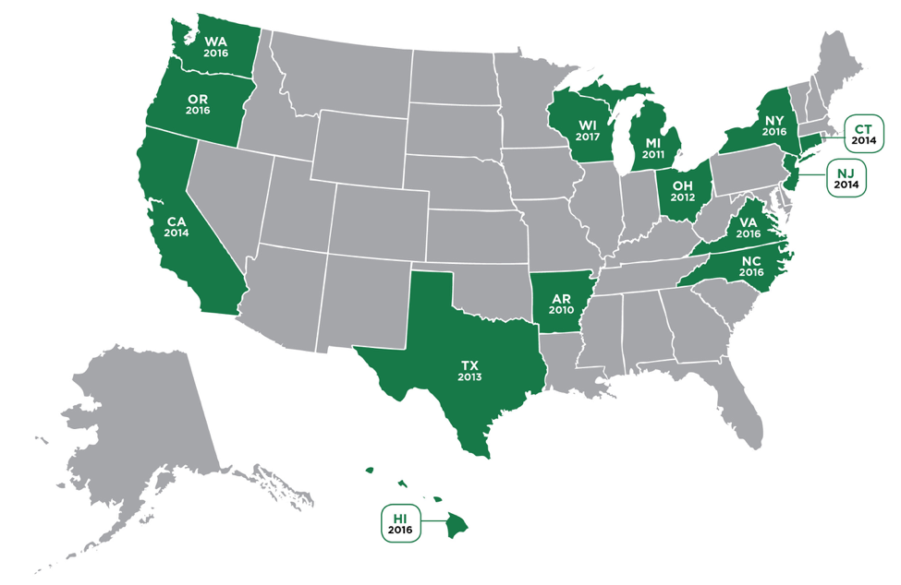

Network of State
Student Success Centers
WI
2018: Welcome, Florida!

Slide 34

NCCCS Definition of Student Success
Student Success Pathway
Students make informed decisions.
Students progress through effective learning pathways that lead to valuable credentials, without unnecessary detours.
Students are provided integrated, targeted supports and interventions when they are most effective.
Dr. Lisa Chapman
NCCCS Executive VP/CAO
Roadmap to completion that includes
connected courses, programs, and support services
Notes:
how teachers can not only improve their expertise in their fields, but also develop their pedagogical expertise
---what does this mean to you??
Any conflicting emotions or thoughts?
Higher Ed today

Slide 35
Serving 58 Community Colleges
The NC Student Success Center provides support for all 58 colleges to advance, scale, and sustain student success efforts.
We help colleges align policies and practices to ensure access, equity, significant learning, and completion of credentials.
We also represent the collective voice of NCCCS practitioners in state-level and national policy discussions.

Slide 36
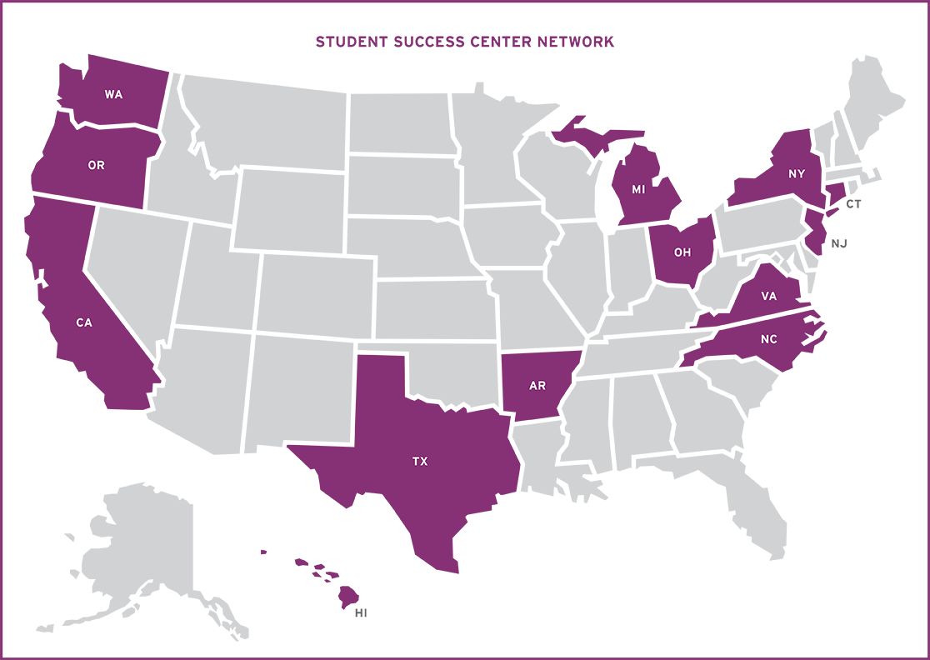
Network of State
Student Success Centers
WI

Slide 37
Understanding our students in context

Slide 38

Let’s debate!
The attitudes and behaviors of instructors can affect student motivation and success.

Slide 39
Why do some students succeed. . .
. . .and others don’t?

Slide 40

Understanding our colleagues in context

Slide 41

Let’s debate!
The attitudes and behaviors of administrators and supervisors can affect employee motivation
and success.

Slide 42

What informs employees’ beliefs about success?
and students’ beliefs about college & success?

Slide 43

Understanding our colleges in context
Changing demographics
“2 North Carolinas”
Policy changes

Slide 44
Understanding the System in context
Public perceptions of our work
Our perceptions of our work
System Strategic Plan

Slide 45


Understanding our effectiveness
Most of the world will make decisions by either guessing or using their gut. They will be either lucky or wrong.
Suhail Doshi

Slide 46
15-minute break

Slide 47
NC Guided Pathways to Success (NC-GPS)*
integrated, institution-wide approach to creating highly structured student experiences that guide them on the pathway to completion
*Based on the AACC Guided Pathways framework

Slide 48

NC-GPS: Essential Practice 1
Clarify paths to student end goals

Slide 49

NC-GPS: Essential Practice 2
Help students choose and enter a pathway

Slide 50

NC-GPS: Essential Practice 3
Help students stay on path

Slide 51
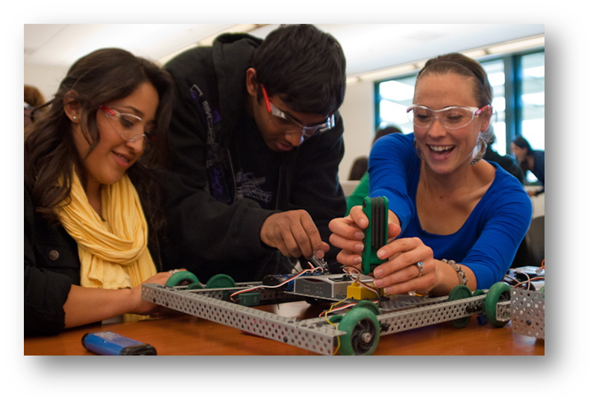
NC-GPS: Essential Practice 4
Ensure that students are learning

Slide 52

NC-GPS works to help the 58 colleges. . .
align policies and practices with the NCCCS mission and our values to ensure
  access,
  equity,
  significant learning, &
  completion of credentials.

Slide 53

Write and rip: Our students’ lives & responsibilities at home & at college
Using your sticky notes,
--with ONE item per page--
describe the lives and experiences of our
students today.

Slide 54

An educator’s role is to guide discovery and to be one with the students in a community of seekers.
Paolo Friere

Slide 55

Leading Change in the NIC

Slide 56

Learning Effectively in Teams

Slide 57
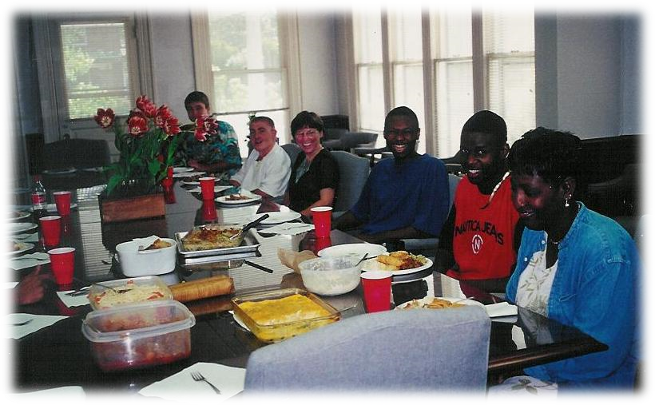
Basic Elements of Cooperative Learning
Positive interdependence
Face-to-face interaction
Individual accountability
Interpersonal skills
Group processing

Slide 58
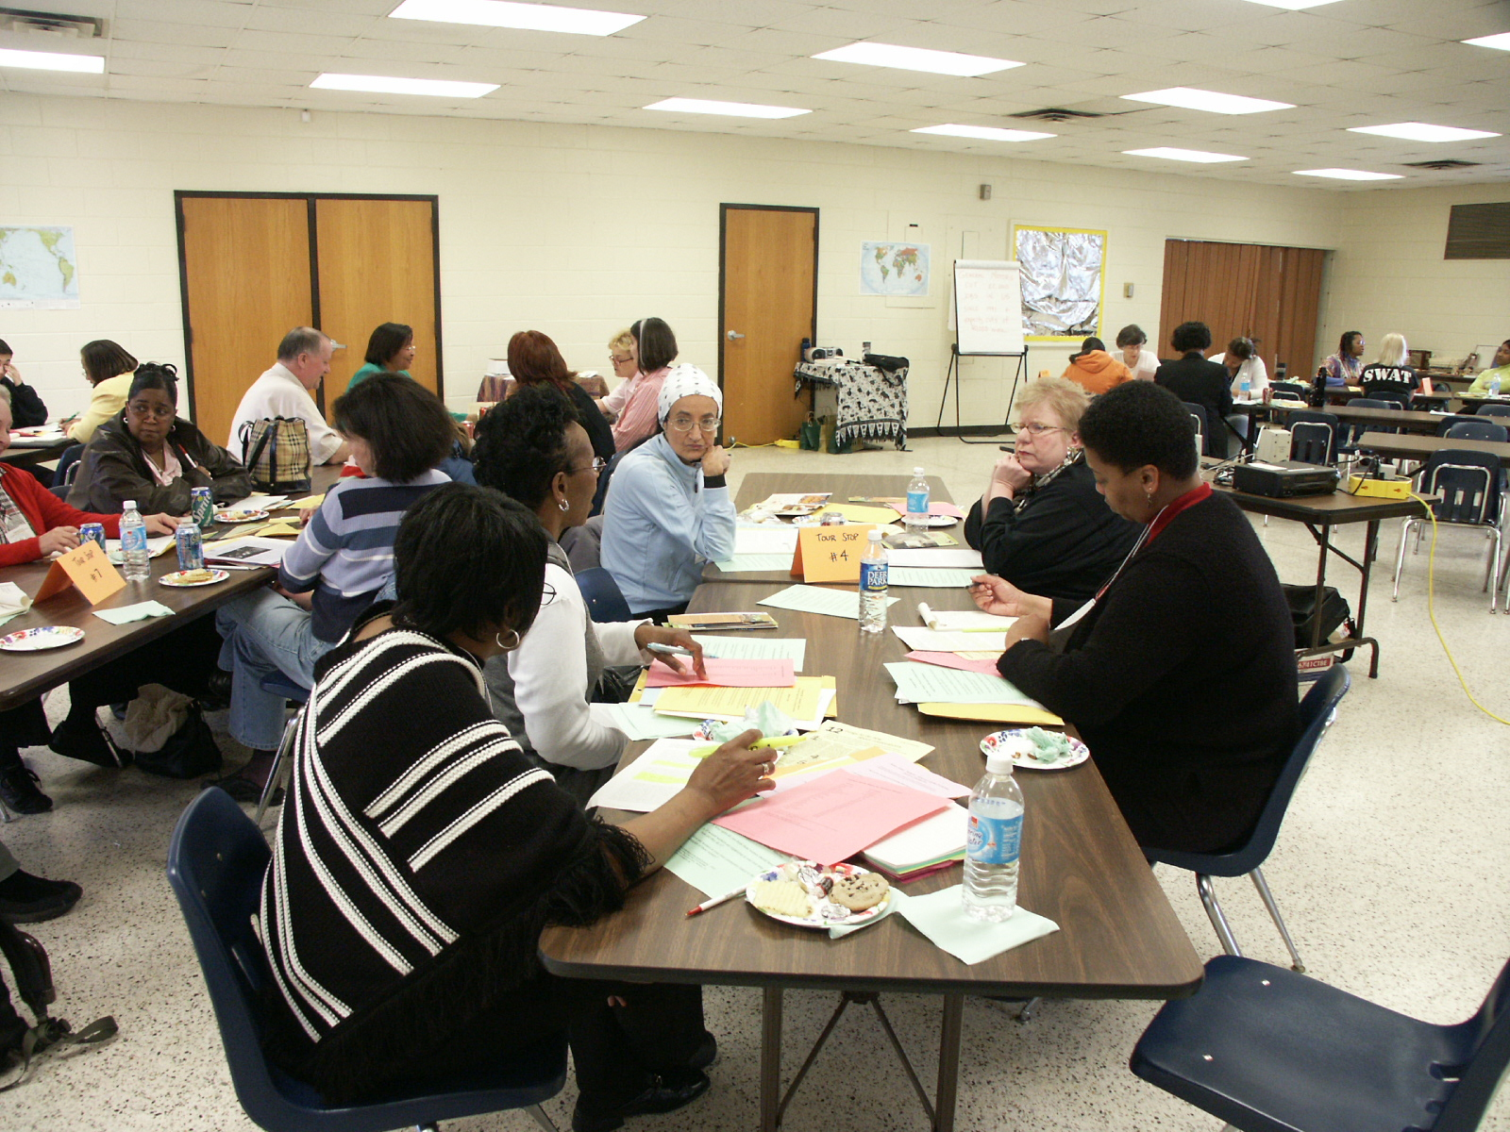
Characteristics of Cooperative Learning
All members active participants in process
Creates a sense of community
Creates greater outcomes for all participants

Slide 59
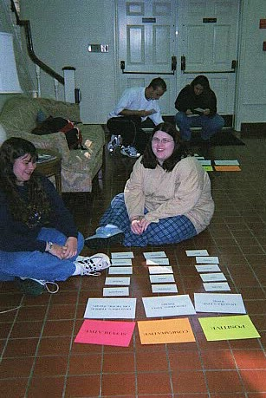
Knowledge co-created, not transferred
Locates knowledge in the community rather than in the individual
Makes working and learning research-related activities

Slide 60
15-minute break

Slide 61
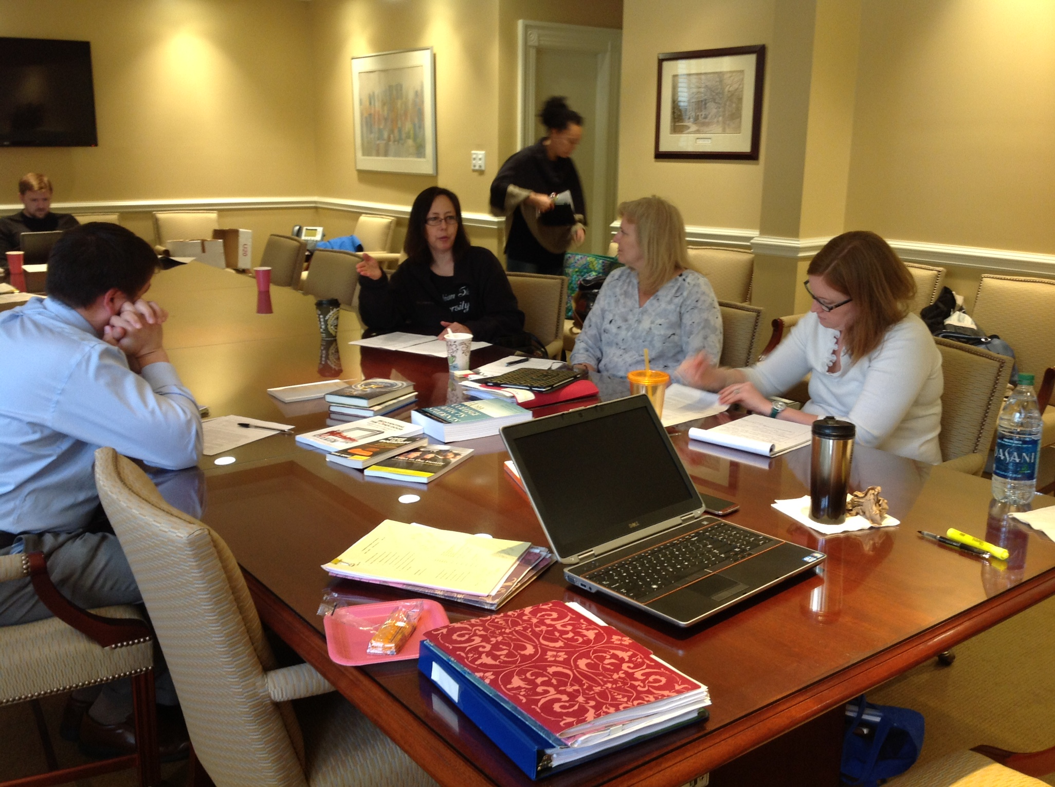
Formal Group Activity
Partner
Reading
Assignment
[20 minutes]

Slide 62
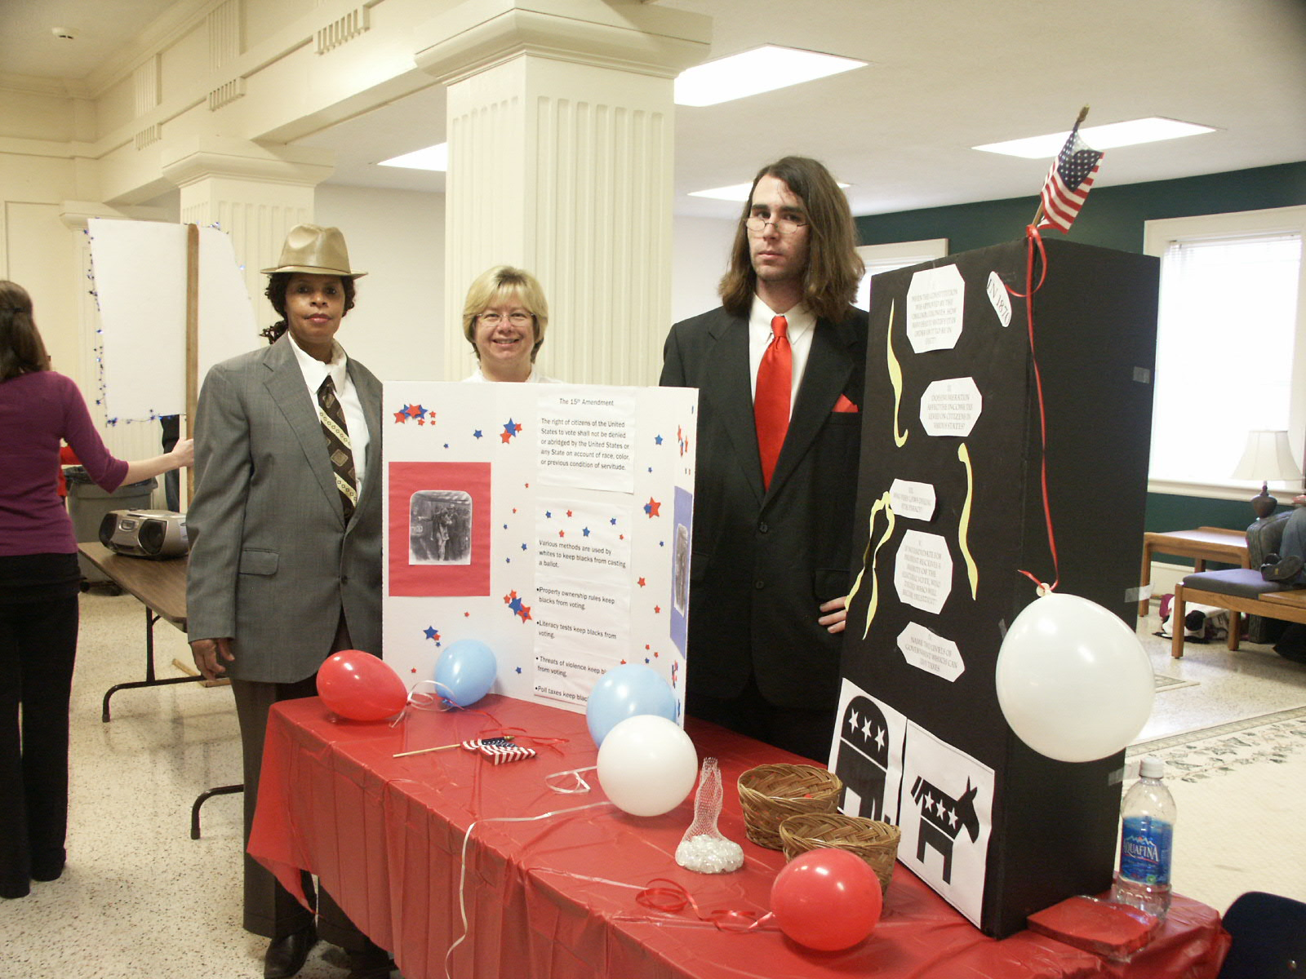
Consider these questions with your group:
Evaluation of
Group Activity
What is one thing that your group did well together?
What is one way you can improve next time?

Slide 63
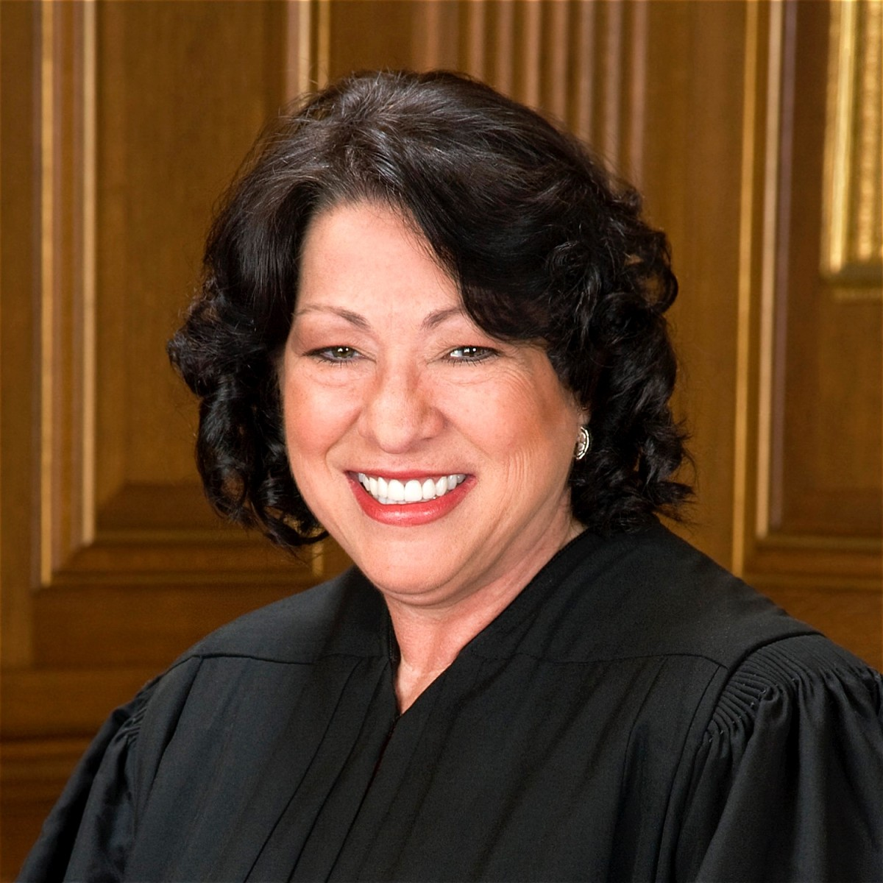
I strive never to forget the real world consequences of my decisions on individuals, businesses and government.
Sonia Sotomayor
Supreme Court Justice

Slide 64

Questions and discussion

Slide 65

Day One Assessment
Please complete the assessment and leave it on the table at the back of the room.

