Slide 1
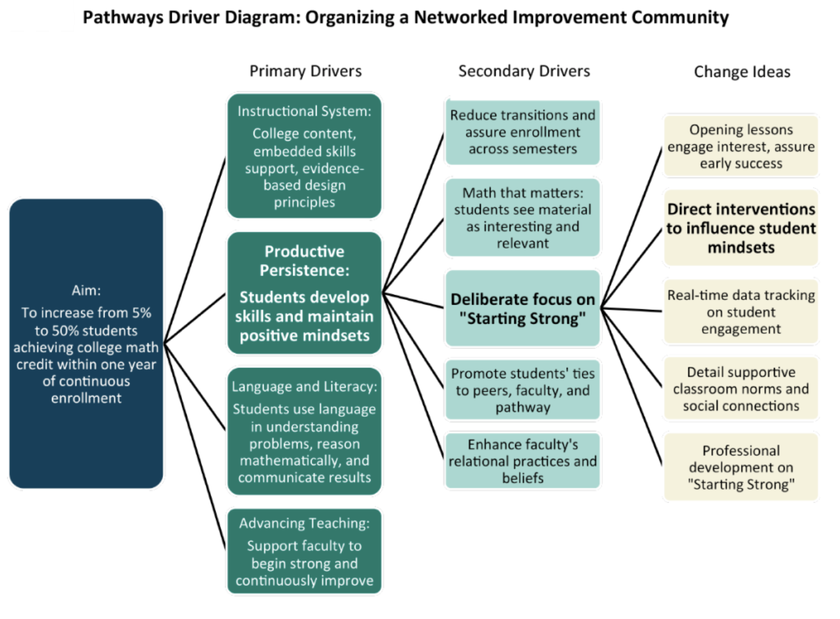
Source: https://www.carnegiefoundation.org/blog/what-living-improvement-really-looks-like/ [Accessed 28 May 2018]

Slide 2
Driver Diagram: A tool to visualize/guide a working theory of practice improvement
1. Identify the improvement aim/goal or target
2. Identify potential primary drivers (factors/possible levers for change/improvement)
3. Identify secondary drivers (subsets of factors/levers for change)
4. Identify possible changes to test before implementation
Primary Drivers
Secondary Drivers
Change Ideas
Aim/Goal

