Slide 1

Identifying Achievement Gaps among North Carolina Community College Students
Presented to the Strategic Planning Committee
of the State Board of Community Colleges
April 19, 2018
John Evans, Associate Director,
NCCCS Student Life
Roxanne Newton, Executive Director,
NC Student Success Center

Slide 2
Key Points
NCCCS Strategic Plan and student success metrics
Achievement gaps among student populations
Data and institutional research capacity across the System
Future directions and action plans

Slide 3
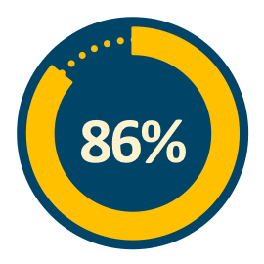
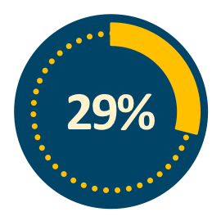
North Carolina
Percentage of adults 25+ that have a high school diploma.
Percentage of adults 25+ that have a bachelor’s degree.
https://www.census.gov/quickfacts/NC

Slide 4
47%
of NC adults have
a certificate, associate’s degree, or more
http://strongernation.luminafoundation.org/report/2018/#nation

Slide 5
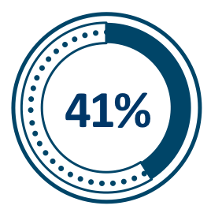
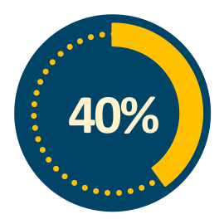
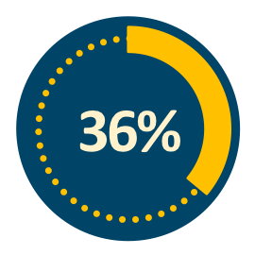
Nationwide Access
12.2 MILLION STUDENTS
  7.2 Million: Credit
  5 Million: Noncredit
All US Undergrads
First Time Freshman
44%
Male
56%
Female
28
Average Age
62%
Part time
38%
Full time
First Generation
AACC Fast Facts 2018

Slide 6
North Carolina Access
710,000 STUDENTS
~1 in 10 North Carolinians
40%
Male
60%
Female
59%
Part time
41%
Full time
28
Average Age

Slide 7
National Completion
A national study of first time college students who enrolled in a community college in the fall of 2010, both part-time and full-time, found that only 39% earned a credential from a 2-year or 4-year institution within six years.
(Shapiro et al., 2017)

Slide 8
42%
Nationwide, 42% of all community college students enroll in at at least one developmental education course.
(Chen & Simone, 2016).

Slide 9

In NC, 1 in 3 recent high school graduates enroll in developmental coursework.
RPM, 2017

Slide 10
Student Interest & Access:
Goal - Increase the percentage of North Carolinians, particularly within underserved populations, pursuing and easily accessing education or training through North Carolina Community Colleges.
1.3
Identify and reduce access barriers for all prospective students, particularly among underserved populations.

Slide 11
Clear & Supported Pathways for
Student Progress & Success:
Goal - Provide a continuum of education, training, advising, and support to help students and workers make informed decisions that lead to credentials and careers.
2.3.
Increase completion of credentials.
2.2.
Provide integrated, targeted support services that promote student success.
2.4.
Reduce achievement gaps for underserved students.

Slide 12

NC Student Success Center Priorities
Priority 1
Assist colleges with implementation of Guided Pathways to Success (NC GPS) practices for improved learning and completion rates

Slide 13

NC Student Success Center Priorities
Priority 2
To establish an equity action plan to address achievement gaps of underserved students (first-generation, low-income, students of color, adult students, English language learners, among others)

Slide 14


NC Student Success Center Priorities
Priority 3
To promote a data-informed culture of continuous inquiry, learning, and improvement
across the System

Slide 15
First Year Progression
Fall 2015 Cohort
Percentage of first‐time students attempting at least 12 hours within their first academic year who successfully complete at least 12 of those hours.
2017 MMSI Data Report

Slide 16
Aggregate First-Year GPA
Fall 2015 Cohort
Cumulative first-year GPA of first‐time students.
2017 MMSI Data Report

Slide 17
First-Year Successful Credit Hour Completion
Fall 2015 Cohort
Percentage of credit hours successfully completed (with an A, B, C or P) during the first academic year (fall, spring, and summer).
2017 MMSI Data Report

Slide 18
Academic Progress Standard
Fall 2015 Cohort
Percentage of students meeting the minimum satisfactory academic progress standards
(a cumulative GPA of 2.0 and 67% rate) during the fall and spring semester of their first academic year.
2017 MMSI Data Report

Slide 19
Success Rate in College‐Level English Courses
Fall 2014 Cohort
Percentage of first‐time Associate Degree seeking and transfer pathway students passing a credit‐bearing English course with a “C” or better within their first two academic years.
2017 MMSI Data Report

Slide 20
Success Rate in College‐Level Math Courses
Fall 2014 Cohort
Percentage of first‐time Associate Degree seeking and transfer pathway students passing a credit‐bearing Math course with a “C” or better within their first two academic years.
2017 MMSI Data Report

Slide 21
Data Capacity Need
System-level data
College data
Program & department data
Course-level & classroom data

Slide 22
How can our system work to ensure that more students learn and complete their goals?

Slide 23
NC GPS Plan Goals
Assist colleges with NC GPS implementation (in cohorts of 15-20)
Benchmarking project: NC GPS Scale of Adoption Self-Assessment
Provide NC GPS technical assistance & professional development
Create networked improvement communities across the NCCCS

Slide 24
“We must take students from where they are and carry them as far as they can go.”
Dr. Dallas Herring

