Slide 1





Appendix IV:
Assistive Technology
Disability Academy Module 15
Notes:
Disability Academy Module 15
Appendix 4 Assistive Technology

Slide 2
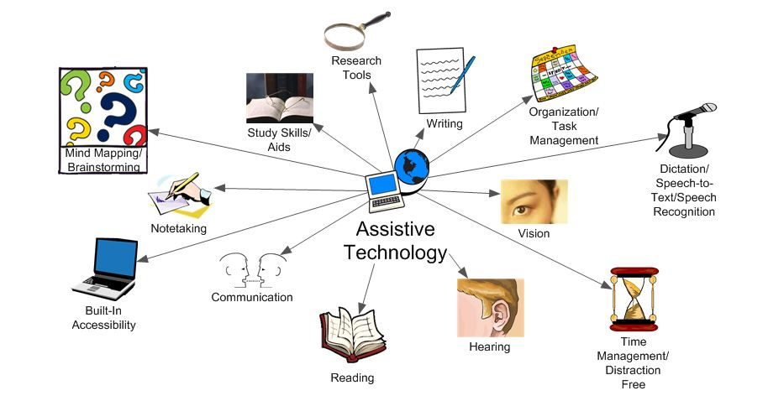
Assistive Technology
Notes:
Assistive technology consists of different categories depending on the level of complexity

Slide 3
What is Assistive Technology?
The Individuals with Disabilities Education Act (IDEA) of 2004 states: An assistive technology device is defined as "any item, piece of equipment, or product system, whether acquired commercially off the shelf, modified, or customized, that is used to increase, maintain, or improve functional capabilities of a child with a disability.”*
*https://ectacenter.org/topics/atech/definitions.asp
Notes:
First, what is assistive technology
The Individuals with Disabilities Education Act (IDEA) of 2004 states: An assistive technology device is defined as “any item, piece of equipment, or product system, whether acquired commercially off the shelf, modified, or customized, that is used to increase, maintain, or improve functional capabilities of a child with a disability
The resource link is from Early Childhood Technical Assistance Center

Slide 4
Assistive Technology Definitions
Accessible information technology – Technology that can be used by people with a wide range of abilities and disabilities. It incorporates the principles of universal design, whereby each user is able to interact with the technology in ways that work best for him or her.
Adaptive technology – Name for products which help people who cannot use regular versions of products, primarily people with physical disabilities such as limitations to vision, hearing, and mobility.
Assistive technology (AT) – Any item, piece of equipment, or product system that is used to increase, maintain, or improve functional capabilities of individuals with disabilities. Examples include message boards, screen readers, refreshable Braille displays, keyboard and mouse modifications, and head pointers.
ADA glossary
https://adata.org/glossary-terms
Notes:
The following are definitions from the ADA National Network.
Accessible information technology – Technology that can be used by people with a wide range of abilities and disabilities. It incorporates the principles of universal design, whereby each user is able to interact with the technology in ways that work best for him or her.
Adaptive technology – Name for products which help people who cannot use regular versions of products, primarily people with physical disabilities such as limitations to vision, hearing, and mobility.
Assistive technology (short AT) – Any item, piece of equipment, or product system that is used to increase, maintain, or improve functional capabilities of individuals with disabilities. Examples include message boards, screen readers, refreshable Braille displays, keyboard and mouse modifications, and head pointers.

Slide 5
Types of Assistive Technology
There are 3 basic types of Assistive Technology:
Low/No
Mid
High
Notes:
There are three types of assistive technology
Low or no tech
Mid tech
And high tech

Slide 6


No Tech and Low Tech
Low Tech Assistive Technology is the most common form of assistive technology. These devices or equipment are usually simple, don’t plug in, are less expensive, and do not have complex or mechanical features. They are commonly easily found in the user’s familiar living or work space.
Notes:
No or low tech assistive technology is the most common form of assistive technology. These devices or equipment are usually simple, don’t plug in, are less expensive, and do not have complex or mechanical features. They are commonly easily found in the user’s familiar living or work space.

Slide 7
Examples of No Tech or Low Tech
Graphic organizer
Visual schedules
Adapted pencil (weighted, fat, skinny, triangular, golf etc.)
Adaptive paper (graph, special spacing or texture, HWT etc.)
Pencil grip
Adapted eraser
Slant board
Sticky notes (Post-it, etc.)
Highlighter
Squishy ball or sensory input (fidgets)
Tactile ruler
Velcro
Page protector or colored transparency
Binder clip (for grip for turning pages)
Jumbo anything (text, materials, paper, etc.)
Manipulatives
Notes:
Examples of no tech or low tech include
Graphic organizer
Visual schedules
Adapted pencil (weighted, fat, skinny, triangular, golf etc.)
Adaptive paper (graph, special spacing or texture)
Pencil grip
Adapted eraser
Slant board
Sticky notes
Highlighter
Squishy ball or sensory input
Tactile ruler
Velcro
Page protector or colored transparency
Binder clip
Jumbo anything
Manipulatives

Slide 8
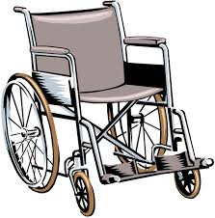
Mid Tech Assistive Technology
Mid Tech Assistive Technology is not as complex or expensive as the high tech solutions. Although some training may be required, Mid Tech AT includes simple battery-powered items without computerized parts.
Notes:
Mid Tech Assistive Technology is not as complex or expensive as the high tech solutions. Although some training may be required, Mid Tech AT includes simple battery-powered items without computerized parts.

Slide 9
Examples of Mid Tech
Electrical device
Screen magnifier
Audio book
Adapted cd player/music player
Voice amplification
Scooter
Gait trainer
Wheelchair
Braille translation software
Switch adapted games or toys
Closed Caption Televisions (CCTV)
Adapted seating (bouncy ball, chairs with seat belts)
Adapted keyboard or mouse
Calculator
Electronic speller or dictionary
Word prediction software
Notes:
Examples of mid tech include
Electrical device
Screen magnifier
Audio book
Adapted cd player or music player
Voice amplification
Scooter
Gait trainer
Wheelchair
Braille translation software
Switch adapted games or toys
Closed Caption Televisions
Adapted seating
Adapted keyboard or mouse
Calculator
Electronic speller or dictionary
And Word prediction software

Slide 10
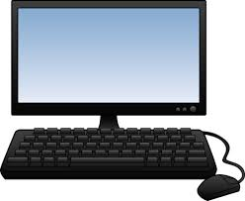
High Tech Assistive Technology
High Tech AT refers to the most complex devices or equipment. They may have digital or electronic components, may be computerized, will likely require training, and may be more expensive.
Notes:
High Tech AT refers to the most complex devices or equipment. They may have digital or electronic components, may be computerized, will likely require training, and may be more expensive.

Slide 11
Examples of High Tech Assistive Technology
Computer
Electronic tablet (iPad, iPod, Kindle, Samsung tablet etc.)
Power wheelchair and scooter
Portable word processor
Digital hearing aids
Computers with specialized software such as voice recognition or magnification software
Electronic aids to daily living
Voice activated telephones
Smart pens such as Livescribe
Digital hands-free headset
Smart board
Alerting device
Augmentative and alternative communication (AAC) device
Communication devices with voices
Bluetooth integration
DigiDrive technology (operating a vehicle with a joystick)
Text to speech and speech to text software
Notes:
Examples of high tech assistive technology include
Computer
Electronic tablet Power wheelchair and scooter
Portable word processor
Digital hearing aids
Computers with specialized software such as voice recognition or magnification software
Electronic aids to daily living
Voice activated telephones
Smart pens such as a Livescribe
Digital hands-free headset
Smart board
Alerting device
Augmentative and alternative communication device
Communication devices with voices
Bluetooth integration
DigiDrive technology
Text to speech and speech to text software

Slide 12
Technology Assessments
Notes:
Technology assessments

Slide 13
What is an assistive technology assessment?
An interactive meeting designed to determine what technology best suits the student’s needs
Ideally not a one time occurrence, but continuing follow-up
Considers the student’s abilities, the environment, the task, and the needed tools
Notes:
Each college may have different ways of assessing student needs. Most assistive technology assessments consist of an interactive meeting designed to determine what technology best suits the students needs
At Wilkes Community College, we meet with the student and go over the above requirements for example, a student’s reading comprehension may qualify for Read and Write, a program that reads tests aloud to the student
Ideally this interactive meeting is not a one time occurrence, as meetings need to take place to see how the student is doing on the new assistive technology they are provided.
During the assessment the student’s abilities, the environment, the task, and the needed tools need to be considered
If students qualify for equipment are not on hand, referrals can be made to agencies such as the NCATP (North Carolina Assistive Technology Program).

Slide 14
North Carolina Assistive Technology Program
Program is to promote independence for people with disabilities through technology
Federally and State funded program
Services are statewide
Available to all ages and abilities
Services include:
  Device demonstrations
  Short-term device loans
  Reutilization of assistive technology
North Carolina Assistive Technology Program
VR assistive Tech
https://www.ncdhhs.gov/divisions/vocational-rehabilitation-services/north-carolina-assistive-technology-program
Notes:
The North Carolina Assistive Technology Program is a program that promotes independence for people with disabilities through technology
The NCATP is a federally and state funded program
They provide Services that are statewide and are available to all ages and abilities
Services include:
Device demonstrations
Short-term device loans
Reutilization of assistive technology
A reference link is provided to the NCATP website

Slide 15
Module 15 Assistive Technology
Created by April Teague and Renee Macemore
Notes:
This concludes module 15 on assistive technology

