Slide 1

Serving persons with hearing loss

Slide 2
Classification of Hearing Loss
Degree of hearing loss | Hearing loss range (dB HL)
Normal | –10 to 15
Slight | 16 to 25
Mild | 26 to 40
Moderate | 41 to 55
Moderately severe | 56 to 70
Severe | 71 to 90
Profound | 91+
Source: Clark, J. G. (1981). Uses and abuses of hearing loss classification. Asha, 23, 493–500.

Slide 3
How can hearing loss be described?
High-frequency versus low-frequency. A person hears either high-pitched or low-pitched sounds better.
Bilateral versus unilateral. Bilateral means hearing loss in both ears. Unilateral means hearing loss in one ear.
Symmetrical versus asymmetrical. Symmetrical means the severity and shape of hearing loss are the same in each ear. Asymmetrical means each ear has a different severity and shape.
Progressive versus sudden hearing loss. Progressive means that hearing loss becomes worse over time. Sudden means hearing loss that happens quickly. Student might not necessarily know that hearing loss has occurred.
Fluctuating versus stable hearing loss. Fluctuating means hearing loss that changes over time. It sometimes gets better, sometimes gets worse. Stable means that your hearing loss has stayed the same.
For more Information go to (https://www.asha.org/public/hearing/Configuration-of-Hearing-Loss/) (Opens in new window)

Slide 4
How does the type of hearing loss affect accommodations and instruction?
Accommodations need to address the configuration of the hearing loss.
Not every student with a hearing loss uses sign language.
Preferential seating can improve access for students that are hard of hearing and for those using a sign language interpreter.
Not all students with hearing loss know sign language. Some students need alternate formats of instruction such as written instructions. However, a person using ASL needs to have the instructions interpreted into their primary visual language
Always provide written instruction and scripts to students with a hearing loss.
Yelling does not work!!!!! It is embarrassing to the student

Slide 5
Sign Language
American Sign Language (ASL)
A visually understood language most commonly used in the US
Has its own unique grammatical and linguistic features
Visually rich – includes facial expressions and gestures
Considered native language for a ‘Child of Deaf Adults’ (CODA)
Manually Coded English (MCE)
Uses a sign for each spoken word in the English Language
Lacks conceptual accuracy – lacks meaning

Slide 6
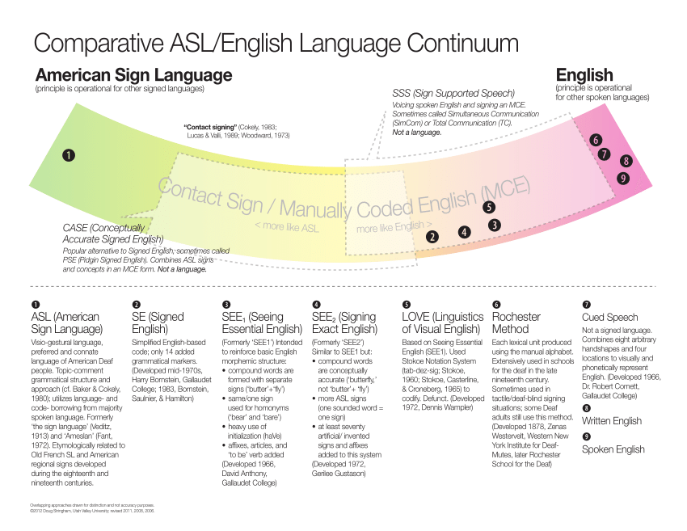
Sign Language Continuum
Most Interpreters will thrive to interpreted to the middle of the spectrum

Slide 7
Professional Interpreting
Education Interpretation
Community Interpretation
K-12 setting or post-secondary setting
Must have Educational Interpreter Proficiency Assessment (EIPA) Score of 3.0 (pertains to NC)
For more information go to classroom interpreting.org (opens in new window)
Interpreting in Vocational, medical, governmental, stage, and judicial settings
Grandfather License – enacted 15 years ago for existing interpreters
Provisional License – if the Interpreter Training Programs (ITP’s) have been passed
Full Licensure requires a NIC test, offered by the Registry of Interpreters for the Deaf.
For more Information go to https://rid.org/ and https://ncitlb.org/

Slide 8
Tips for the Educator who wants to communicate with the Deaf student in their classroom
Attend Continuing Education Classes
Ask your student to teach you one sign every day
Include the interpreter in your classroom planning. Ask for advice on how to make activities more accessible.
Your effort will positively affect classroom engagement and learning!
Information for this presentation was in part provided by
Josee' A. Hupp-Croteau,
RID-NIC, CI & CT; Ed:K-12
Owner, Certified ASL/Eng Interpreter

