Slide 1
Students with Intellectual Disabilities (ID)
Trudie Hughes, Ph.D.

Slide 2
Discussion Question
Why do advocacy groups want the newer label of “intellectual and developmental disability” instead of mental retardation?
What purpose does the new label serve?
What was wrong with the old label?

Slide 3
Person First Language
“People with disabilities are people, first!” Kathie Snow
A person should not be defined by their disability label.
Old, inaccurate descriptors and the inappropriate use of medical diagnoses perpetuate negative stereotypes…” Kathy Snow
“Disability is a natural part of the human experience…” U.S. Developmental Disabilities/Bill of Rights Act

Slide 4
Examples of Person First Language
Say:
Paul has a cognitive disability
Sara has a learning disability
Bob has a physical disability
Tom has a mental health condition
Children without disabilities
Ryan receives special ed services
Accessible parking
Kathie Snow, www.disabilityisnatural.com
Instead of:
The handicapped or disabled
That LD kid
He’s a quadriplegic/is crippled
He’s emotionally disturbed/mentally ill.
Normal/healthy/typical kids
He’s in special ed; is a sped student/inclusion student
Handicapped parking

Slide 5
Intellectual Disability
Significantly sub-average general intellectual functioning, existing concurrently with deficits in adaptive behavior and manifested during the developmental period, that adversely affects a child’s educational performance.
Is not an inherent trait of any individual, but instead is characterized by a combination of deficits in both cognitive functioning and adaptive behavior.
The severity is determined by the discrepancy between the individual’s capabilities and the expectations of the social environment.
Notes:
While the term mental retardation is still widely used within education and is noted in the federal law as a disability category, many advocacy groups feel that this label has too many negative connotations. The newer label of intellectual disability is becoming far more accepted and prevalent within the field due to its far less pejorative nature.

Slide 6
Intellectual Quotient (IQ)
Intellectual functioning is measured using a combination of intelligence (IQ tests) and achievement assessments.
For years, professionals have sub-divided individuals with intellectual disability by IQ into the following groups:
Mild: 70-55
Moderate: 55-40
Severe: 40-25
Profound: <25
Average intelligence is a standard score of 85-115

Slide 7
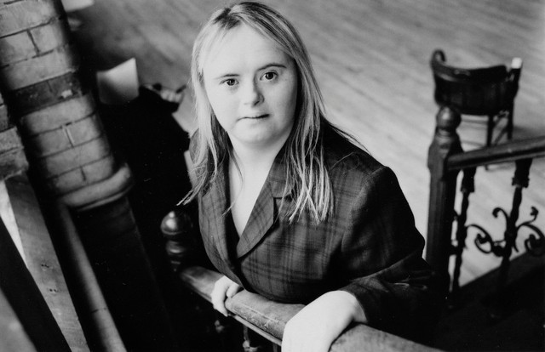
Down Syndrome
Trisomy 21 – the 21st set of chromosomes is a triplet rather than a pair. Normal human cell contains 23 pairs of chromosomes.
Thick epicanthal folds in corners of eyes
Small stature
Decreased muscle tone (hypotonia)
Small oral cavity – result in protruding tongue

Slide 8
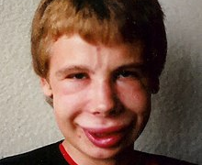

Fragile X
FMR1 Gene
X chromosome in 23rd pair, males X & Y – bottom X is pinched
Elongated face
Large protruding ears
Large testes
Stereotypic movements (hand flapping)
Social anxiety

Slide 9
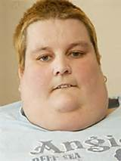
Prader-Willi Syndrome
Inherited a chromosomal abnormality from father
Infants are lethargic & have difficulty eating
Around age 1 become obsessed with food
Short in stature

Slide 10

Williams Syndrome
Absence of material on the 7th pair of chromosome
Elfin faces
Upturned nose
Short stature
Good skills in music & language
Sociable in nature

Slide 11
Characteristics
Limitations in Intellectual Functioning
Limitations in Adaptive Behavior
Problem-solving
Attention
Abstract thinking
Remembering information
Conceptual skills
Social skills
Practical Skills
Notes:
Limitations in intellectual functioning refers to the student’s general mental capabilities which effect the student’s ability to solve problems, pay attention, think abstractly, and remember information. The most extreme problems caused by the limited intellectual functioning are found in memory, generalization, and motivation.
Limitations in adaptive behavior refer to inability of the individual to meet the social responsibility and personal independence expected for his/her age and culture. The adaptive behavior of students with intellectual disability will almost always fall below the norm of their typical peers. Adaptive behavior consists of conceptual skills (self-determination, reading and writing), social skills (following rules and taking responsibility), and practical skills (daily living and employment skills). Individuals with intellectual disability can have a combination of strengths and weaknesses in one or more of these areas.

Slide 12
Characteristics Cont.
Difficulty remembering new information
Difficulty generalizing skills
Difficulty with intrinsic (or internal) motivation
Notes:
A student with intellectual disability may require new information to be presented multiple times before the new information or skill is acquired.
Individuals with intellectual disability typically have difficulty transferring skills learned in one environment (like school) to other environments (such as home). For this reason, instruction of skills is typically addressed in various settings.
For the most part, these individuals require external motivation, or prompts from others, before acting. Students with intellectual disability develop a sense of distrusting their own judgment and relying on the decisions of others.

Slide 13
Limitations
Intellectual Functioning
Adaptive Behavior
Self-Determination Skills
Notes:
Limitations in intellectual functioning often include difficulties with memory recall, task and skill generalization, and a tendency towards low motivation and learned helplessness.
Issues in adaptive behavior may include difficulties with conceptual skills, social skills and practical skills.
Individuals with intellectual disability also often exhibit deficits in self-determination skills as well, including skill areas such as choice making, problem solving, and goal setting.

Slide 14
Impact on Learning
With the appropriate supports, students with ID can achieve a high quality of life.
Accommodations will be needed in both academics and other functional areas such as independent living.
Independence and self-reliance should always be primary goals of all instructional strategies employed with students with ID.

Slide 15
Impact on Learning Cont.
The student with ID will learn and understand fewer concepts at a much slower pace than the student without a disability.
The student with ID will continue to learn and understand some aspects of the world, but this growth is less complete with significant gaps.
New learning is filtered through a younger mental context.

Slide 16
Teaching Strategies
Direct Instruction
Academic Skills
  Real World Reading Skills
  Real World Math Skills
  Real World Writing Skills
  Learn skills in applicable environments
  Generalize skills to various situations and other environments

Slide 17
Teaching Strategies Cont.
Functional Skills
  Additional skill areas:
    money concepts,
    time concepts
    independent living skills
    self-care and hygiene
    community access
    vocational training

Slide 18
More Strategies
  Teach one concept at a time.
  Teach one step at a time to help support memorization and sequencing.
  Teach students in small groups, or one-on-one if possible.
  Always provide multiple opportunities to practice skills in a number of different settings.
  Use physical and verbal prompting to guide correct responses, and provide specific verbal praise to reinforce these responses.

Slide 19
Resources
National Association of Down syndrome
https://www.nads.org/
The ARC
https://thearc.org/
Best Buddies
https://www.bestbuddies.org/
Voice of Reason
https://www.vor.net/
ELWYN
https://www.elwyn.org/

