Slide 1



Perkins V Act
Module

Slide 2
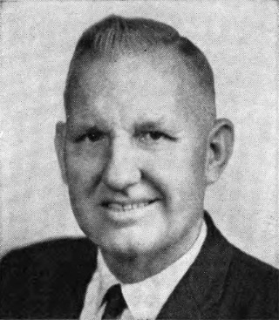
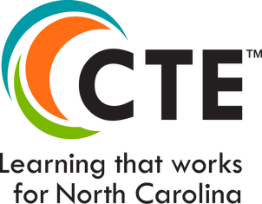
Ca
A BRIEF HISTORY OF THE PERKINS ACT
The Carl D. Perkins Act is a federal education program that invests in secondary and postsecondary Career and Technical Education (CTE) programs in all 50 states and territories.
1984: the Carl D. Perkins Act is the first Perkins legislation committed to increasing learner access to high-quality CTE programs of study.
1998 and 2006: Perkins was reauthorized.
2018: the Strengthening Career and Technical Education of the 21st Century Act or Perkins V was signed into law expanding focus on workforce alignment, accountability, and equity.
Carl D. Perkins, US Representative from Kentucky

Slide 3
?
WHAT IS PERKINS V ACT?
Perkins V, formally known as the Strengthening Career and Technical Education for the 21st Century Act, is the fifth iteration of the Carl D. Perkins Career and Technical Education Act, reauthorized in 2018. This federal law governs the allocation of grant funds and the guidelines for Career and Technical Education (CTE) programs across the United States. The primary goal of Perkins V is to increase access to high-quality CTE programs that prepare students for high-wage, high-skill, and in-demand careers.

Slide 4
North Carolina Perkins Funding Distribution
Perkins grant funds are divided with secondary receiving two-thirds and postsecondary one-third of the total state allocation.
Postsecondary Allocation Formula:
Based on the percentage of CTE students receiving Pell Grants or BIA assistance.
Pell Grant and BIA assistance verification forms are distributed each spring.
Postsecondary Eligibility:
To qualify for Perkins funds, community colleges or consortia must receive a minimum allocation of $50,000 through formula funding.

Slide 5

WHAT ARE THE KEY GOALS OF PERKINS V?
1
2
3
  Expand access to high-quality Career and Technical Education (CTE) programs for all students
  Prepare students for high-wage, high skill, and in-demand careers
  Requires colleges to conduct a Comprehensive Local Needs Assessment (CLNA)

Slide 6
KEY COMPONENTS
Local Needs Assessment (CLNA):
Requires biennial assessment to align programs with workforce demands.
Engages local stakeholders to identify gaps and align resources.
Special Populations:
Inclusive support for individuals with disabilities, low-income students, non-traditional fields, etc.
Focus on removing barriers to equitable CTE access.
Perkins V

Slide 7

Emphasis on Career Pathways & Industry Partnerships
Career Pathways:
Programs structured to provide clear paths to credentials and job opportunities in high-demand fields
Industry Partnerships:
Strengthened ties with industry to support work-based learning, apprenticeships, and real-world experience
Outcomes: Perkins V encourages CTE programs to stay aligned with labor market trends, supporting students in their transitions into skilled, high-demand roles.

Slide 8
PROGRAM QUALITY & ACCOUNTABILITY
Data-Driven Accountability:
Performance indicators measure success in:
Post program placement
Credentials earned
Students in non-traditional fields
Local Flexibility:
States and institutions have greater autonomy to customize programs and funding to address unique needs effectively.

Slide 9
PERFORMANCE INDICATORS DEFINED
1P1 – Postsecondary Retention and Placement
The percentage of CTE concentrators who, during their second quarter after program completion, remain enrolled in postsecondary education, are in advanced training, military services, or a service program that receives assistance under title I of the National and Community Service Act of 1990, are volunteers as described in section 5(a) of the Peace Corps Act or are placed or retained in employment.
2P1 – Curriculum certificate, diploma, or associate degree
The percentage of CTE concentrators who receive a recognized postsecondary credential during participation or within 1 year of program completion.
3P1 – Non-traditional Program Enrollment
The percentage of CTE concentrators in career and technical programs and programs of study that lead to non-traditional fields

Slide 10
CTE Concentrators defined
Perkins V Section 113(b)(4)(i)(II) requires colleges to make “meaningful progress toward improving the performance of all CTE concentrators, including special populations and subgroups.
Perkins V Section 3(12) defines CTE concentrator as a student who has earned at least 12 CTE credits within a CTE program or program of study.
NCCCS calculates it as a student with a CTE primary program code who has earned at least 12 CTE credits within that program or program of study.

Slide 11
WHO ARE THE SPECIAL POPULATIONS?*
Individuals with disabilities;
Individuals from economically disadvantaged families, including low-income youth and adults;
Individuals preparing for non-traditional fields;
Single-parents, including single pregnant women;
Out-of-workforce individuals;
English learners;
Homeless individuals described in section 725 of the McKinney-Vento Homeless Assistance Act
(42 U.S.C. 11434a);
Youth who are in, or have aged out of, the foster care system; and
Youth with a parent who –
Is a member of the armed forces (as such term is defined in section 101(a)(4) of title 10, U.S.C.); and
Is on active duty (as such term is defined in section 101(d)(1) of such title).
*Perkins V, Section 3(48)

Slide 12
REQUIRED ESEA STUDENT SUBGROUPS*
(A) Economically disadvantaged students;
(B) Students from major racial and ethnic groups;
Children with disabilities; and
English language learners.
*Elementary & Secondary Education Act of 1965, Section 1111(c)(2)(B) Referenced in Perkins Section 114(e)(8)(B)(i)
Additional Group

Slide 13


USING THE PERKINS V GRANT FOR LOCAL NEEDS
Community colleges create a local application to allocate basic grant funds, based on a comprehensive local needs assessment (CLNA). This assessment focuses on six key activities to ensure effective and impactful fund usage.
Developing both the CLNA and the local application requires input from a diverse group of stakeholders, including:
  Representatives from secondary and postsecondary CTE programs
  Workforce and industry partners
  Parents and students
  Special populations advocates
  Organizations serving out-of-school, homeless, and at-risk youth

Slide 14
PERKINS V GRANT REQUIRED ACTIVITIES
Community Colleges must allocate basic grant funds to support these six required activities:
Career Exploration and Development-
Provide students with opportunities for career exploration and guidance to help them understand career pathways and make informed choices about their education and career goals.
Professional Development for Educators-
Offer continuous professional development for CTE instructors, faculty, administrators, and other CTE personnel to enhance their skills, support student achievement, and improve program quality.
High-Quality Programs and Standards Alignment-
Develop and implement rigorous CTE programs that are aligned with industry standards and relevant to the labor market, ensuring that students are equipped with the skills required for high-demand jobs.
Student Support Services-
Provide comprehensive support services, including tutoring, counseling, and mentorship, especially for special populations, to help students succeed in CTE programs and transition smoothly to postsecondary education or the workforce.
Innovation and Modernization of Equipment and Infrastructure-
Invest in state-of-the-art technology and equipment, work-based learning opportunities, and relevant curricula that meet current industry standards, enhancing students' hands-on skills.
Data Collection, Reporting, and Continuous Improvement-
Collect and analyze data to assess program effectiveness, measure student outcomes, and inform continuous improvement efforts, aligning with Perkins V accountability requirements.

Slide 15
ENSURING COMPLIANCE WITH CIVIL RIGHTS LAWS
Methods of Administration (MOAs) are carried out under the guidance of the U.S. Department of Education’s Office for Civil Rights (OCR) by the North Carolina Community Colleges System Office (NCCCS).
NCCCS is responsible for ensuring that all state-funded postsecondary community colleges in the system, adhere to federal civil rights laws, which prohibit discrimination based on race, color, national origin, sex, disability, or age.
More information about this topic can be found here Office for Civil Rights (OCR) | U.S. Department of Education

Slide 16
FEDERAL CIVIL RIGHTS LAWS GOVERNING MOA
Title VI of the Civil Rights Act of 1964: Prohibits discrimination based on race, color, or national origin.
Title IX of the Education Amendments of 1972: Prohibits discrimination based on sex in education programs and activities.
Section 504 of the Rehabilitation Act of 1973: Prohibits discrimination based on disability.
The Americans with Disabilities Act (ADA) of 1990: Prohibits discrimination against individuals with disabilities.
The Age Discrimination Act of 1975: Prohibits discrimination based on age.

Slide 17


North Carolina Community College System Perkins/CTE Staff
Dr. Bob Witchger
Executive Director of Perkins CTE​
witchgerb@nccommunitycolleges.edu​
Dr. Tony Reggi
Associate Director of Perkins CTE​
reggia@nccommunitycolleges.edu​
Patti Coultas
Assistant Director of Perkins CTE - East ​
coultasp@nccommunitycolleges.edu ​
Dr. Mary Olvera
State Director of Teacher Education, Public Services, and Perkins Special Populations​
olveram@nccommunitycolleges.edu​
Stefanie Schroeder
Assistant Director of Perkins CTE - West​
schroeders@nccommunitycolleges.edu​
Darice McDougald
Perkins Program Specialist​
mcdougaldd@nccommunitycolleges.edu​

Slide 18









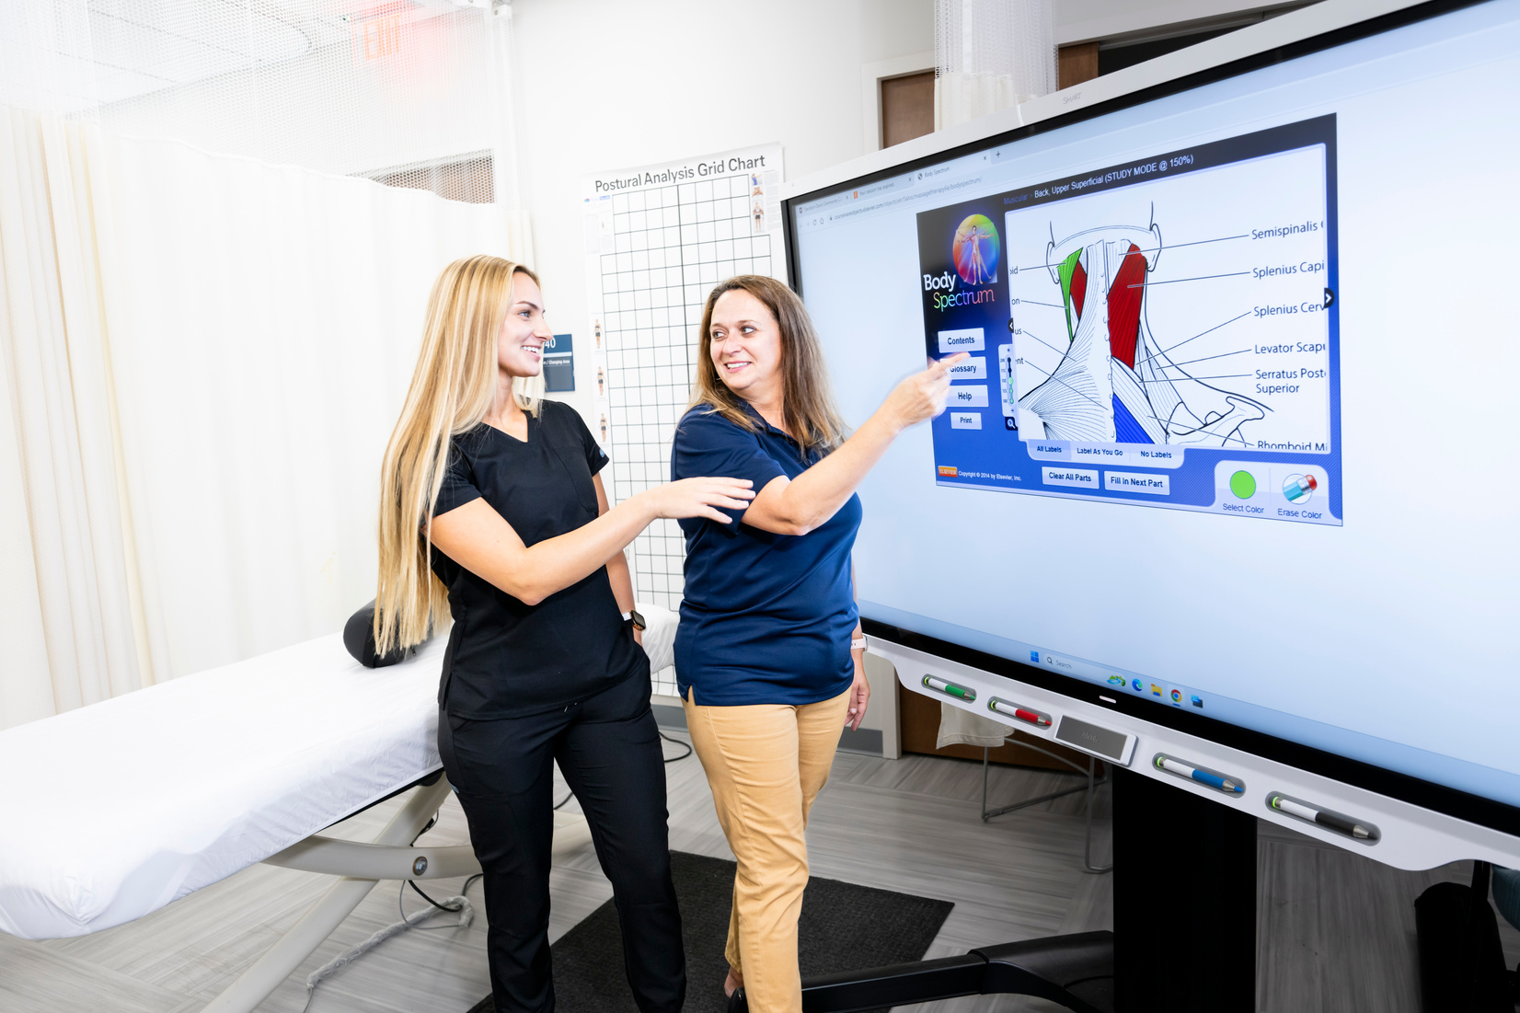




more photos to choose from

