Slide 1
Food for Thought: Career Development and Career Planning
Dr. Bob Witchger
Director, Career and Technical Education
North Carolina Community Colleges

Slide 2

Think of yourself not as the architect of your career but as the sculptor. Expect to have to do a lot of hard hammering and chiseling and scraping and polishing
BC Forbes

Slide 3

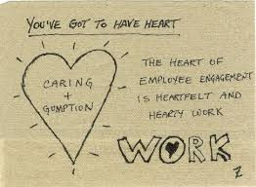
Your work is to discover your work, and then with all your heart to give yourself to it

Slide 4

Meaningfulness of work in life has global and enduring appeal

Slide 5

People tend to seek out occupations that enhance a sense of self

Slide 6
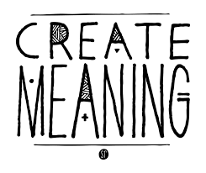

The idea of meaning and work is also revealed in how employees determine their career goals

Slide 7

“The evolving sequence of a person’s work experiences
over time”

Slide 8

Perspective of career in the US and many parts of Europe has an individual focus, based on the interests and goals of the person.

Slide 9
Career development is an ongoing process of planning and directed action toward personal work and life goals

Slide 10

Development means growth, continuous acquisition and application of one’s skills.

Slide 11
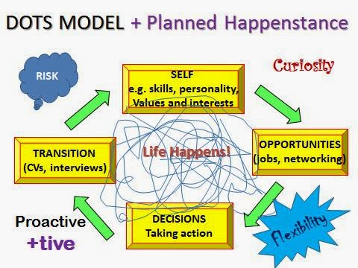
Career development is the process of acquiring and experiencing planned and unplanned activities that support attainment of life and work goals.

Slide 12
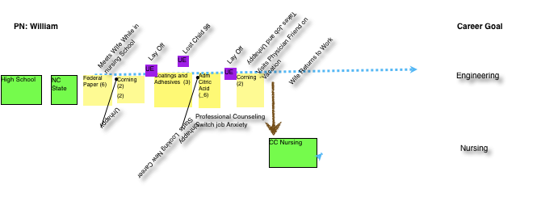

Slide 13
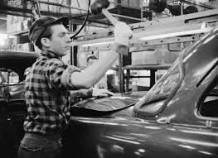
Career Development started in the 1950s, yet evidence in European trade guilds of the 12th century.

Slide 14
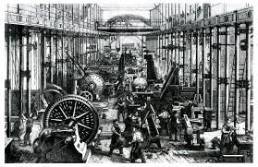
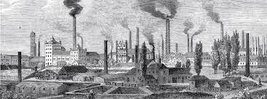
Late nineteenth and early twentieth centuries, industrial revolution in the US and in Europe prompted the need for vocational training to match the needs of the newly emerging manufacturing-based economy,

Slide 15

Frank Parsons -
Engineer, Lawyer
Originates the term
Vocational Guidance
1909
An early model for career development

Slide 16

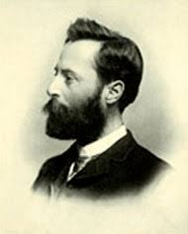
Parson's model is based on practical experience rather than research. It is well respected.
Early proponent of matching individual interests and skills with job requirements.

Slide 17

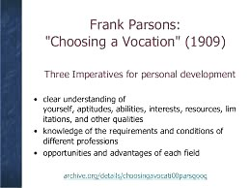

Slide 18
Three Basic Tenants
1. Understanding yourself
2. Recognize skills that different types of work require
3. Coordinate those two factors to find a suitable job
The theory of Trait and Factors has evolved over time finding fit between the person and the job centered on Testing

Slide 19
Career Planning can involve:
1. Ability or Intelligence Testing
2. Aptitude or Technical Competence Testing
3. Interest or Personality Testing
(Moore et al. 2007)

Slide 20
Brief History
1940 and 50s saw the upswing in career counselor training in colleges and universities verifying its place as a profession
1950s and 60s challenged by developmental psychologists advocating the view that career development what not a one-time rational match but rather a longitudinal process

Slide 21
Stages of Life Theory

Slide 22
Donald Super, key scholar in the developmental approach
— Based on Life Stages and role
Note: Stage theory has come under criticism over time, yet significant milestones in the development of career practice and theory

Slide 23
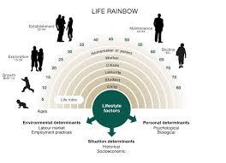

Slide 24
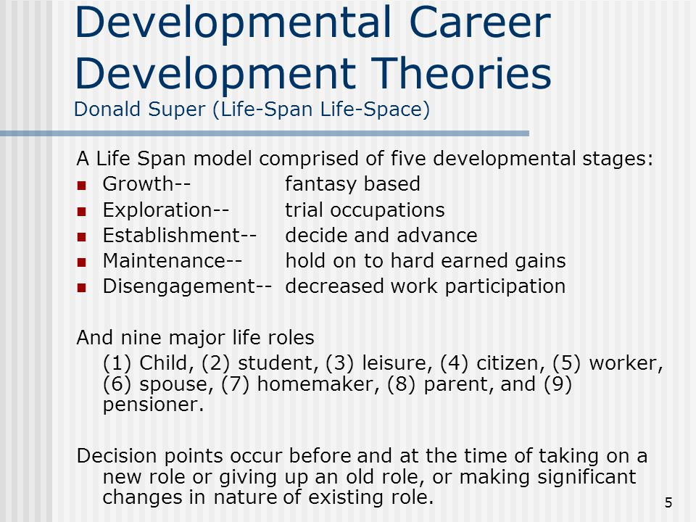

Slide 25
Self Directed Search

Slide 26

60’s and 70’s saw the revival of Parsons matching idea in John Hollands theory of linking types of people with occupational environments in RIASEC realistic, investigative, artistic, social enterprising, and conventional system of categorizing remains mainstay of key interest inventories

Slide 27
Self Directed Search

Slide 28
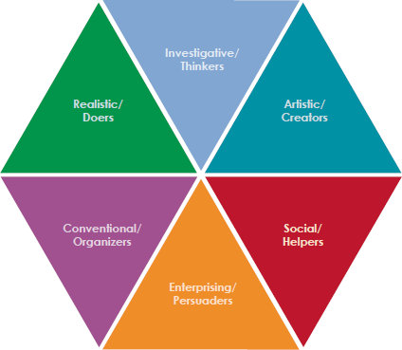
Holland Types
Realistic
Investigative

Slide 29
Holland Types
Artistic
Social

Slide 30
Holland Types
Enterprising
Conventional

Slide 31
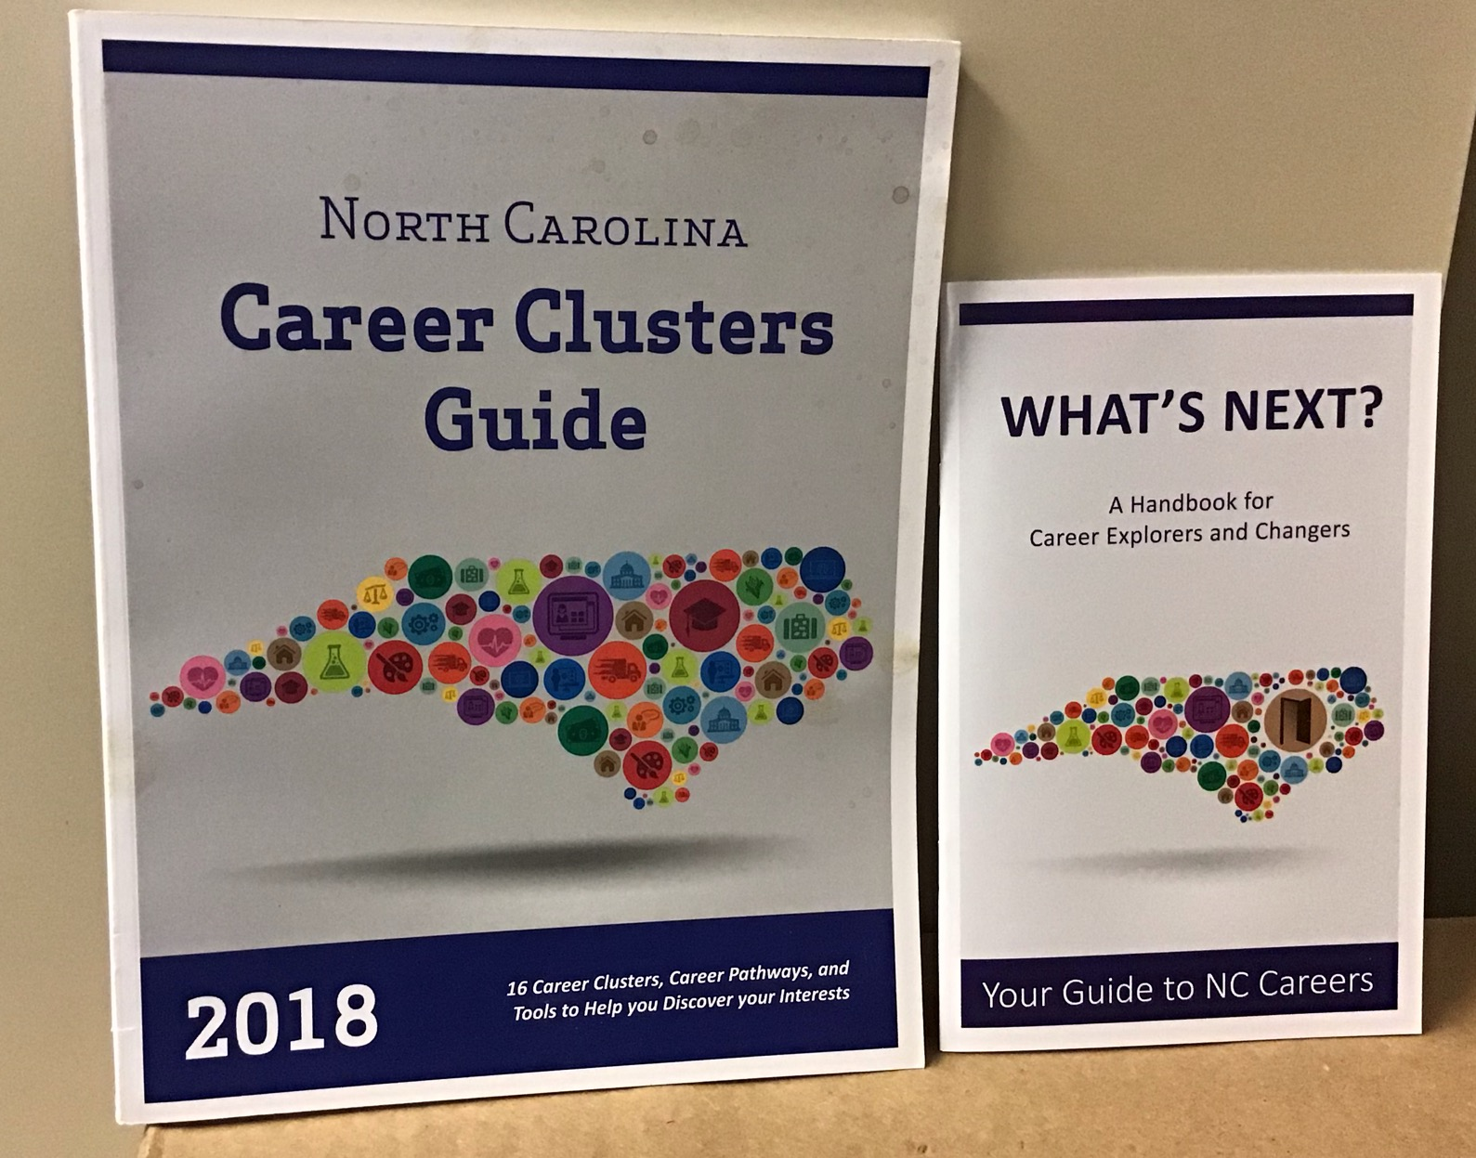

Slide 32
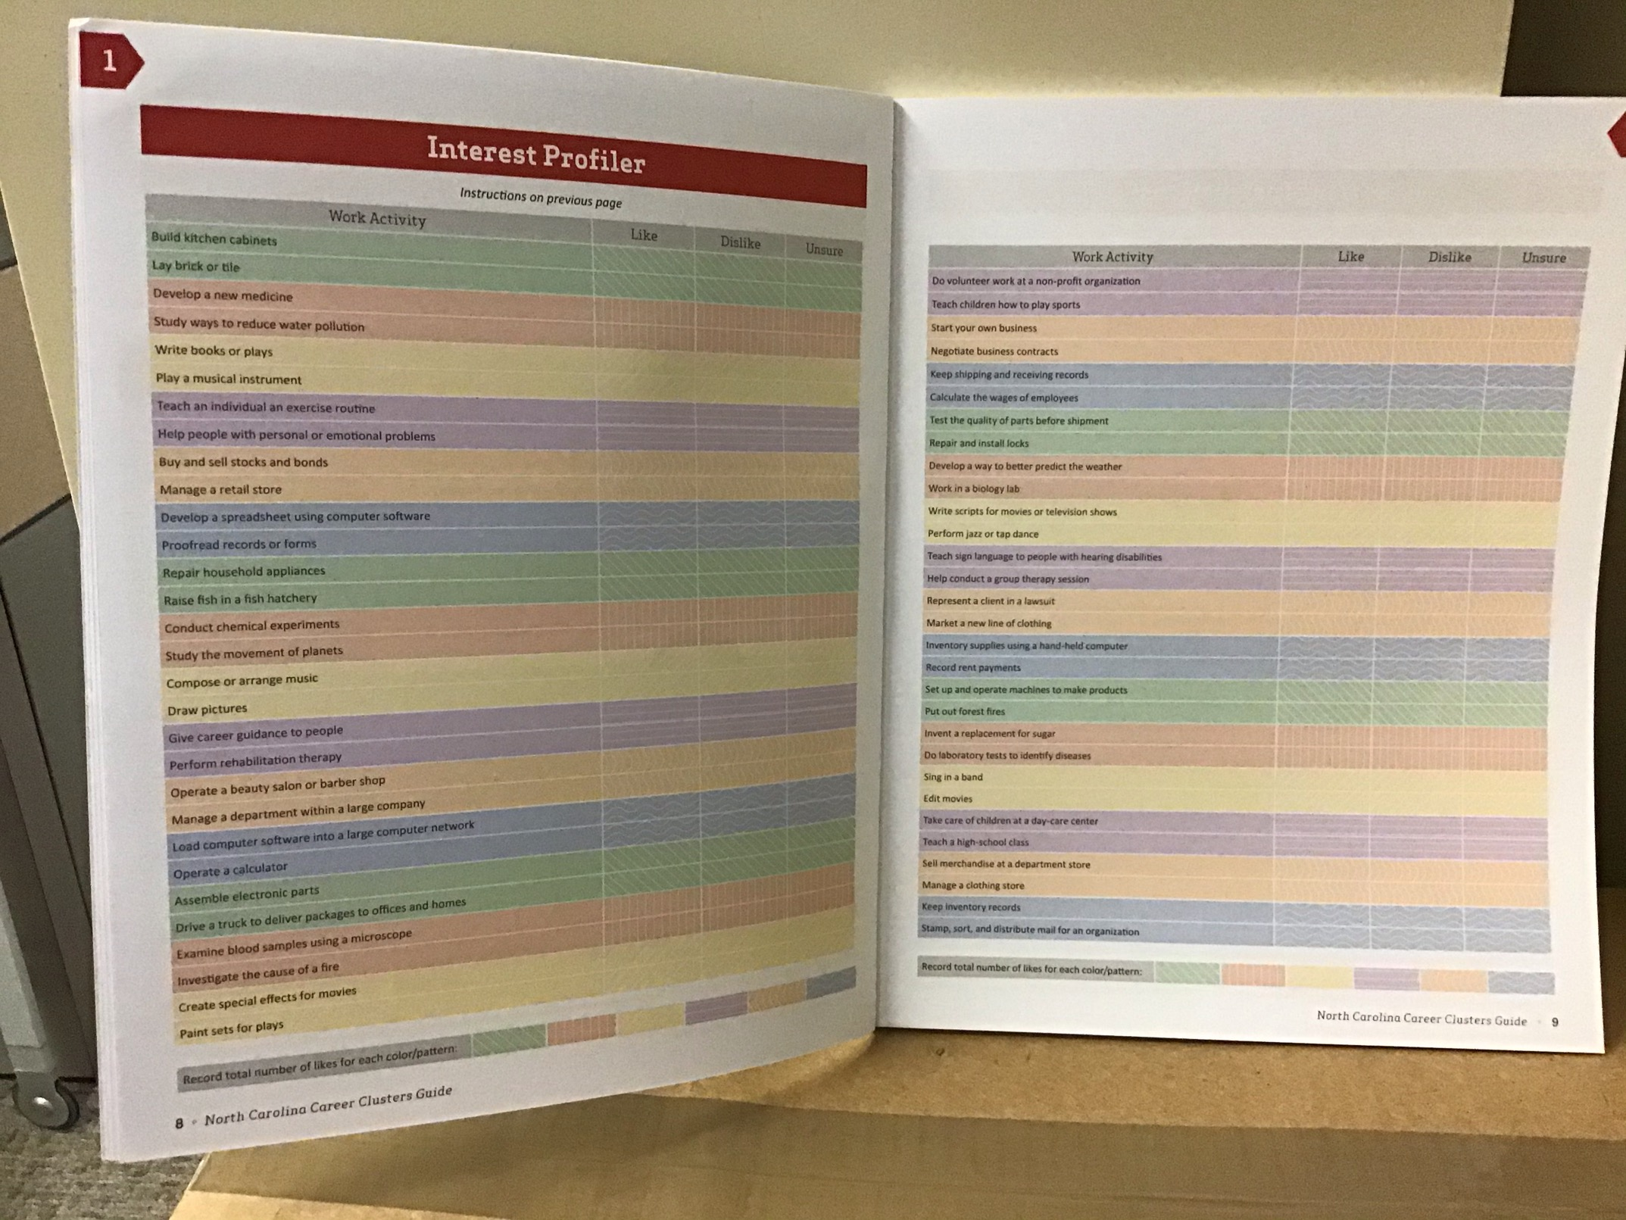
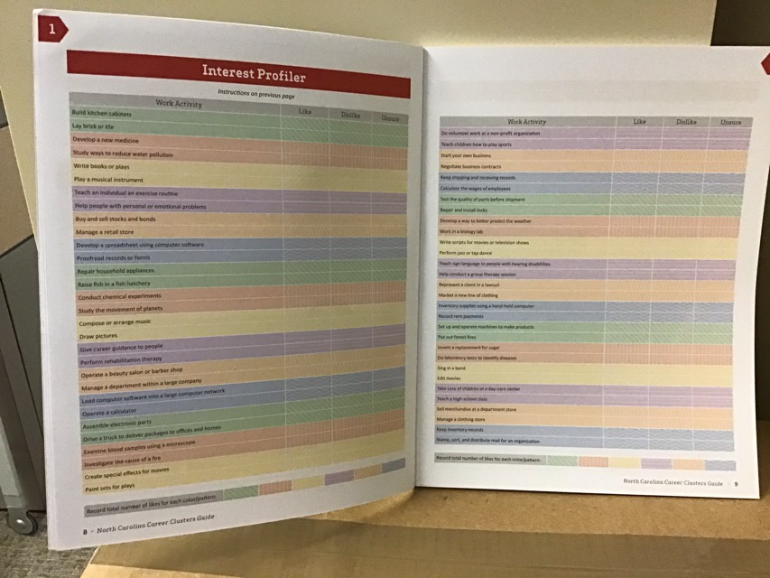

Slide 33
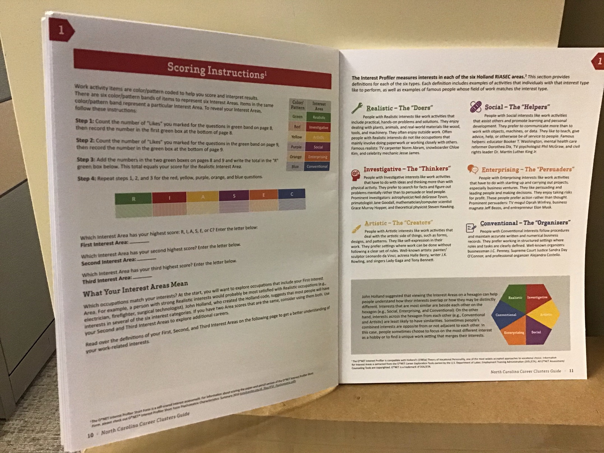


Slide 34
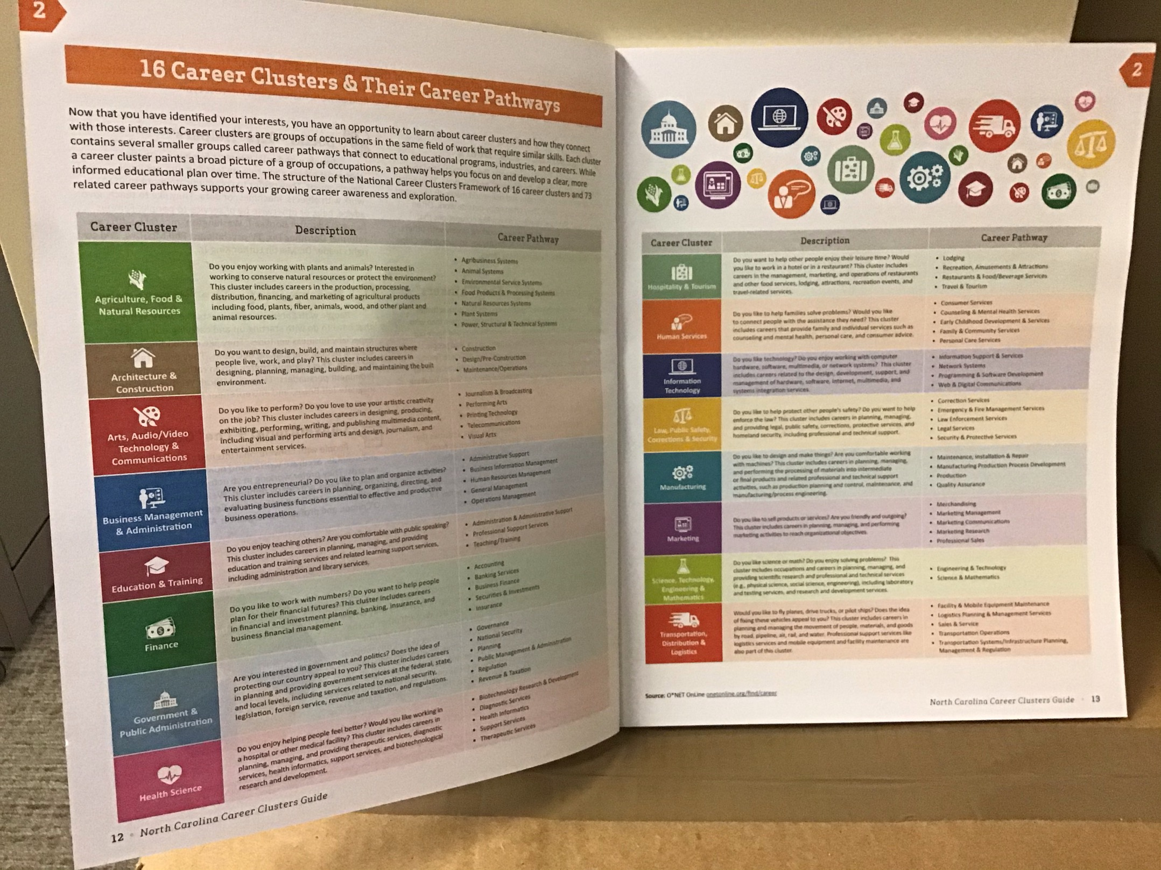

Slide 35
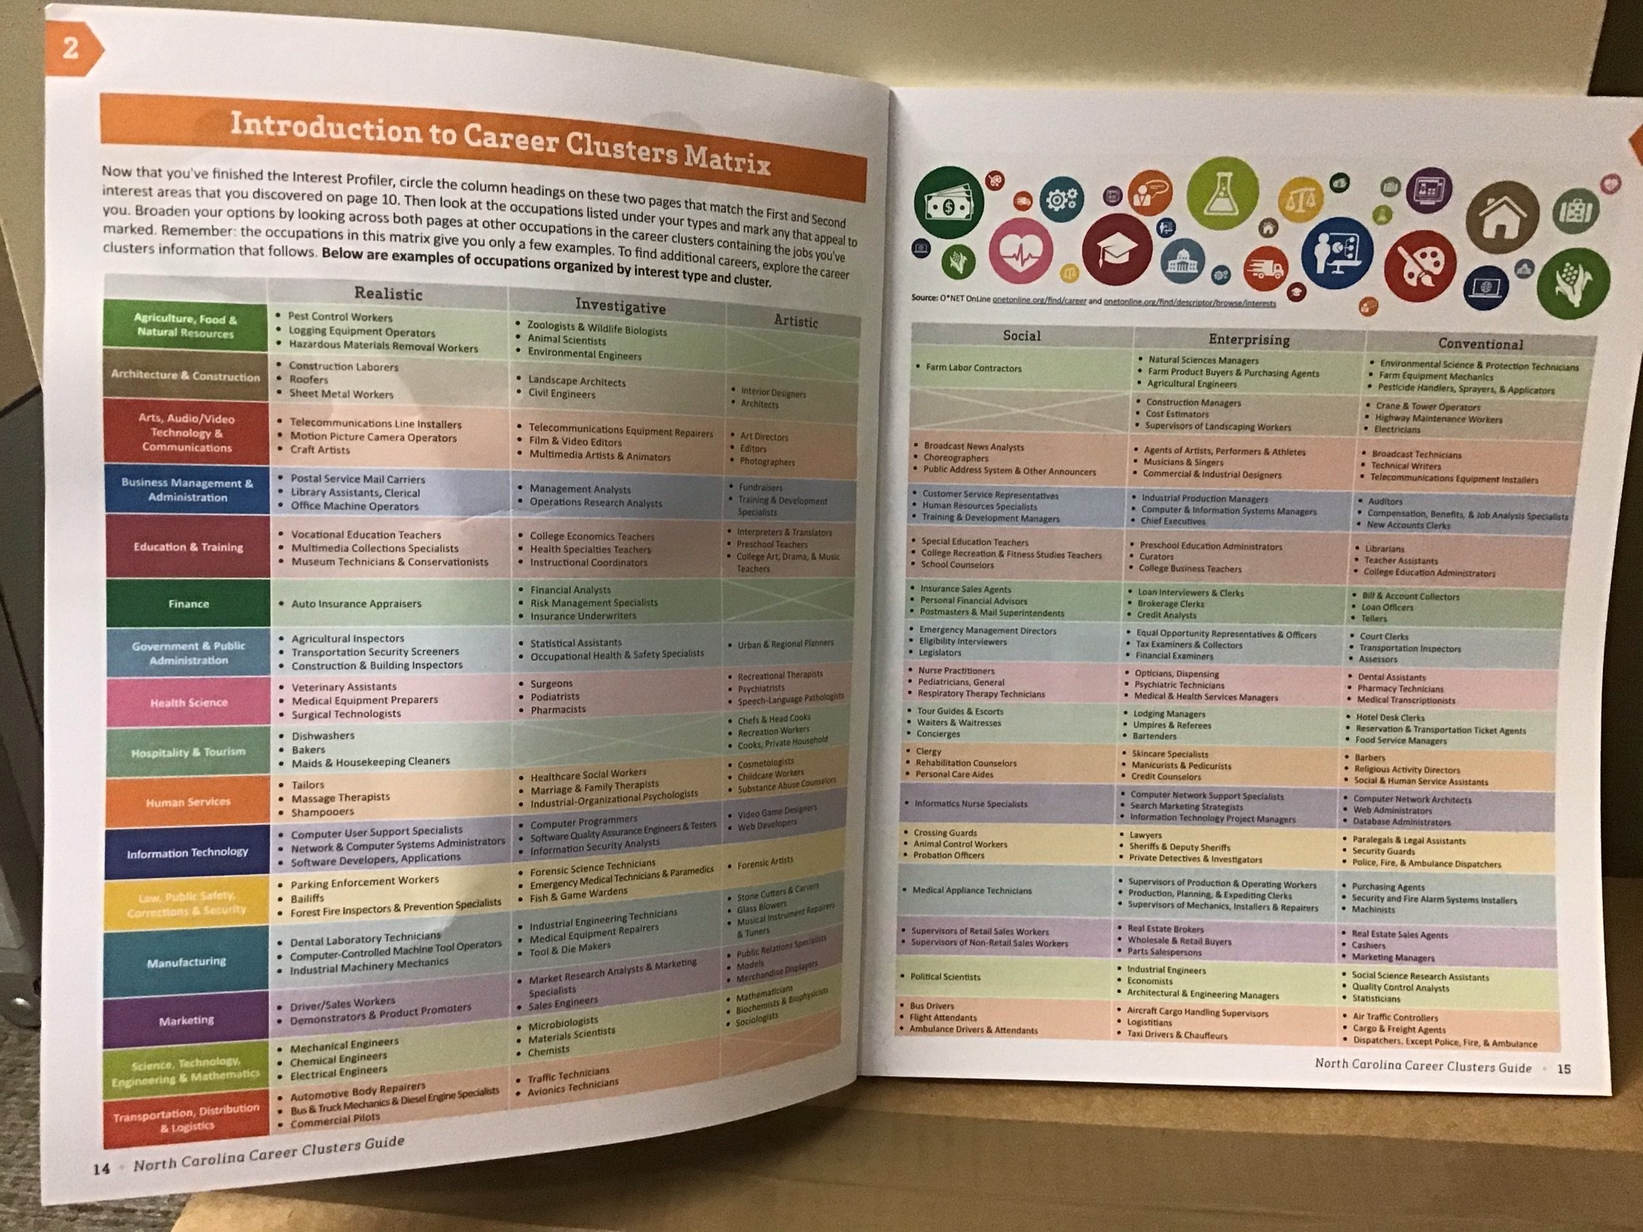
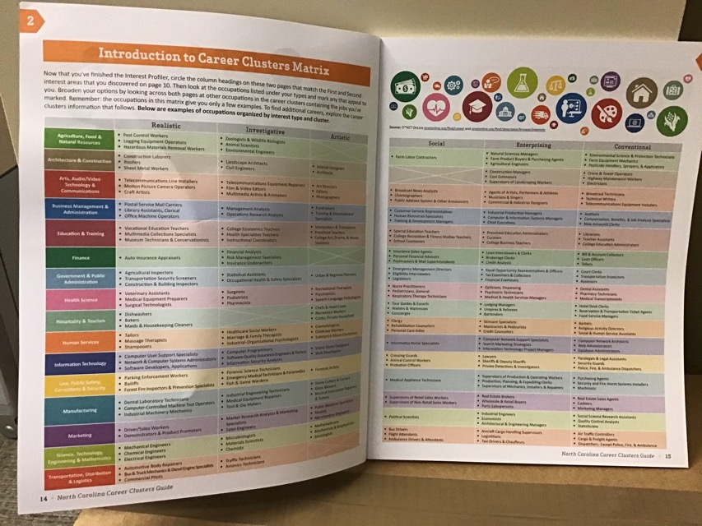

Slide 36
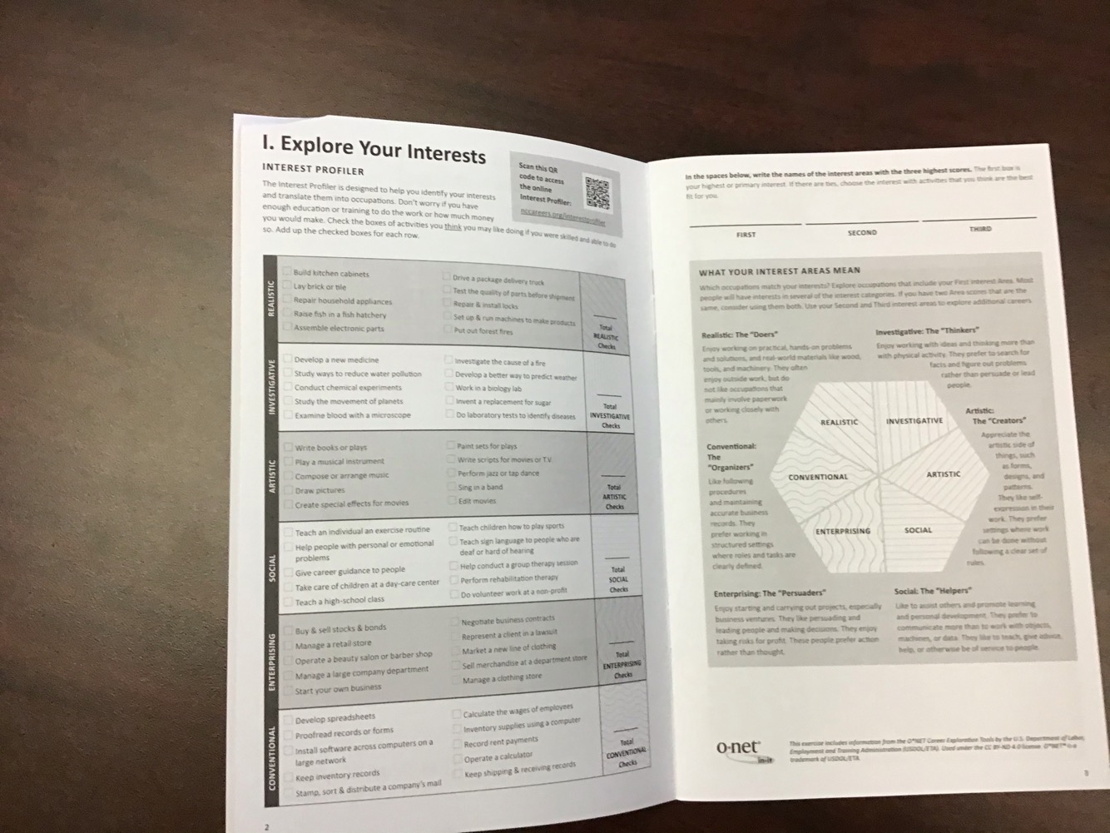
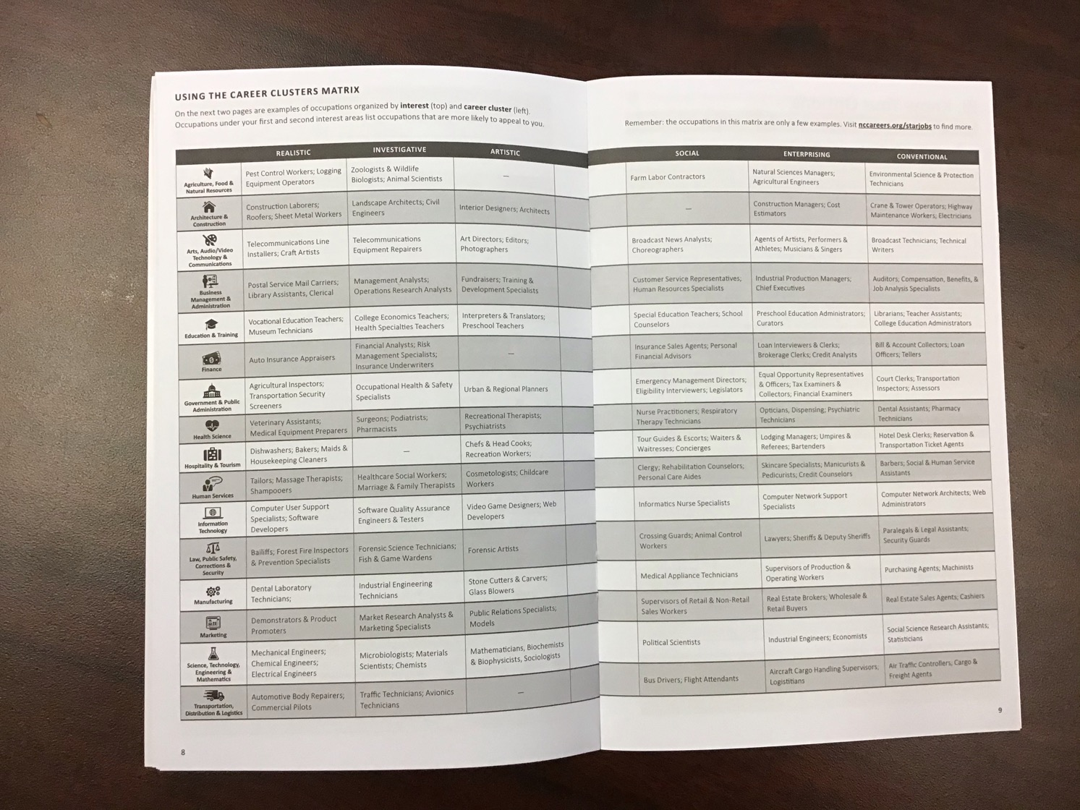

Slide 37
A Career Path of a Community College Student

Slide 38
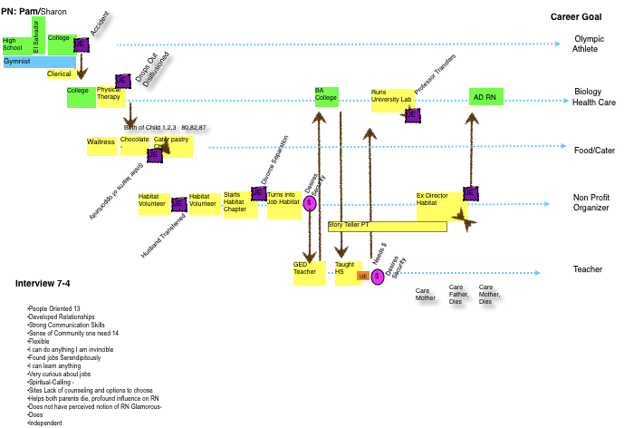


Slide 39
Life Interacts with Career Development

Slide 40

Current career landscape
has been characterized as turbulent, unpredictable, & challenging

Slide 41

Economic Turmoil
Technological Advances
Social Influences
Diverse Workforce
Governmental Policies

Slide 42
Technological Advances – ushered in the rising knowledge economy and have influenced not only the types of jobs available, but also how work is done – teams, on-line, where works is done telecommuting, the scope of work – global access to potential suppliers and customers

Slide 43
Changing Domestic Demographics – global access to workers and government legislation have created a widely diverse workforce that had varied career goals and interests

Slide 44
Economic Turmoil: has fundamentally changed how career development is viewed by individual and how it is addressed by organizations

Slide 45
By dismissing employee with apparent disregard for work records or skills, companies inadvertently gave up the employee loyalty and commitment

Slide 46

- Employees have begun taking control of their own career trajectories
- Ready to move when
opportunities
appear
The Boundaryless Career

Slide 47
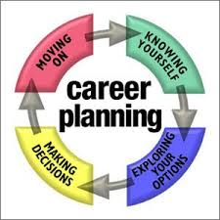
Career Development will rise focused on the individual and his or her needs recognize that workers need to be flexible and strive foe employability in their overall careers rather than stability within one organization

Slide 48
Skilled Career Development Professionals Cultivate skills
Career Development Models and Theories
Career Resources Including organization or other sources of information)
Career Counseling for individual and group work Career assessment
Career Development of diverse populations
Ethical career counseling practices
Technology related to career planning
Developing and implementing a career development program

Slide 49

This new area of career development will require individuals to be actively involved in their own career development and planning

Slide 50
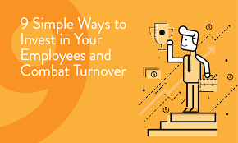
This will require organizations to acquire a new mindset one that invests in employees without experiencing or providing a long-term commitment.

Slide 51
PN: JoAnn
Career Goal
4 H
High School
Veterinarian
Dropped Over 2 story Rail
Diary Queen
Photo Lab
College
English Teacher
UE
Father Dies
Undecided
Rehab Tech
Mother Ill
UE
UE
College CNA
Nursing Home
College RN
College RN
Nurse
Has to Retake Classes
Interview 11
Care and Love of Animals and People evident through out life
Volunteer experience influences career choices when matched with values Cousin Down Syndrome
Abusive Boy Friend, Drops, back together, hit again leaves
My Nurses help get got through it so I decided to give it a try
Persistence - Uncanny ability to push on
Risk Taker
“I prayed a lot”
“ I want to help people”
Figured out alternative ways of doing things

Slide 52
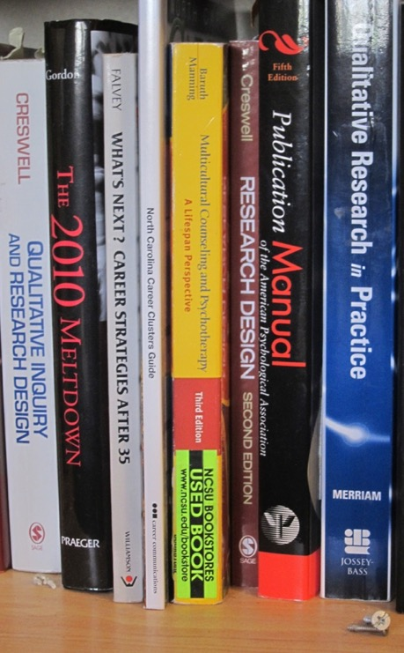
Definitions
Career pathways
  Lifelong, includes many career goals and jobs
  Subject to many forces (within and without)
  HS to Present time
Unplanned events
  Unanticipated & without intention
Pivotal unplanned events
  Change in career goal
Non-pivotal unplanned events
  No change in career goal

Slide 53
I
Individual Career Path
Every Dynamic
Encompasses one’s whole life beyond prep for a job
Involves the ever-changing context of life
Subject to Environmental pressures and constraints
Can be the convergence of Personal and Work Life

Slide 54
In Context of Change
Many people now worry about the security of their current jobs and the future of the United States in the world economy(Lee & Johnson).
During the past 30 years the world has undergone accelerated change fueled by a bewildering combination of technical, economic, social, and cultural forces (Gordon).

Slide 55
In Context of Change
Career pathways are lifelong and subject to forces from within and outside the self.
With technological, social, economic, and cultural change, it is no longer common for workers to stay employed at one company for twenty or more years, continuing along the same linear career path (Witchger, 2011).

Slide 56
Workforce
Technology - changes the way we work
Globalization – competition in a Flat World
Sector technologies – retraining – Sector Strategies
Manufacturing – Workforce shrinks - Enhanced with technology
Service industry - grows, several jobs for sustainable wage
Nature of work – shifts
Lifelong jobs may become short stints

Slide 57
  career changers sought out career counseling...
to reassess their interests, skills, and abilities and determine a new occupation to pursue.
to solve their problem of indecision
To help or solve their selection of a career

Slide 58
Career Pathways a Lifelong Process
More recently theories of career development have been expanded due to the recognition that occupational choice along one’s career pathway is a lifelong process of decision making and not a single terminal decision ( Witchger, 2011)

Slide 59

Career Paths have Decision Points
pivotal or non-pivotal in career decisions
Unplanned Event
Career Pathway
Non-pivotal Event
Career Goal A
Pivotal Event
Career Goal B

Slide 60
PN: Annette
Unexpected Grades Seeks Support of Brother
No Opening in IT College
Career Goal
High School
College
College
Workers argue in her office Threaten to hurt her.
UE
UE
Walmart Wakes Up
Computer Science
Mother Dies,
Layoff Shutting Down Plant Off Shore
Stress - Paralyzed Hospital Quits Stress
Ice Cream Sales
Secretary
Cashier
Child Born, Quits - Goes Home
UE
Finishing Mill
UE
College
Textile Mills
Textile
Mgr. Finishing Mill (6)
Textile (6)
UE
Textiles
UE
UE
UE
Home and Trucking Company
UE
Home and Trucking Company
Part Time Accountant Customer Service
Starts Cutting Husbands Steak
Nursing Holds Promise - Enrolls in college
In Hospital with Cancer ??
Community College
Health Care RN
Perception of security in nursing field.
Interview 5.2

Slide 61
The influence of unplanned events
Five categories of unplanned :
Family
Health
Interpersonal
Work
Education

Slide 62
1. Family related unplanned events
Incidents:
Divorce
Spousal abuse
Oppressive relationships
Fall in love, marriage
Unplanned pregnancy
Child care challenges
Sudden transfer of spouse
Effects:
Moved to new town
Changed jobs
Joined military
Sought support
Changed pathway
Hit pot hole
Unable to change

Slide 63

PN: Phyllis
Career Goal
BoyFriend - Dictates Sec job
UE
Divorced
Moves In with Brother
Leaves Fiance
Unplanned Met Person at work, Engaged Married
Husband Drunk, Feared Moved out
Tech School Clerical
UE
Unplanned Met Person Moves, Borfriend Finds Job
Husband wants to Move
UE
Burns out on the job
Son Old Enough and In School
Married
UE
Fired BCause Married Worker
Reconciles Stay at Home
Secretary
Mill xx7
Phillips Mills
Secretary
Tech School
Secretary
Office Manager
UE
UE
UE
Medical Sales
Secretary xx1
UE
EPA Type
Secretary xx4
Pregnant
Grandmother & Aunt Nurses Try to influence RN
Sales Barker Lounger xx8
Moves to Raleigh
TTT Trucking
Service Writer
UE
Husband Diabetes Decides to get married and takes care of husband manages his meds
Scared Low Esteem
High School
(Health)
UE
CC Pre Requisites
Nursing
Nursing School -
Nursing

Slide 64
2. Health related unplanned events
Incidents:
Serious automobile crashes
Broken bones
Unanticipated surgery
Serious illness
Sports accidents
Miscarriages
Death of loved one
Effects:
Hospitalization with significant Interactions with health care system
Physical incapacity to continue in the same job
Rethink career
Empowered in career

Slide 65
PN: Megan
Car Accident
Ran into Girlfriend
Promoted to Manager
Career Goal
UE
?
High School
UE
Office Work
Video Store
Phone Sales
Call Center
Mgr Computer
Service Center
Business, Undecided
UE
Lost Scholarship
Unplanned Pregnancy
Unsatisfied, Driven, Better Self
College Biology
l
Challenged Girlfriend Says Jump through Hoops
UE
UE
College Surge Tech
l
Surge Tech
Health Care
Fails RN School
UE
UE
Nursing
CC Nursing
l
CC Nursing
l
Nurse Practitioner
Interview 10
Driven
Seeking Change
Very self Motivated
Shows not signs of calling in career
Very practical in her decisions
Not about the jump into marriage because of a child

Slide 66
3. Unplanned events of an interpersonal nature
Incidents:
Unexpected meeting
Unexpected phone call or e-mail
Social conversations
Job lead when not looking for work
  Effects:
  Support and enhanced career direction
  Critically examined career goal
  Change in career direction
  Changed later

Slide 67
c
PN: William
Visits Physician Friend on Vacation
Career Goal
Meets WIfe While in nursing School
Lay Off
Lost Child 98
Takes Job and Unhappy
Lay Off
UE
Wife Returns to Work
Engineering
UE
Coatings and Adhesives (3)
Adm Citric Acid (_6)
UE
UE
High School
NC State
Federal Paper (6)
Corning (2)
(2)
Corning - (2)
Unhappy
Professional Counseling
Switch job Anxiety
Unhappy
Starts Looking New Career
CC Nursing
Nursing
Interview 14 - 10

Slide 68
4. Work related unplanned events
Incidents:
Forced resignations
Conflicts on the job
Layoffs
Business failures
Effects:
Lost job and started new work
Changed jobs
Changed career

Slide 69


PN: Temeka
Career Goal
Sudden Loss of Childcare
Birth of Baby (3)
Pregnancy HS (5)
UE
College Surge Tech
Hired as PCA
Surge Tech
College Enrolls as RN
Health Occupations RN
HS
College
UE
Company Closes Lay Off
RN - Nursing
Cashier Gas Station
Burger King
Birth of Baby (2)
Ministry Health Focus
Machine Operator FT
UE
Girl Friend offers Job Lead
“This is my calling”
Applies Nursing Program - Yet Enrolls Surge Tech
Manufacturing
College PT
ESC offers College Training
Interview 8 - 5
Persistence
Plans Ahead
Completes Training.
Searches on Own
Determination
Quick Learner
Flexible
Nursing is my calling
Optimistic
Great Support System

Slide 70
5. Education related unplanned events
Incidents:
Scheduling errors
Enrolled in wrong class
Unexpectedly met influential professor
Effects:
Change major
New program of study
Dropped out of college
Explore new career direction

Slide 71
PN: Judy
Career Goal
Switch to Economics
High School
UNC
UE
CC Nursing School
Husband Transferred
Miscarries 2 x
Pre Med Nursing
Approached to Switch Career
Divorced,
UE
UNC
BCBS - Customer service
UE
Southern National Bank
BCBS - Customer service
aerobics
Friend Encourages Nursing
UE
Business/ Economics
UE
UE
Taught Aerobics - 3 types
Remarries
Waited Tables
Communication / Customer Service Technology
UE
Tricom Communications
Trainer
TC Communications Trainer Raleigh
Call From BCBS Friend
RELOCATES TO RALEIGH

Slide 72
A. Internal factors
Flexibility - Adapting, balancing, compromise
Curiosity - Discovery, eager to find out, love learning
Persistence - Determination, hard work, continuing the course
Optimism - Positive outlook, hopefulness, attainable
Risk taking - Explore, leave secure job, exposure
Spirituality - Blessed, spiritually connected, calling
Need for job security - Need, critical, gainful, viable work

Slide 73
B. External factors
Financial support
  Most frequently acknowledged
  Obstacle & enabling
Emotional support
  Need for approval
  Support and encouragement
Logistical support
  Coordination and planning of everyday life
  Balancing family obligations & time constraints
  Proximity of training

Slide 74
PN: Tracy
High School
Break Up Gets out of Town
Career Goal
Plans to get Married
General Ed AP Courses
Married/Kids
Florist (2)
Catalogue Sales (2)
UE
Make Up Moves in w Boy Friend
UNCG
Waitress
Office Conflict, leaves
Describes time as “Wishey Washie” Not Sure of future
BA Degree
Math/English
UE
BF Aunt Calls out of the Blue
Chiropractic Office Assistant
UE
Serenity Counseling
Secretary
Undecided
Clerk Assistant
UE
UE
Social Worker
Nursing Home
Degree
Social Work
Handling people maybe health care
UE
CC Health
Took Classes to learn about heath care
Engaged, Then Break UP
Moves home w Mommy and Daddy
Applies to Nursing School
CC RN RN
Assoc. Degree Nursing
Interview 4.1
Future BSRN , MSRN
Challenging Study
Learns from others in the environment
“You need to graduate HS then go to work and decided what you want from work experience, figure it out yourself”
High Achiever
Forces Self, feels free to excel when Independent
Easily Adapts to new settings
Seeks salary, security and benefits
My Parents struggled, I am not going to struggle
If you present yourself, you can do anything, Confidence
Self Assured, yet all new jobs were a risk
I learn from people, people helped me learn change

Slide 75
Definitions
Career pathways
  Lifelong, includes many career goals and jobs
  Subject to many forces (within and without)
  HS to Present time
Unplanned events
  Unanticipated & without intention
Pivotal unplanned events
  Change in career goal
Non-pivotal unplanned events
  No change in career goal

Slide 76
Consider three parameters as important in influencing career decisions:
Authenticity, making choices that allow one to be true to oneself
Balance; Making choices that allow an individual to balance both work and non-work responsibilities
Challenge Making choices that provide interesting and stimulating work and opportunities to advance one’s career and continually develop skills, interests and abilities ( Mainiero and Sullivan 2011)

Slide 77
Questions

